Slide 1
The Resource Mobilisation Project (ResMob) Resource mobilisation for effective implementation of the updated biodiversity strategy in Namibia
Fast-track water accounts in Namibia
Closing Regional Workshop for the United Nations Development Account Project
11-13 December 2017
Nairobi, Kenya

Slide 2
Background on Natural Capital Accounting in Namibia
Namibia
Past areas: Water (national in 2006, Okavango in 2010), Forestry & wildlife (in 2004), Tourism (since 2006)
Purpose (tourism accounts): industry performance and contribution to GDP (3,9 %) and employment (5,3 %)
[2012]
SEEA Training | 11-13-2017 | Nairobi, Kenya
Notes:
Background of NCA in Namibia
The program on Natural Resource Accounting started in 1993
The program was institutionalising Environmental Economic accounting under the sponsorship of SIDA and USAID
Initial pilot accounts were developed on water, fisheries, energy, mineral, forestry, livestock, land and wildlife
NCA followed a decentralization approach; i.e. Water accounts were transferred to Ministry of Agriculture, Water and Forestry
In 2005, the program was integrated into the Ministry of Environment and Tourism after the donor funding ended
No account updated in the last 10 year

Slide 3
Methodology: SEEA-Water
Fast-track compilation of water accounts
Three methodological components specific to Namibian conditions:
Physical system of flows for rainfall, surface water and groundwater
Water supply structure and distribution, comprising the classification of activities and products as well as physical supply and use tables
Economic use and value of water
Notes:
A feasibility study on NCA was carried out in 2015 by the ResMob and MET
A fast track water account to showcase the possibilities of environemntal-economic accounting based on the SEEA-water freamework

Slide 4
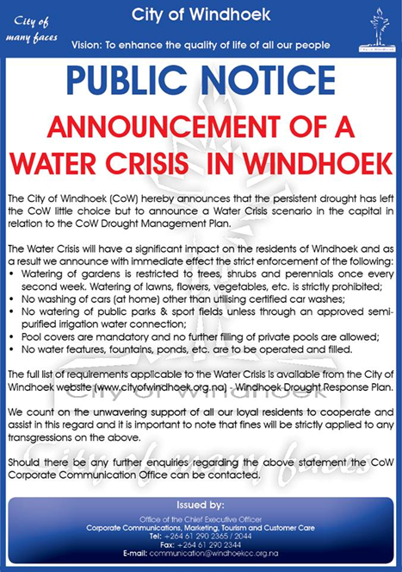
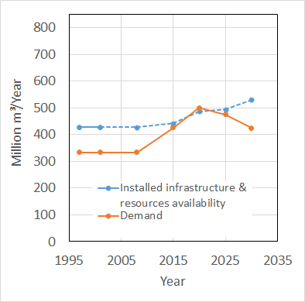
Water Accounts – Projected demand vs. resources
Starting in 2015, demand will exceed installed water capacity.
Notes:
Green shows how the actual demand should look like, especially with the current drought and water crisis the country is facing

Slide 5
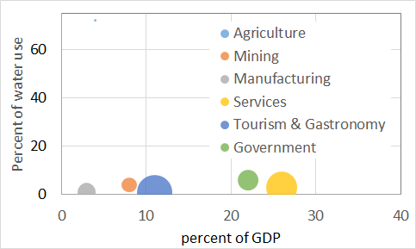
Water Accounts – Water productivity
Irrigation agriculture is the least economically productive use of water.

Slide 6
Challenges
Decentralisation approach failed due to limited capacity to establish and update NCAs and
NCAs were not mainstreamed into the work plans of natural resource based Ministries
Lack of institutional cooperation due to political agendas
Data acquisition challenges
Lack of awareness about the usefulness of environmental statistics
No specific demand for NCA by policy makers and resource managers
Basic statistics not produced on a regular basis
SEEA Training | 11-13-2017 | Nairobi, Kenya

Slide 7
Institutional arrangements
Signing of a Memorandum of Understanding between the Ministry of Environment and Namibia Statistics Agency
Established a Technical Working Group on Natural Capital Accounting to strengthen institutional cooperation
Integration of FDES and SEEA into NSA organisational structure
Notes:
General principles and the scope of cooperation of the MoU:
The production and dissemination of environmental statistics that is crucial to inform policy formulation and decision making
To account for natural resources in the national accounts
To collect and disseminate environmental statistics
To work towards implementing the Aichi targets of the Convention on Biological Diversity, to integrate the value of biodiversity into national accounting
Working Group aims to:
Share knowledge and experience in the field of environemtnal accounting
Update natural accounts and to ensure that the natural accounts are published together with the national accounts
To ensure the mainstreaming of Natural Capital Accounting into ther respective instititions annual workplans
Capacity development

Slide 8
Thank you for your attention!
Full Feasibility Study on NCA in Namibia: Fast Track Water Accounts Report is available here (https://resmob.org/reports/ )
Contact:
Email: info@resmob.org
Website: https://resmob.org/

