Slide 1
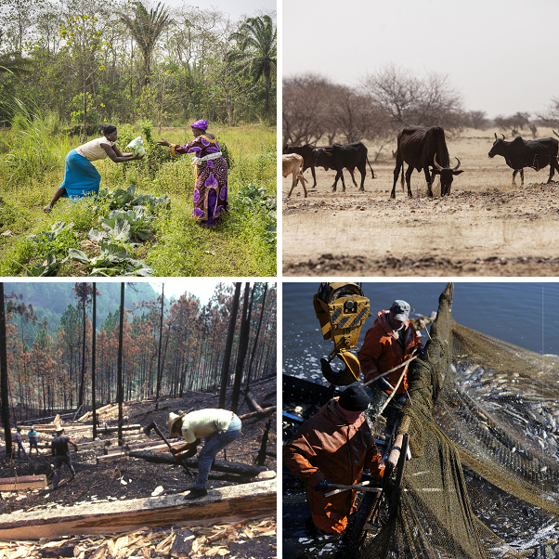


SEEA aFF Air emissions accounts mapping IPCC greenhouse gas emissions categories to ISIC A
Francesco N. Tubiello, Silvia Cerilli
Statistics Division
23rd Meeting London Group
San José, 17-20 October 2017

Slide 2
OUTLINE
From SEEA CF to SEEA AFF Air Emissions Accounts
Challenges and Opportunities of mapping land-based activities/GHG emissions between SEEA and IPCC/UNFCCC
SEEA AFF Air Emissions Accounts application: Central America countries

Slide 3
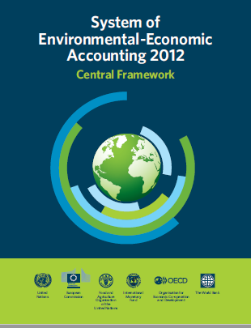
From SEEA CF to SEEA AFF: Air Emissions Accounts
SEEA AFF Air Emissions Accounts extend those in SEEA CF
SEEA AFF Air Emissions Accounts include additional categories of land-based emissions/removals of GHG which are relevant to SEEA because directly associated with economic activities in Agriculture, Forestry and Fisheries

Slide 4
From SEEA CF to SEEA AFF: Air Emissions Accounts
SEEA AFF Air Emission Account is mapped onto the ISIC Section A, divisions
A01 Crops and Livestock
A02 Forestry
A03 Fishing
SEEA AFF Air Emission Account can be mapped onto the Agriculture and Land Use, Land Use Change and Forestry reporting tables of the UN Framework Convention on Climate Change (UNFCCC) which follows the Guidelines of the Intergovernmental Panel on Climate Change (IPCC) for National GHG Inventories

Slide 5
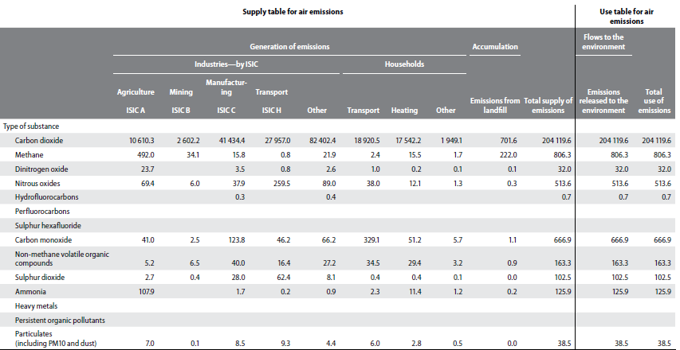
Air Emissions from SEEA CF to SEEA AFF
Air emissions accounts in SEEA CF

Slide 6
Air Emissions from SEEA CF to SEEA AFF
SEEA AFF Air Emissions Account

Slide 7
Challenges and Opportunities:
SEEA and IPCC/UNFCCC Reporting
The scope of both the SEEA and UNFCCC/IPCC is reporting of anthropogenic GHG emissions (emissions dependent on human activity): emissions from natural processes are not in scope

Slide 8
Challenges and Opportunities:
SEEA and IPCC/UNFCCC Reporting
UNFCCC is an established process linked to International Climate Policy since 1992, with internationally approved technical guidelines for reporting (IPCC) since 1996
Most countries have built-in legislation establishing UNFCCC focal points, institutional arrangements towards national GHG Inventories, including for Agriculture and LULUCF
Dozens of Countries (Annex I) report regularly at annual intervals, since 1992, with historical time series 1990-present
Most developing countries report inventories, at increasingly frequent intervals—with the ability to report at different Tiers

Slide 9
Challenges and Opportunities:
SEEA and IPCC/UNFCCC Reporting
Differences in system boundaries:
  SEEA follows the residence principle
  UNFCCC/IPCC follows the territorial principle
Differences in underlying statistical classifications
  The SEEA reports by economic activity (ISIC).
  UNFCCC/IPCC reports with a focus on biophysical processes

Slide 10
Challenges and Opportunities:
SEEA and IPCC/UNFCCC Reporting
IPCC distinguishes between the Agriculture sector and the Land Use, Land Use Change and Forestry (LULUCF)
In IPCC/UNFCC reporting system different GHG gases generated by the same economic activity may be reported separately under Agriculture (where only non- CO₂ gases are reported) and LULUCF (where mostly CO₂ gas is reported)
IPCC/UNFCCC allows reporting of removals under LULUCF

Slide 11
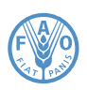
Challenges and Opportunities:
SEEA and IPCC/UNFCCC Reporting
DOMAIN | CATEGORY |  | GAS reported | Data source
Agriculture | Enteric Fermentation |  | CH₄ | FAOSTAT
 | Manure Management |  | CH₄, N₂O | FAOSTAT
 | Rice Cultivation |  | CH₄ | FAOSTAT
 | Agricultural soils | Synthetic Fertilizers | N₂O | FAOSTAT
 |  | Manure applied to soils | N₂O | FAOSTAT
 |  | Manure left on pasture | N₂O | FAOSTAT
 |  | Crop residues | N₂O | FAOSTAT
 |  | Cultivated organic soils | N₂O | HWSD, GLC2000
 | Burning - Savanna |  | CH₄, N₂O | GFED4, JRC, FRA-GEZ
 | Burning – Crop residues |  | CH₄, N₂O | FAOSTAT
DOMAIN | CATEGORY | GAS reported | Data source
LULUCF | Forest land | CO₂ | FRA
 | Cropland | CO₂ | HWSD, GLC2000
 | Grassland | CO₂ | HWSD, GLC2000
 | Burning Biomass | CH₄, N₂O, CO₂ | GFED4, HWSD
 | Wetlands | CO₂
 | Settlements | CO₂
 | Other land | CO₂

Slide 12

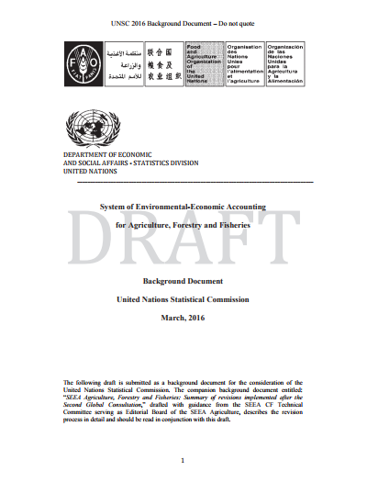
SEEA AFF Air Emissions Accounts

Slide 13
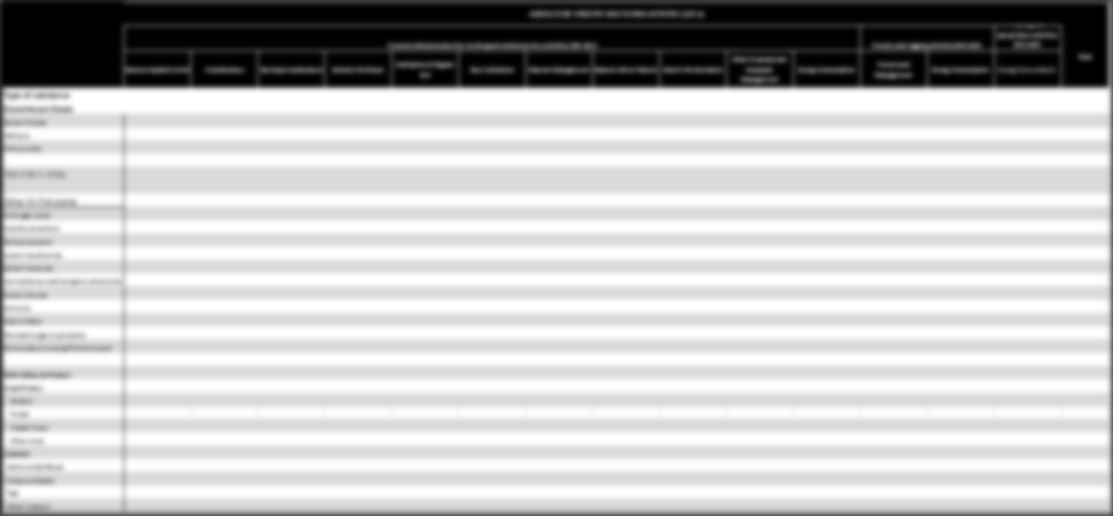
SEEA AFF Air Emissions Account and ISIC

Slide 14
SEEA AFF Air Emissions Account - Rows

Slide 15
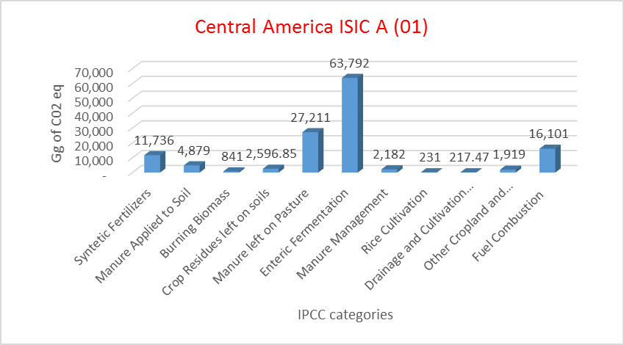
SEEA AFF Air Emissions Accounts application: Central America countries
Source: FAOSTAT, http://www.fao.org/faostat/en/#data/GT

Slide 16
SEEA AFF Air Emissions Accounts application: Central America countries
Forest: Changes occurred on Forest Land in the reported year
Net Forest Conversion: Changes from forest to other land use
Data are computed at Tier 1, following IPCC 2006 Vol. 4, Ch. 2 and 4
Source: FAOSTAT, http://www.fao.org/faostat/en/#data/GF

Slide 17
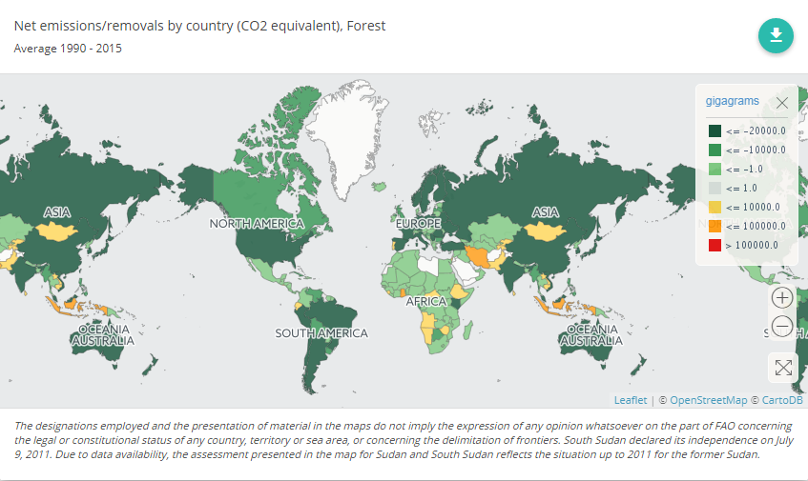
SEEA AFF Air Emissions Accounts application: Central America countries

Slide 18
Conclusions
SEEA AFF provides an expanded Table for Air Emissions Accounts, providing necessary additional details to reporting from activities within ISIC A01-03, with possibility to report by gas and product
In doing so, it provides a (hopefully useful) mapping between IPCC/UNFCCC categories unto SEEA categories
SEEA AFF allows in principle to also report carbon removals from land management and land use change—possible linkages to EEA

Slide 19
QUESTION
How to link the SEEA AFF Air emissions accounts to the SEEA EEA carbon accounting?

Slide 20
Thank You
Contacts:
Silvia.Cerilli@fao.org
francesco.fubiello@fao.org
http://www.fao.org/economic/ess/agri-environment/en/

