Slide 1

Accounting for Ecosystem and Biodiversity Related Themes in Uganda
23rd London Group meeting, costa Rica, 17th – 20th October, 2017
Steven king (steven.king@unep-wcmc.org)
Institute for the Development
of Environmental-Economic
Accounting
Notes:
Good afternoon – my name is Steven King and I work with the UN Environment World Conservation Monitoring Centre
So my presentation will provide a quick overview of a project between NPA (Uganda), NEMA (Uganda), WCS, UNEP-WCMC and the IDDEA group on compiling experimental ecosystems accounts in Uganda.
Essentially the project focused on how Ecosystem Extent and Land Accounts could be extended to inform on biodiversity themes, we term these extensions ‘Species Accounts’
So Many thanks for opportunity to present some of this work – hope you enjoy

Slide 2

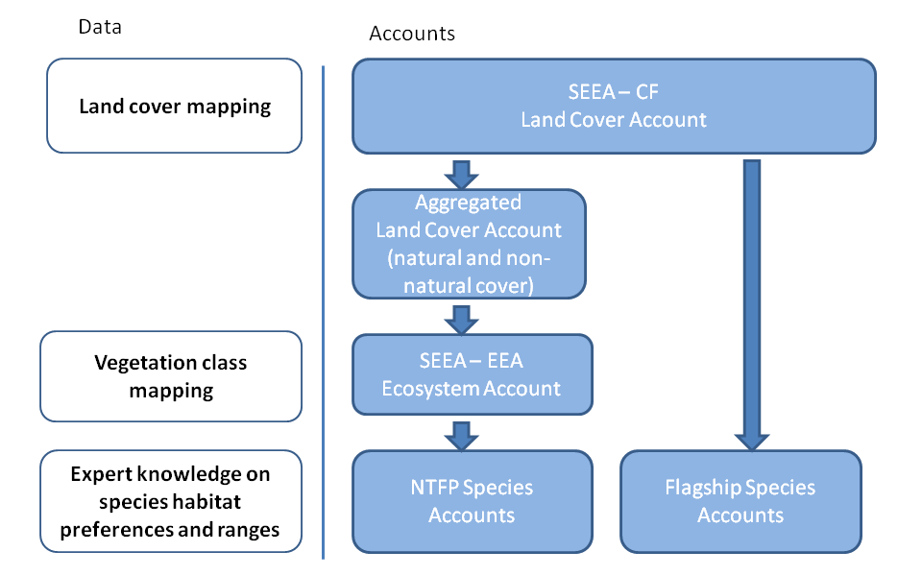
Data sources and accounting outputs
Policy entry points
  NBSAP (II) – Achieve Aichi Targets
  NDP (II) – Implements SDGs
Notes:
So the accounts were designed to inform on certain policy objectives – NBSAP to implement Aichi Targets and NDP for SDGs
The diagram on the right shows the different accounts compiled and the various data integrated to inform their construction
We compiled land accounts for different periods using remotely sensed land cover data.
We aggregated this to provide accounts of natural land cover
We intersected this with spatial data on vegetation distribution to understand the implications of land cover change on natural ecosystems.
Expert knowledge was then used to link the implications of observed land cover change to extent of suitable habitat for selected Noon-Timber Forest produce and Flagship Species – these are our species accoutns.

Slide 3
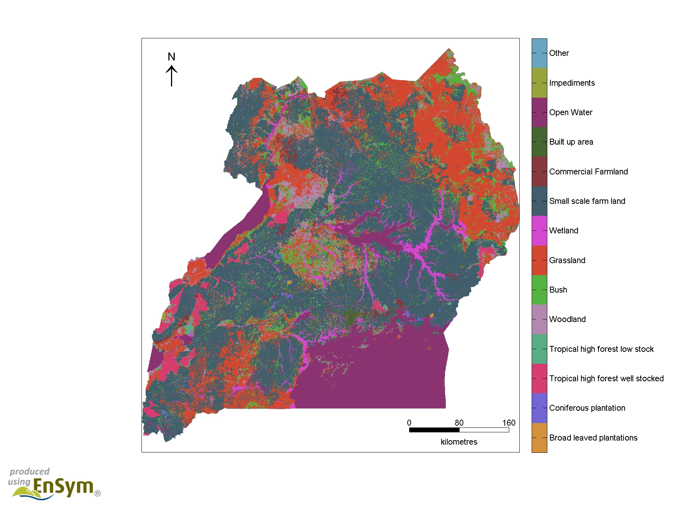
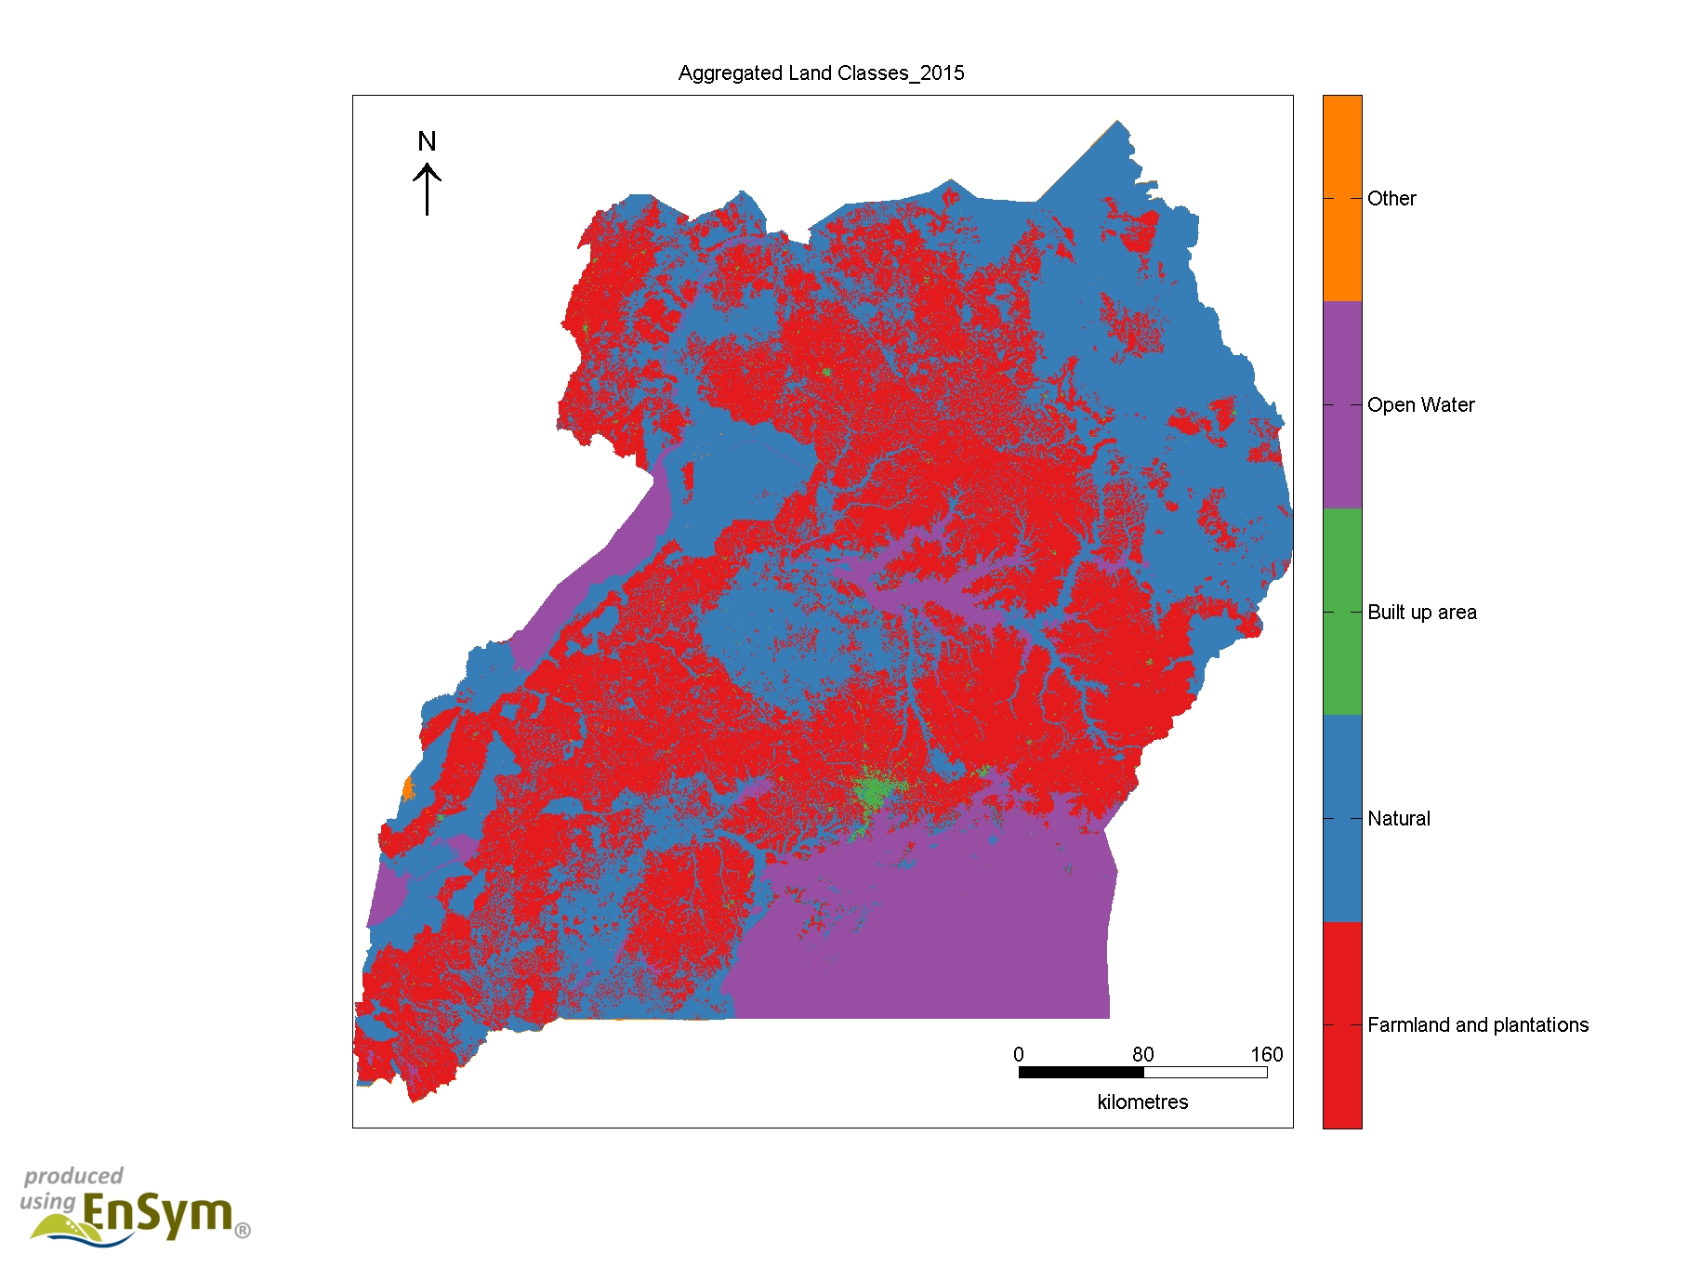
Land cover
Digital maps of land cover produced for 1990, 2005, 2010 and 2015 (FAO LCCS V3)
Extent of NBS Land Cover Classes
Natural Land Cover / Use in Blue
(aggregated NBS Classes)
Notes:
For Uganda maps of land cover are available for 1990, 2005, 2010 and 2015
Here we see this information mapped out. The left map shows the distribution of the land cover classes routinely mapped for Uganda
And the right map shows all the land cover classes that represent natural land use

Slide 4
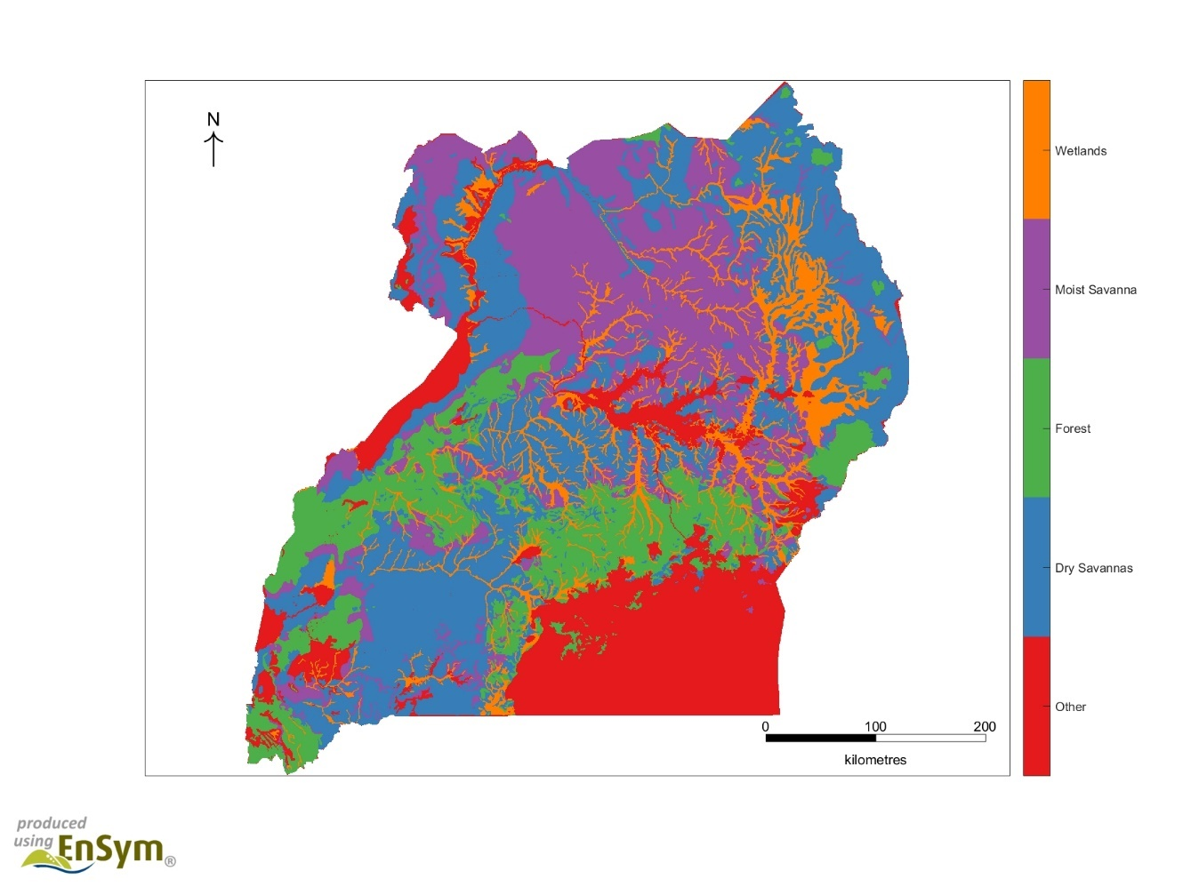
Vegetation (Ecosystem) data
Original extent of ecosystems in Uganda (Biome scale)
Based on Pomeroy et al. (2002) – http://pdf.usaid.gov/pdf_docs/pnacy477.pdf
Driver et al. (2015) - http://www.statssa.gov.za/wp-content/uploads/2016/08/Land-and-Ecosystem-Accounting-in-KZN-Discussion-Document-FINAL.pdf
Notes:
In order to characterise natural ecosystems we use a map of the of vegetation in Uganda under natural land conditions.
The map presents data on 4 Natural Biomes (wetland, Moist savannah, Forest, Dry savannah), which can also be are disaggregated to 22 main vegetation classes
We then create ecosystem extent accounts by calculating the extent of each ecosystem in areas of natural land cover for the different time periods we have land cover mapping for.
This approach is not new!

Slide 5
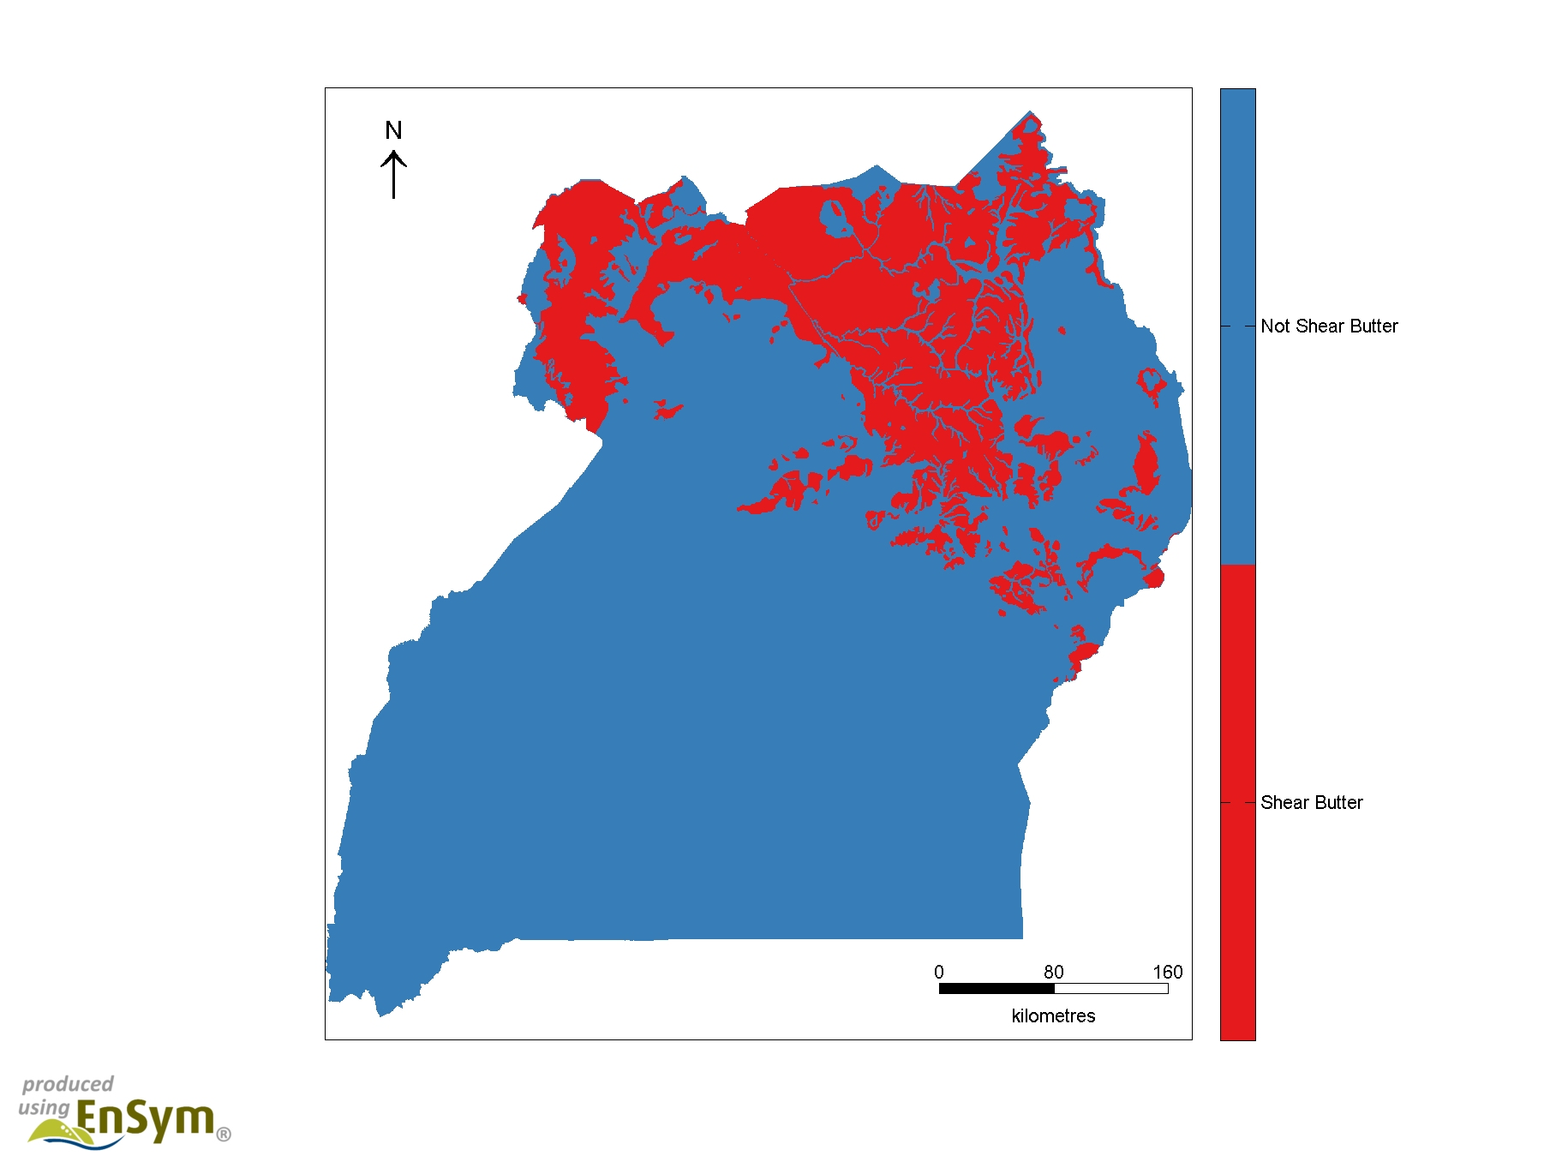
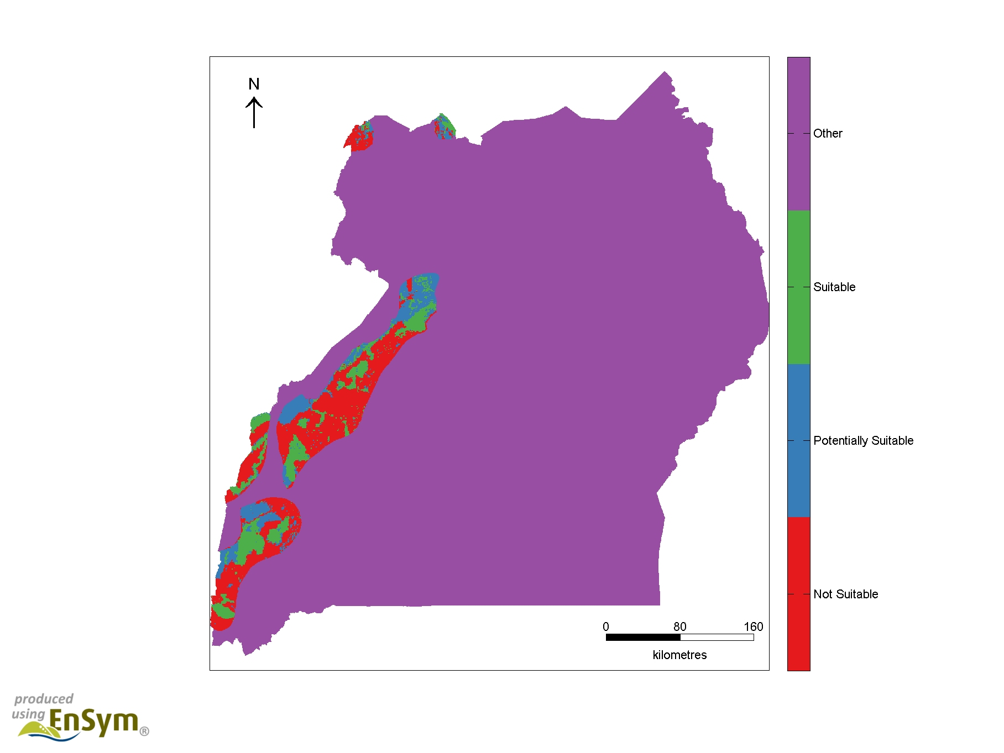
NTFP and flagship species data
Original extent of Shea tree suitable habitat
Extent of Chimpanzee suitable habitat in IUCN Range
Notes:
We then use expert knowledge to link the extent of natural ecosystems with important Non-Timber Forest Product species
Also we use IUCN species habitat preferences and range of occupancy to link the extent of suitable Land Cover types with flagship species
Using this approach we are able to generate time-series maps and accounts of the natural areas with the potential for Shea Butter harvesting (Red areas, left Map) and where suitable habitat for chimpanzees (flagship species) exist that could support wildlife watching tourism (Green Areas, Right Hand Map).
Also completed for Prunus Africana; Gum Arabic (NTFPs) and Elephants (Flagship)

Slide 6
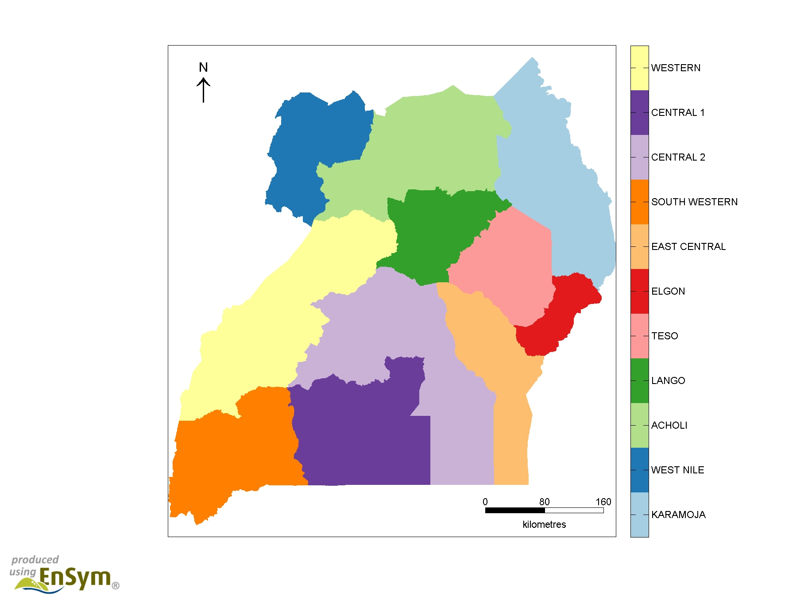
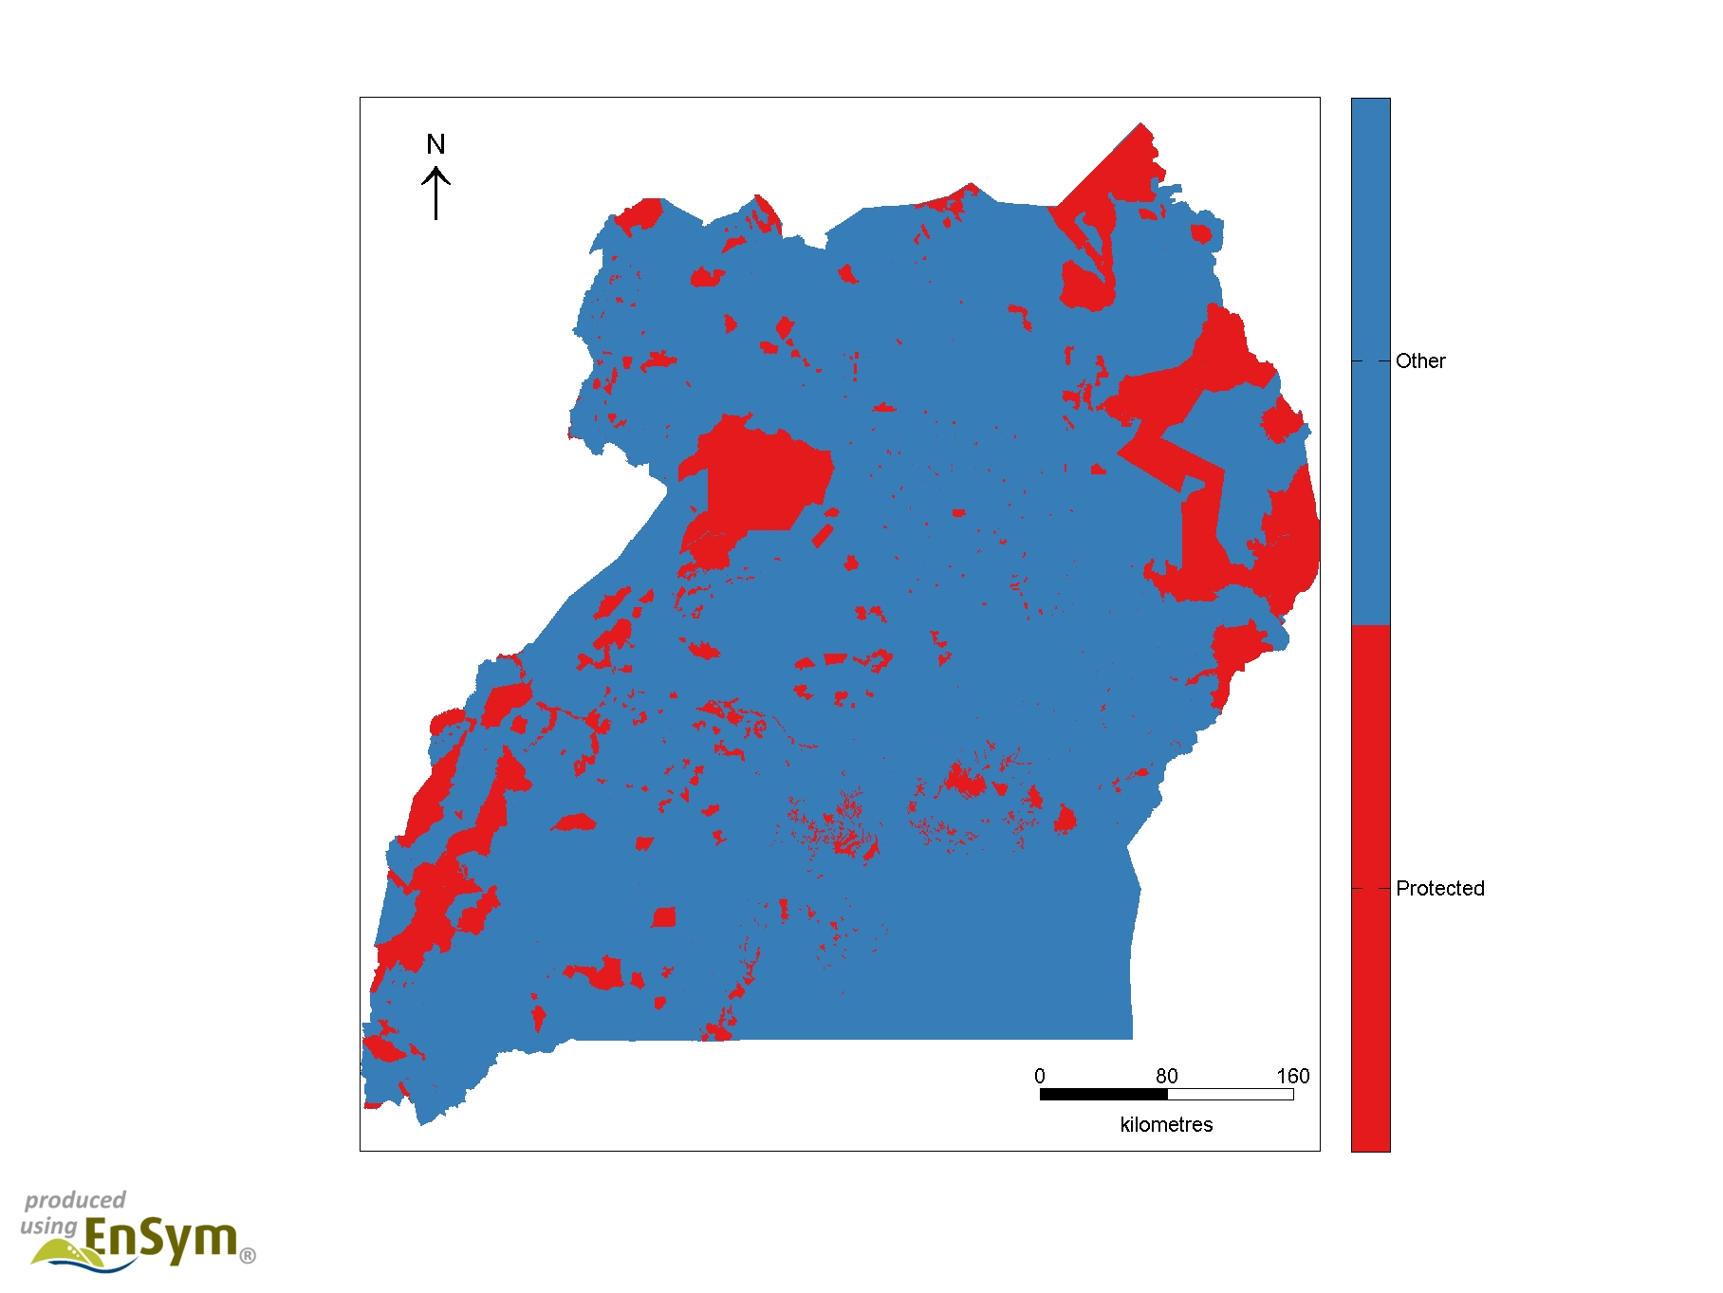
Ecosystem accounting areas
Sub-Regions for policy responses
Protected area estate
Notes:
For Uganda we compiled accounts at national, sub-regional and protected area estate scales.
So whilst there is no new data or approaches here, it is clear we are now weaving different stories together and starting to provide a more holisitic picture environment in ugands

Slide 7
National Ecosystem extent Account 2010-2015
Notes:
Here is an example of the ecosystem extent account for Uganda as a whole for the period 2010 to 2015– we see a reduction in the extent of all natural biomes over the period and a commensurate increase non –natural
This can be linked to specific land uses, such as small scale farming, plantations or urbanisation via information on Land Cover
So we can see how economic decisions on land use have impacted on natural ecosystems.

Slide 8
Shea Butter Nut tree account 1990-2015 by Sub-Region and Protected Area
Notes:
With respect to our two ecosystem services of interest……First we look at Shea nut provision. So these accounts present information buy Sub-Region, which is aggregated to the national scale in the final column.
This account represents the period from 1990 to 2015 and shows that the potential Shea nut provisioning services remain good (green oval) in Karamoja and that most of which is not in conflict with protected areas (other green oval). This suggests that Karamoja can support combined conservation-development opportunities via sustainable harvesting
However, land use change has substantially reduced the potential for Shea nut provision in Teso (red oval) – only 15% of the original existing area suitable for harvesting remain

Slide 9
Chimpanzee account 2005 – 2015 by Sub-Region and Protected Area
Notes:
Second – for iconic wildlife species and potential tourism opportunities,
This accounts shows the changes in the extent of suitable habitat for chimpanzees by sub-region between 2005 and 2015,
The account shows a small, positive, changes in the extent of fully suitable habitat for Chimpanzees in South Western (green Oval) with a majority of this habitat covered by the protected areas estate (bottom green oval).
This indicates that the Protected Areas estate is performing well and could support wildlife tourist watching opportunities.
However, significant losses in fully suitable habitat are observed in the Western sub region (Red Oval) and there is the potential to expand the protected area estate in this subregion to help secure wildlife watching opportunities in the long term.

Slide 10
Some policy insights
Aichi Target 12 (Conservation status of threatened species improved): Species accounts inform on range protection.
Aichi Target 11 (terrestrial and inland water ecosystems conserved through protected areas for socio-economic benefits): The accounts track progress towards protecting an ecologically representative areas of biodiversity importance.
SDG 1 (End poverty): Species accounts inform on tourism and NTFP possibilities.
SDG 15 (Life on Land): Track the extent of suitable habitat for species, natural ecosystems and their diversity and protection.
Also Aichi Targets 2, 3, 5, 13, 14, 15 and SDG 12.
Report: Experimental Ecosystem Accounting in Uganda: www.wcmc.io/0524

Slide 11
London Group questions
How can we link global land cover data to ecological studies to define ecosystem assets in other countries?
How do we integrate this type of data into classifying managed ecosystems?
Are ‘Species Accounts’ useful constructs for extending the policy applications of extent and land accounts? For example:
  Considering the habitat services of ecosystems
  Useful interim approach in the absence of ecosystem service accounts (e.g., NTFP provisioning)
Notes:
The approach we have employed in Uganda combined ecological based data with remotely sensed observations in land cover. There are clear benefits in using more than one source of data to define ecosystem assets in terms of the analytical power this can provide – what are the other global or local datasets that can support this?
Also how do we integrate this? Agricultural land in areas of former forest will be different to that in former wetlands. Should we account for this?
Species Accounts provide a means of making the better use of the spatial infrastructure the extent accounts provide – we think this is important to retain support for the accounting process. Is this over stretching the use of the extent accounts? For example using them to evaluate habitat and provisioning services?

Slide 12
Thank you

Slide 13
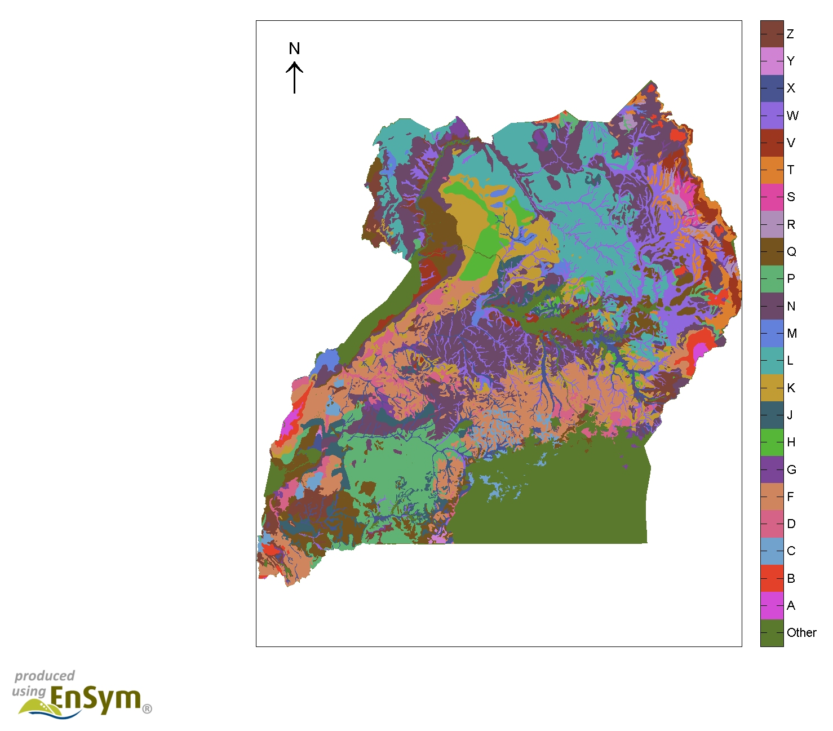
Vegetation (Ecosystem) data
Original extent of ecosystems in Uganda (Ecosystem scale)
Notes:
The map presents data on 22 main vegetation classes

Slide 14
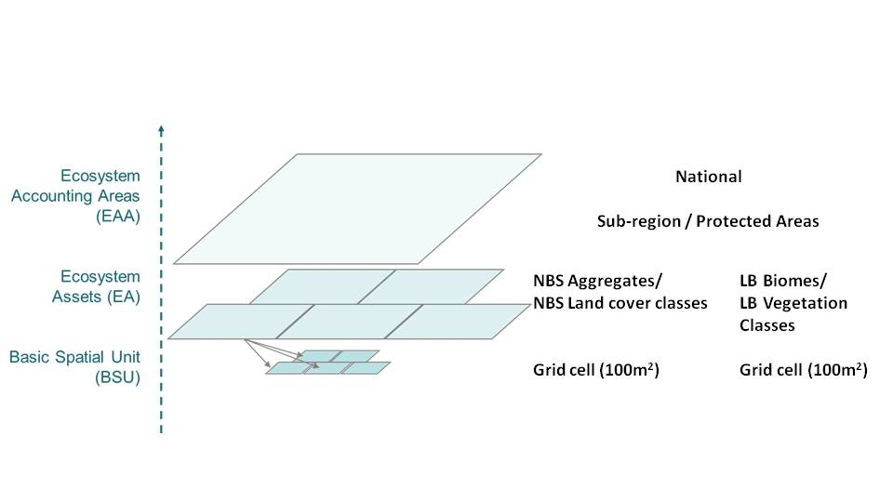
spatial data infrastructure
Environmental Systems Modelling Platform (EnSym)
  Designed to work with grid data and analysis
  Standardised routines for checking missing data and ensuring country extent is maintained to accounts to balance
Notes:
A basic spatial unit (BSU) is created to provide a consistent spatial layer for integration of our different datasets. The approach adopted to generate BSUs for the Ugandan accounts is to create a master grid of 100m grid cells (each representing a BSU) that covers the entire country.
With this spatial infrastructure in place, it is then possible to aggregate data attributed to the BSUs to generate accounts for various accounting areas.
Thus, ecosystem accounts can be developed for each individual Ecosystem Asset, such as a contiguous area of grassland or grass savanna or larger aggregations are defined as Ecosystem Accounting Areas (EAA)

