Slide 1
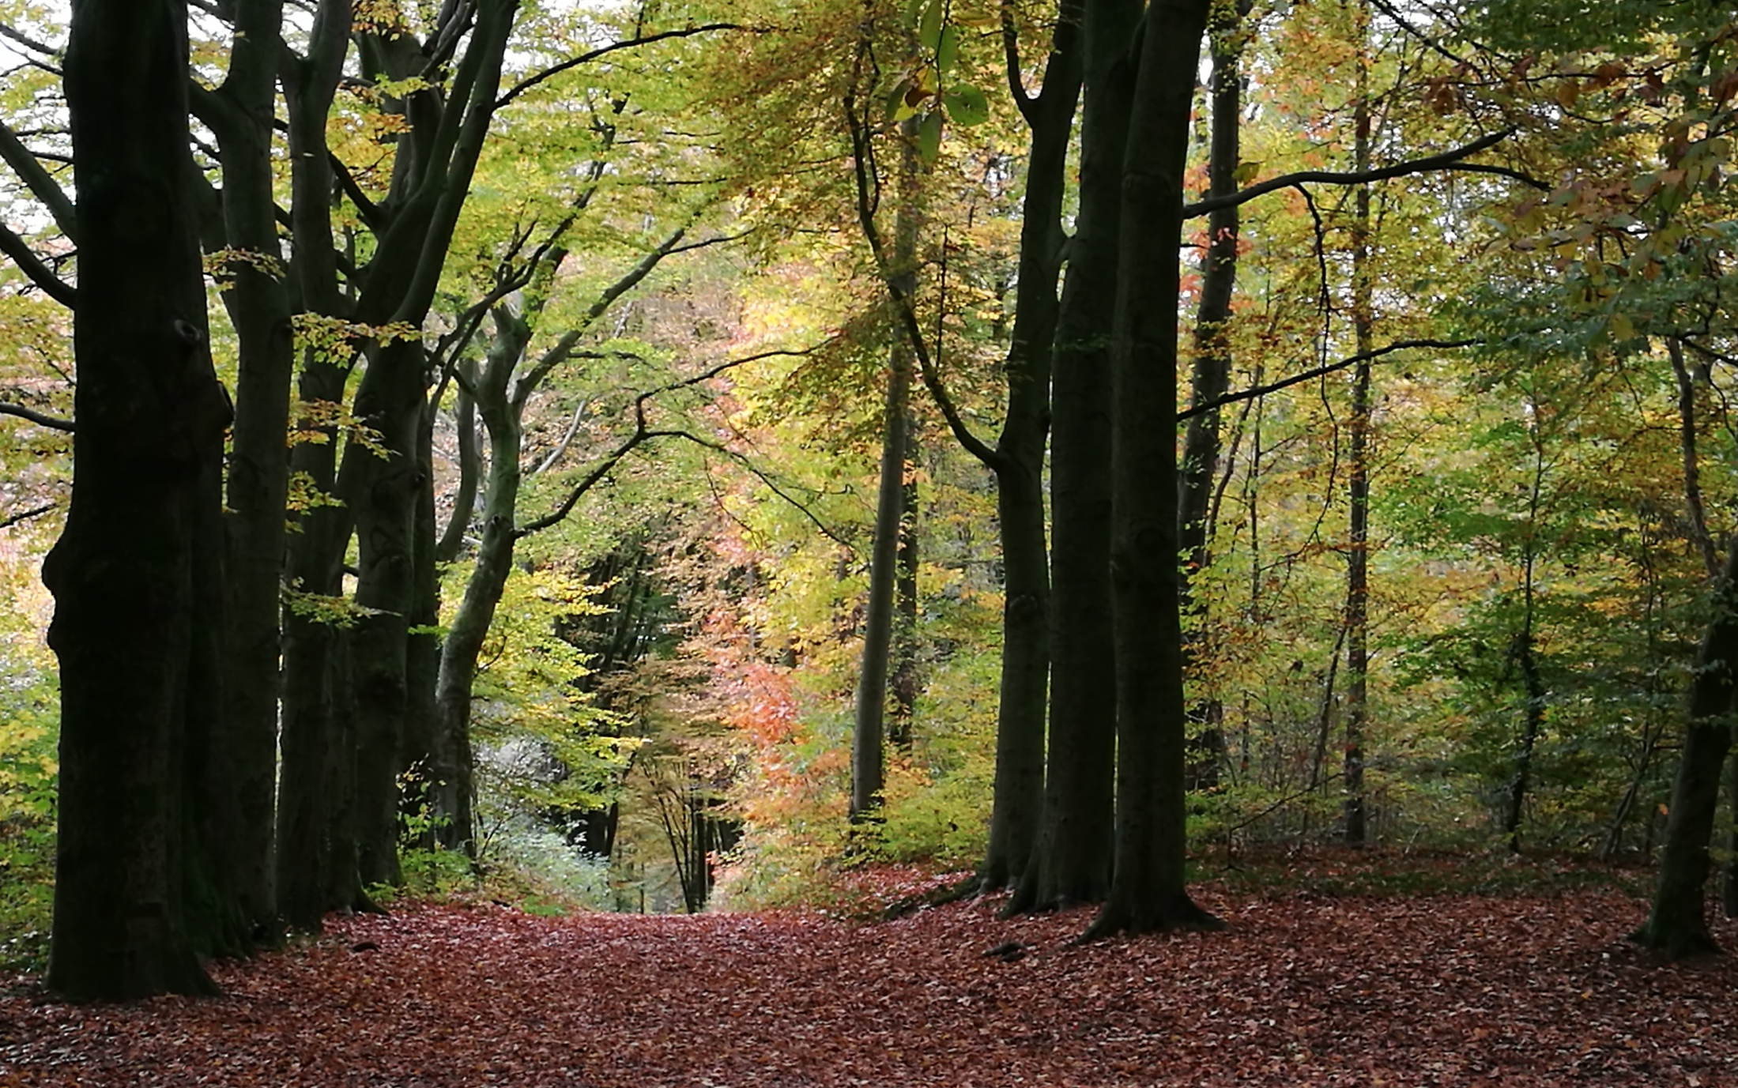



The SEEA EEA Carbon Account for the Netherlands
Sjoerd schenau
Marjolein Lof
Rixt de Jong
Roy Remme
Cor Graveland
Lars Hein

Slide 2
Content
Context project
Biocarbon
Geocarbon
Carbon in the economy
Carbon in the atmosphere
Overall carbon account
Important issues / questions for the LG

Slide 3
Context
Carbon account is a thematic account part of NCA project Netherlands
Aim: to compile a comprehensive carbon account for the Netherlands for one year (2013).
For biocarbon spatially explicit data
Carbon in the economy: new!

Slide 4
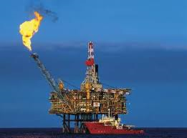
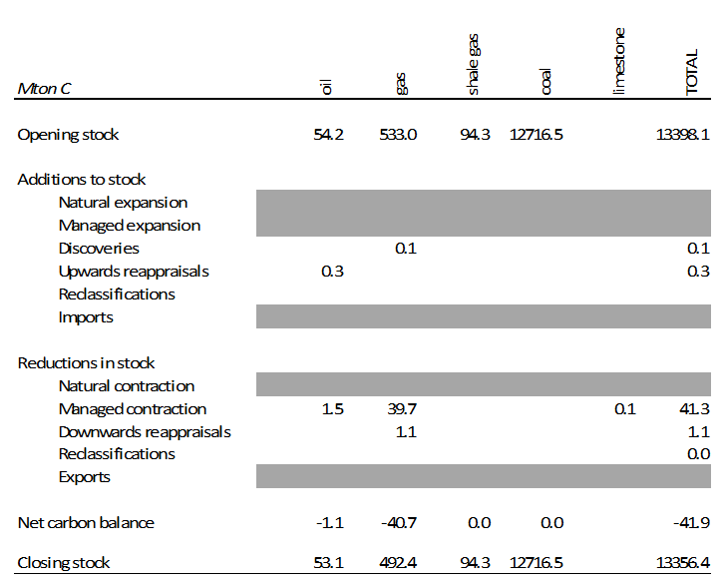
Geocarbon
Geocarbon includes all carbon stored in the lithosphere
only the subsoil energy resources i.e. oil, gas, coal resources, which could potentially be extracted, will be included in the carbon account.
Following the guidelines of the SEEA CF not only the commercially recoverable energy resource will be taken into account, but all known deposits.

Slide 5

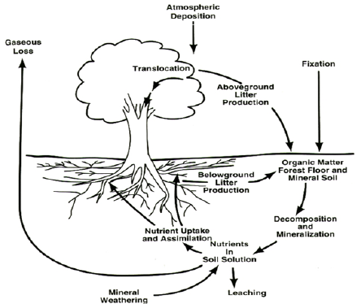
Biocarbon
Sequestration by biomass
Emissions organic soils
Above ground stock
Below ground stock
Carbon stocks: above and below ground
Carbon flows: timber harvest, carbon sequestration
and carbon emissions

Slide 6
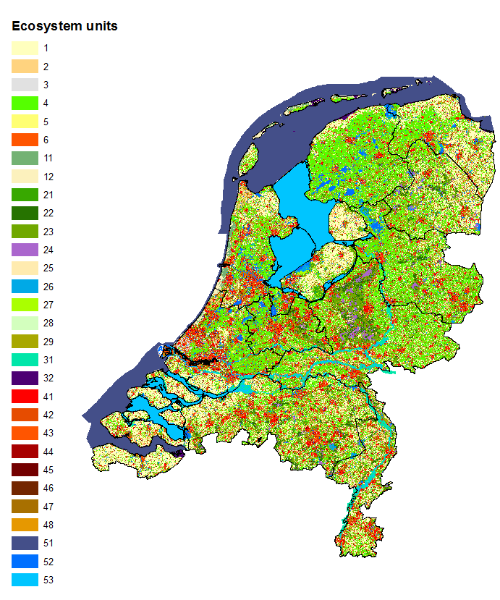
Data sources and methods
 | EU | Vastlegging (tonC/ha/jr) | Voorraad (tonC/ha)
Eenjarig gewas | 1 | 0 | 0
Meerjarig gewas | 2 | 0.38 | 12
Kassen | 4 | 0 | 0
Weiland | 5 | 0.18 | 2
Faunarand | 6 | 0.17 | 2
 | :
Loofbos | 21 | 1.89 | 62
Naaldbos | 22 | 1.89 | 62
Gemengd bos | 23 | 1.89 | 62
Heide | 24 | 0.19 | 8
 | :
Uiterwaarden | 31 | 0.2 | 2
Kwelders | 32 | 4 | 12
 | :
Combining EU_NL kaart met look-up tables
Soil map of the Netherlands
Map of carbon stock in upper 30 cm Dutch soil

Slide 7
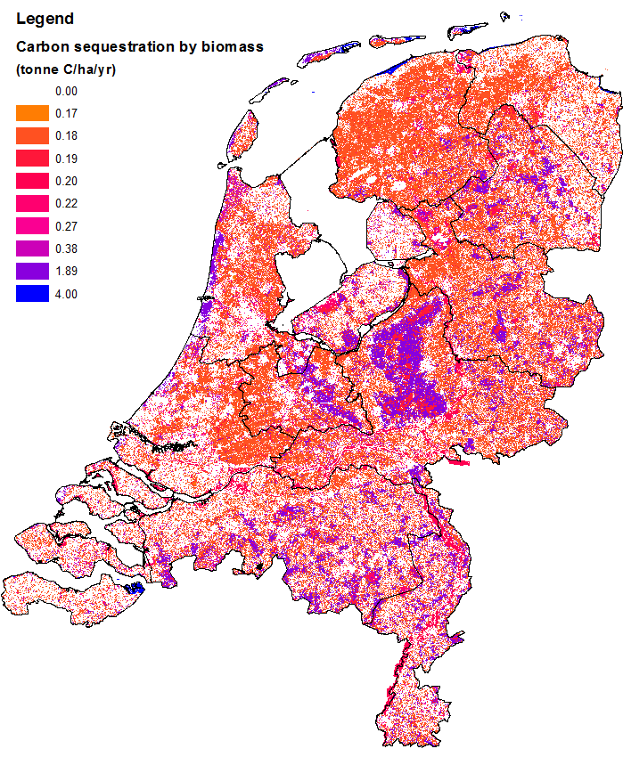
Carbon sequestration
Forests have the largest contribution in C sequestration: 0.59 Mton C jr⁻¹
Total C sequestration: 0.98 Mton C jr⁻¹
Sequestration by biomass
Emissions organic soils
Above ground stock
Below ground stock

Slide 8
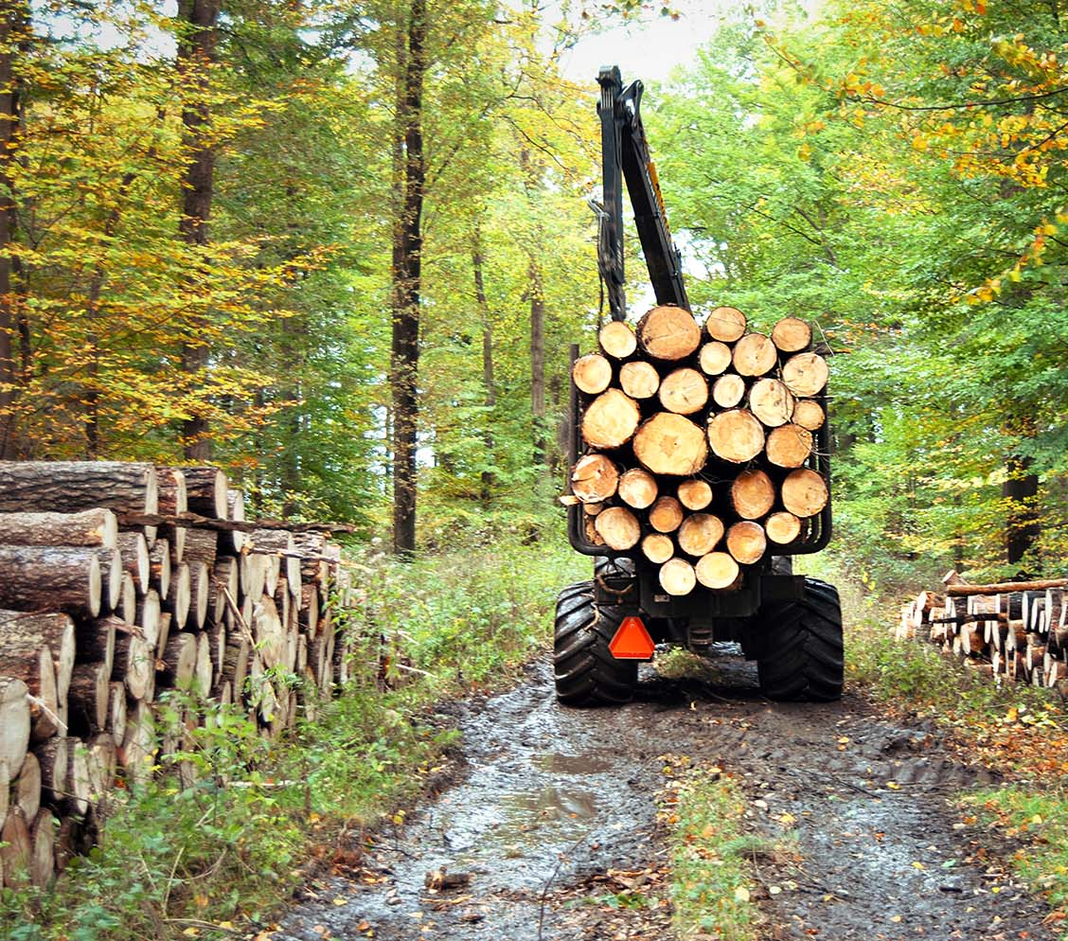
Timber harvest
Average harvest: 3.4 m³ yr⁻¹
Total harvest: 1.1 10⁶ m³ yr⁻¹

Slide 9
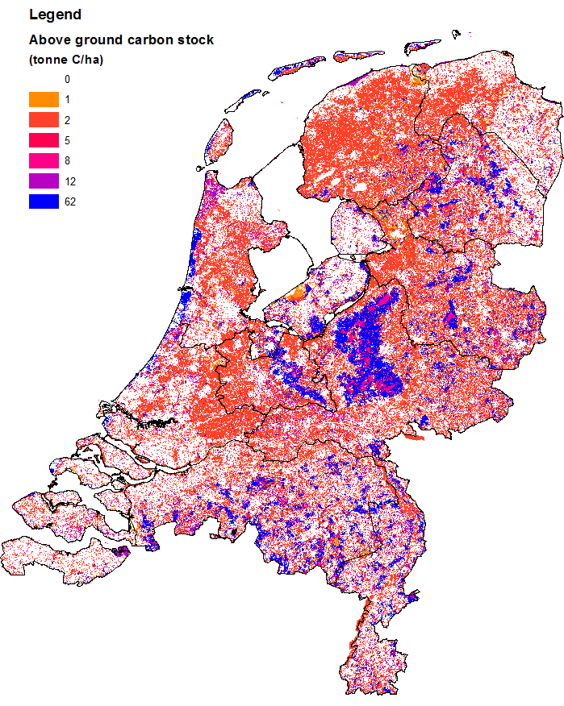
Carbon stock – above ground
Forests have largest carbon stock
Total stock: 25 Mton C
Sequestration by biomass
Emissions organic soils
Above ground stock
Below ground stock

Slide 10
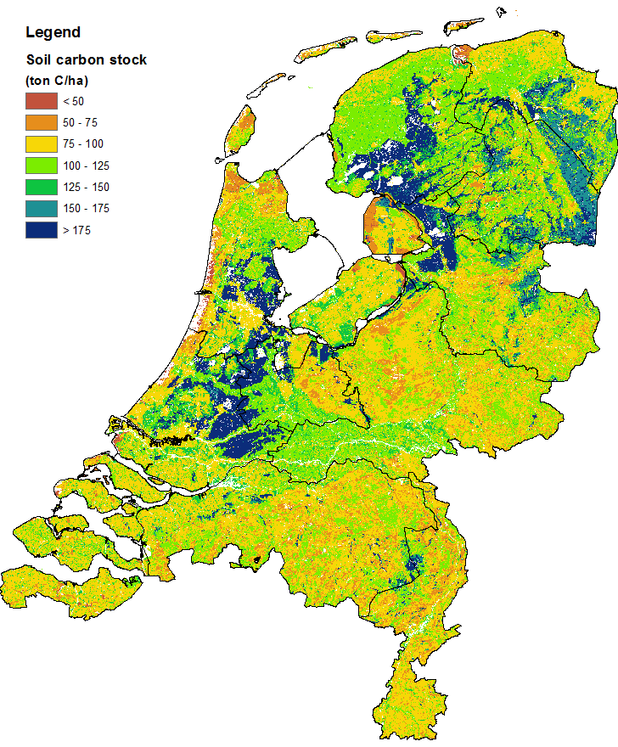
Carbon stock in soil (30 cm)
Peat soils have largest carbon stock
Total stock in soil: 357 Mton C
Sequestration by biomass
Emissions organic soils
Above ground stock
Below ground stock

Slide 11
Emissions from peat and organic soils
Net emission: 0.40 Mton C jr⁻¹
Sequestration by biomass
Emissions organic soils
Above ground stock
Below ground stock

Slide 12
Biocarbon account
Carbon stock above
ground and in soil
Carbon sequestration
Emissions from peat
Timber harvest

Slide 13
Carbon in the economy
Carbon in the economy reflects a wide range of materials that are either in stock or that flow through the economy.
Some flows of carbon related to products (including imports and exports) are relatively well known and were derived from the SEEA CF accounts
The stocks of carbon in the economy are often not well known, as well the flow of carbon associated with fixed capital formation
The account for carbon in the economy also includes data on recycled products, which is valuable information with regard to the circular economy
Notes:
physical supply and use tables, the economy wide Material Flow Accounts, and the energy, water and air emissions accounts.
: carbon in e.g. building materials and in waste dumps, bitumen in roads, etc.

Slide 14
Carbon in the economy

Slide 15
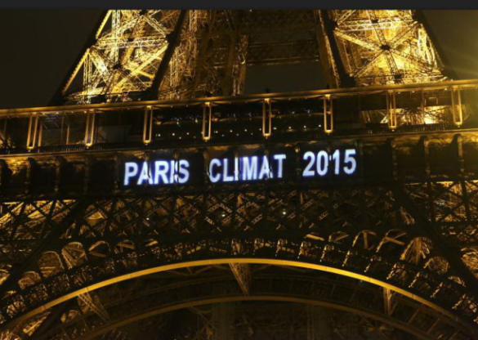
Carbon in the atmosphere
Very relevant in view of climate change!
Additions to stock: emissions from
economic activities
….but also emissions from respiration (humans and livestock) + emissions from soils (biocarbon)
Reduction in stock: carbon sequestration (cultivated plants + biocarbon)
National carbon stock ?????
  We took cumulative C emissions
  since 1900

Slide 16
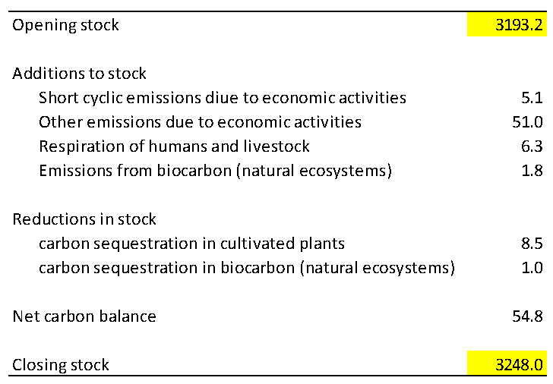
Carbon account for the atmosphere (2013) in Mton C

Slide 17
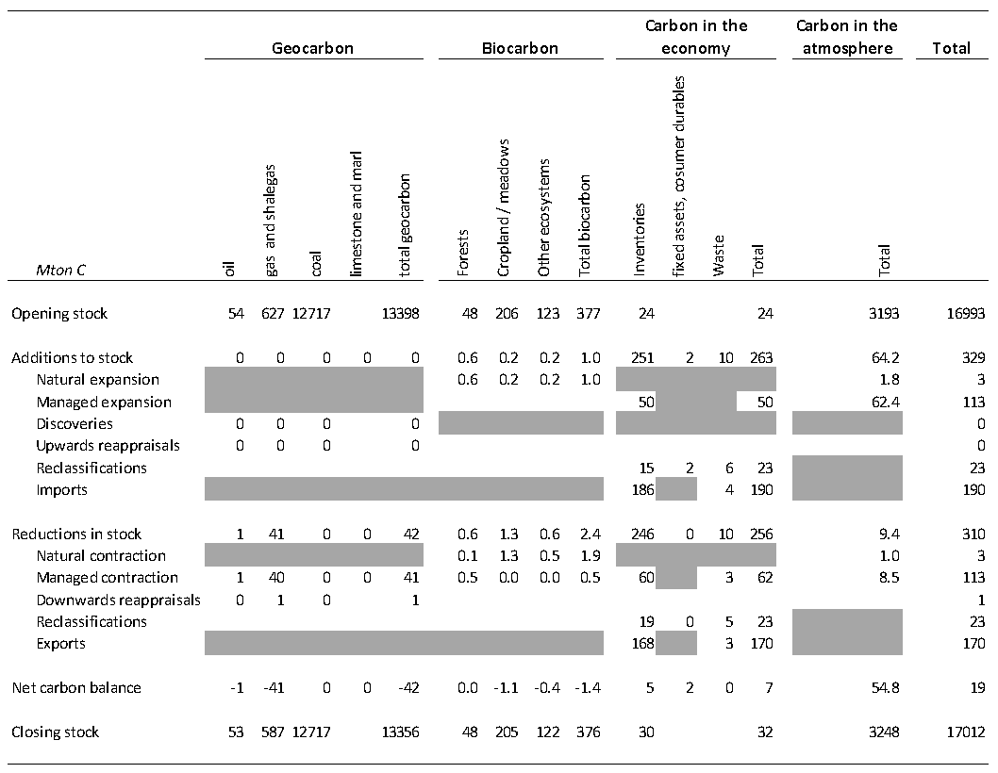
Overall carbon account

Slide 18

Policy relevance
Measuring progress towards international climate mitigation obligations
Supporting specific policy actions in the field of climate change mitigation.
The ecosystem part of the carbon account (i.e. biocarbon) is spatially explicit. Maps depict where carbon emissions take place and which areas are most important for carbon sequestration. This facilitates climate action by provincial and local stakeholders.
Measuring progress towards a circular economy regarding carbon
Notes:
Because of its extended scope, the carbon account is an ideal format to be used for the more detailed requirements on carbon emissions reporting

Slide 19
Issues
Should all carbon flows be recorded in the carbon account (or only the ‘relevant ones’)?
Is the structure of carbon in the economy adequate ?
Data gaps: how to find data for carbon in (economic) stocks ? Is this policy relevant ?
Carbon in the seas/oceans ?
What could be additional policy applications for the carbon account ?

