Slide 1

Energy Accounts for Kenya
C. Magu

Slide 2
Introduction
Kenya’s Vision 2030 has recognized Energy as a key enabler that form the foundation for socio-political and economic growth.
Further, the current energy policy directives under the government are centered improving access to clean and affordable energy (goal 6) and reducing overall cost of energy in order to encourage growth of industries and foreign investment growth.
Some of the projects under this flagship include;
The last mile project
Lower electricity tariffs among others
The PSUT’s and Energy balances will play a critical role in monitoring the implementation and effectiveness of these policies

Slide 3
Introduction
Further, the energy balances for the country are likely to have a sizeable positive shakeup once production of the discovered crude oil and gas discoveries start.
The current crude oil recoverable reserves stand at 750 Million barrels

Slide 4
Our Goal
(formulated in 25 May 2017 Workshop organized by UNSD)
By June 2018, KNBS has published a pilot Energy Account for Kenya (for 2016), using the existing resources of KNBS and its partners, which quantifies the energy economy of Kenya at a sufficient level of disaggregation, which is useful to users, and which can be updated annually (April publication date, for the previous year (start with 1 year lag)).

Slide 5
The Roadmap to the Goal - Discussion
Publication
Verification and recommendations
Compilation of Accounts – iterative process
Conduct data mining / With partners
Design the structure of the account
Consider the applications / uses of the account
Build a partnership between data providers / KNBS / users

Slide 6
Designing the architecture and structure of the account
Architecture:
Start with an energy balance
Transfer into energy PSUTs
Structure:
Full representation and understanding of the energy economy / value chain and the flow of energy
Accurate and disaggregated classification of Energy sources; Energy products and Energy Users

Slide 7
Initial development tasks
Identification of all transactions, in native units (GWh, barrels, tons), and agree on conversion factors to common units (TJ or OE)
Identify source data and their custodians
Describe meta-data: type, collection method, contact person, units, frequency, date of availability
Proceed with data-mining

Slide 8
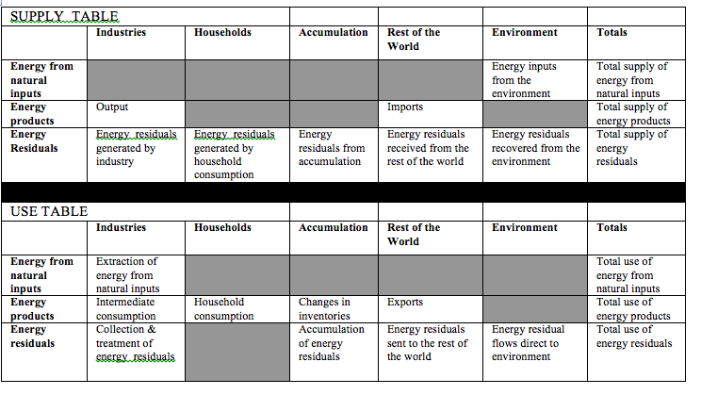
Energy accounts architecture
Energy balance for recording of flows of energy
and
Supply and use tables for recording of flows of energy
Energy balance
Supply of energy
Use of energy
Both types of accounts can be transferred to monetary units – and expanded to include asset accounts

Slide 9
Data Sources:
Electricity data: Kenya Power and Lighting Company Ltd (KPLC)
Kenya Electricity Generating Company Ltd (KENGEN)
Petroleum and Petroleum Products Ltd: Ministry of Energy and Petroleum (MoE&P)
Energy Regulatory Commission (ERC)
Kenya Revenue Authority (KRA)
Kenya Ports Authority (KPA)
Kenya Pipeline Company Ltd (KPC)
Kenya Railways Corporation (Soon)
Informal Energy: Kenya Integrated Household Budget Survey (KIHBS 2015/16) (not yet published)
Supply and Use Tables (SUT, 2009)

Slide 10
Data Harmonization and Validation:
In line with KNBS role of coordinating, monitoring and supervising the National Statistical System (NSS) and under the National Strategy for the Development of Statistics;
Data validation of Energy Statistics is currently been done as a sub-sector in the National Trade and Trade Facilitation Statistics workshop normally held on a quarterly basis
All our data providers (institutions) are members of this committee. The committee meets to compare data across institutions and explain data variability based on time of capture, units of measurements used, variances in temperature which affect the volumes of petroleum products etc.
However, plans are underway to have a stand alone Energy committee to specifically discuss energy data in line with improving the Energy balance and Accounts.
Most of these providers have already been sensitized on Energy accounts as part of SEEA accounts and are already looking forward to the final products.

Slide 11

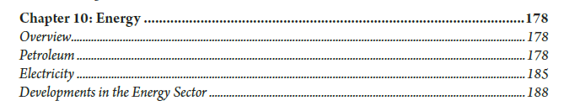

Slide 12
Energy Sector:
Kenya’s Energy Sector is divided into 3 broad groups:
Electricity
Petroleum and Petroleum Products
Informal Energy

Slide 13
Electricity Generation:
As at 2016, 85.25 percent of Kenya’s Electricity generation was drawn from renewable sources; namely Geo-thermal (44.97%), Hydro 39.71%), Thermal (14.75%) and Wind (0.57%)
This is displayed below:

Slide 14
Electricity Demand by Type of Consumer:
In 2016, Over half (51.5%) of Kenyan customers were drawn from the large and Medium (Commercial and Industrial) customers. The Domestic and Small Commercial sector :

Slide 15
Refined Petroleum and Petroleum Products:
The following is domestic consumption for petroleum products by sector:

Slide 16
Refined Petroleum and Petroleum Products:
The following is domestic demand for petroleum products by type of product:

Slide 17
Informal Energy:
This includes but not limited to charcoal, firewood etc. This is estimated takes up a sizeable share of consumed energy, yet it is unregulated and unsustainable.
Estimates will be obtained once the Kenya Integrated Household Budget Survey (KIHBS) 2015/16 has been published.
.

Slide 18
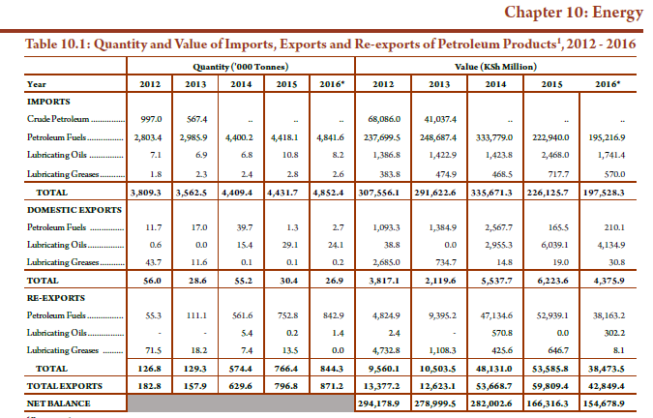

Slide 19
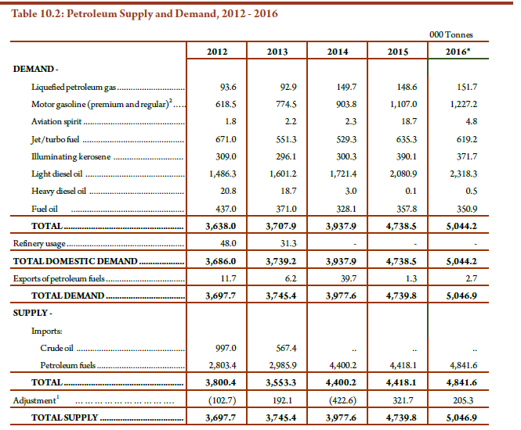

Slide 20
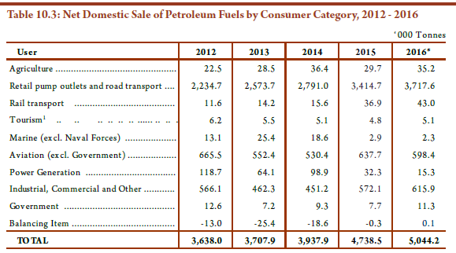

Slide 21
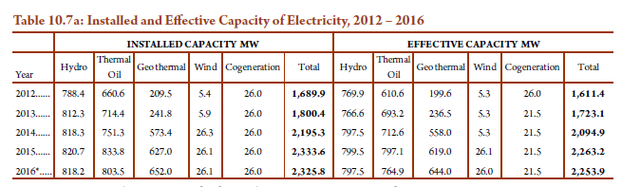
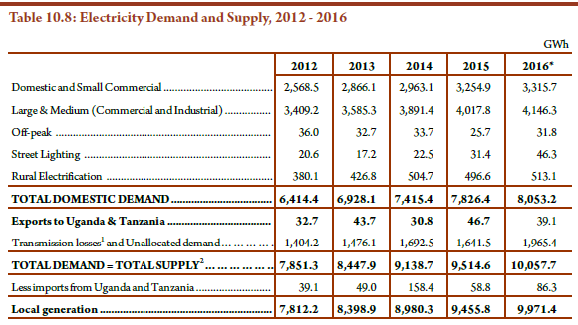

Slide 22
Key challenges faced
Interpretation of data from provider perspective to SUT format (Example; Sector data not necessarily by ISIC); therefore need to map the information to ISIC
Difficulties in convincing some data providers on the need to provide the data; Example; who will pay for the man hours lost while data mining
Different categorization of data; Example Electricity demand by type of consumer rather than by sector
Time and human capacity constraints
Data gaps

Slide 23
Key lessons learnt
Start with what you have then look at the gaps and consider potential data sources
Need to train data providers so as they understand the sudden large need for data and appreciate the outcomes
If sure of the data (Even if just 20 percent of it), publish a summary to create demand, then improve on the data based on demand for it.
Share the data to other statisticians internally (National accountants, former Energy experts etc) and encourage critiques on the data; it will help you to improve on the data

Slide 24
Way forward
Finalize on the Balance/PSUT and publish in the 2018 annual Economic Survey Publication, April 2018
Make the Energy balance/PSUT a continuous annual publication for chapter 10 (Energy)
Work on the MSUT and the Asset Accounts

Slide 25
Applications of Energy Accounts identified during consultations
Economic planning support
Measuring economic development (e.g. last mile project, affordable LPG gas project (still in the pipeline),
Analyzing demand
Reporting (e.g. SDGs)
Policy instrument development (e.g. pricing)
Attract investment

Slide 26
Asante sana

