Slide 1

How will the 2030 Agenda
be monitored?
Africa regional workshop on the SEEA
Jillian Campbell, UN Environment

Slide 2
Overview
Objectives
Describe reporting processes
Be aware of the role of UN Environment in the process
Provide an example of the link between land accounts, earth observation and ecosystem extent
© NABU/Holger Schulz
Photo credit to be given
as shown alongside
(in black or in white)

Slide 3
SG's SDG Progress Report
UN Global Sustainable Development Goal database
The High-level Political Forum
The central platform for the follow up and review of the 2030 Agenda for Sustainable Development and the Sustainable Development Goals
National level statistics
Note: Regional reporting systems are still being developed.
Analysis of global trends as provided by UN System
National level analysis
The Secretary General’s Sustainable Development report
National Sustainable Development Goal reporting
High Level Political Forum
Global reporting system
National reporting system
Economic and Social Council (ECOSOC)
Photo credit to be given
as shown alongside
(in black or in white)

Slide 4
How will the 2030 Agenda be monitored?
GLOBAL Sustainable Development Goal Indicators:
81 Environment related SDGs
Plus: Multilateral Environment Agreements and other initiatives (e.g. Biodiversity Indicators Partnership)
REGIONAL Reporting:
A subset of the Globally Agreed Indicators along with Regionally Agreed Indicators
NATIONAL Sustainable Development Goal Reporting:
Based on Policy relevant national indicators with the aim to alignment with global and regional goals
© NABU/Holger Schulz
Photo credit to be given
as shown alongside
(in black or in white)

Slide 5
Indicator Reporting Information System
National data
How people may think SDG report works?
A single SDG global database

Slide 6
The reality of SDG reporting:
Indicator Reporting Information System
WHO
UNISDR
UNAIDS
ILO
FAO
National
Data
SDG Custodian Agencies
ITU
UN Environment
UNCTAD
World Bank
UNSD
UNICEF
UNODC
…
UNESCO
OECD
The reality of SDG reporting:
Harmonisation and processing for international comparability
SDG GLOBAL DATABASE (maintained by UNSD)

Slide 7
National reporting
National monitoring should be based on national priorities and national contexts
The SEEA provides a framework for monitoring many of the environmental dimensions of development, including on the state of the environment, environmental trends, residuals and impacts.
© NABU/Holger Schulz
Photo credit to be given
as shown alongside
(in black or in white)

Slide 8
The role of UN Environment
UN Environment is the custodian for 26 indicators. Leading methodological work and capacity building work on these indicators. Ensuring full alignment with the SEEA.
Supporting across the SDG indicators to ensure coherence and to build capacity to monitor the environmental dimension of the SDGs.
© NABU/Holger Schulz
Photo credit to be given
as shown alongside
(in black or in white)

Slide 9




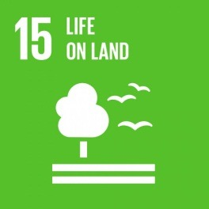

UN Environment Indicators
Water quality, water resource management, freshwater ecosystems
6.3.2, 6.5.1, 6.6.1
8.4.1, 8.4.2, 12.1.1, 12.2.1, 12.2.2, 12.3.1, 12.4.1,
12.4.2, 12.5.1, 12.6.1, 12.7.1, 12.a.1, 12.c.1
Sustainable consumption and production, including material flow accounts, chemicals and wastes, environmental policy, food waste and fossil fuel subsidies.
Ocean related indicators on marine litter, acidification, marine management and coverage of protected areas
14.1.1, 14.2.1, 14.5.1
Protected areas, including mountains, and national targets for the Convention on Biological Diversity, and environmental protection expenditure
15.1.2, 15.4.1, 15.9.1, 15.a.1 15.b.1
Environmentally sound technology and sustainable development policy
17.7.1, 17.14.1

Slide 10
UN Environment Indicators – SEEA linkages
Water quality and freshwater ecosystem extent
Material flow accounts, waste and food waste accounts and fossil fuel subsidies.
Ocean related indicators on marine litter, acidification, marine management and coverage of protected areas
Protected areas, including mountains, and national targets for the Convention on Biological Diversity, and environmental protection expenditure

Slide 11
Land Accounting – Earth Observation –linkages with SDG 6.6.1 and other SDGs
© NABU/Holger Schulz
Photo credit to be given
as shown alongside
(in black or in white)

Slide 12
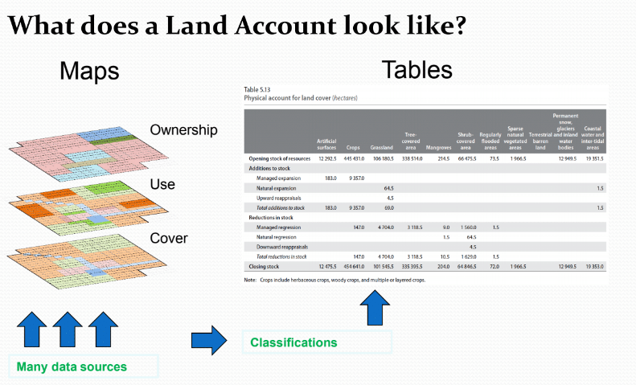
Land accounting
© NABU/Holger Schulz
Photo credit to be given
as shown alongside
(in black or in white)

Slide 13
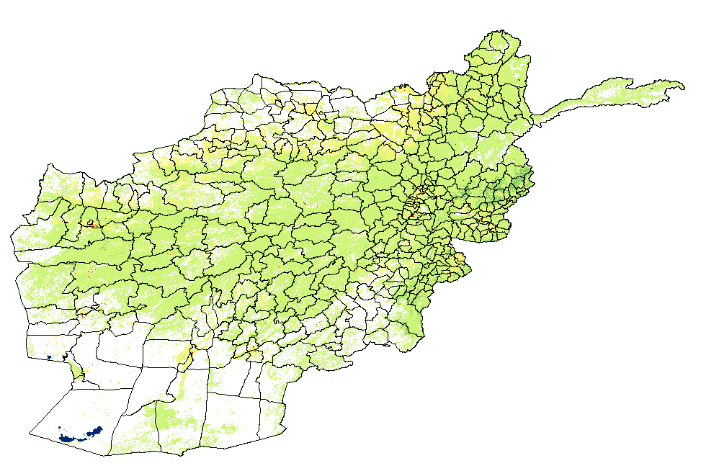
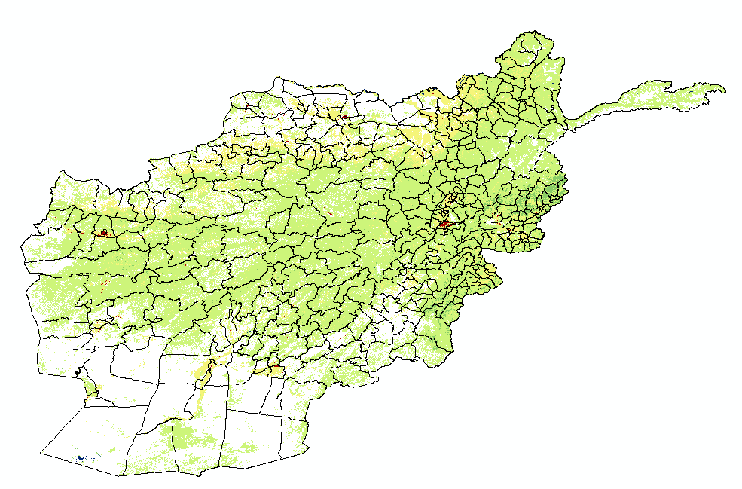
Land cover accounting example: Example (6.6.1)
A map is a collection of pixels (which can be counted)
2000
2015
Note: For illustrative purposes only.
Photo credit to be given
as shown alongside
(in black or in white)
© NABU/Holger Schulz

Slide 14
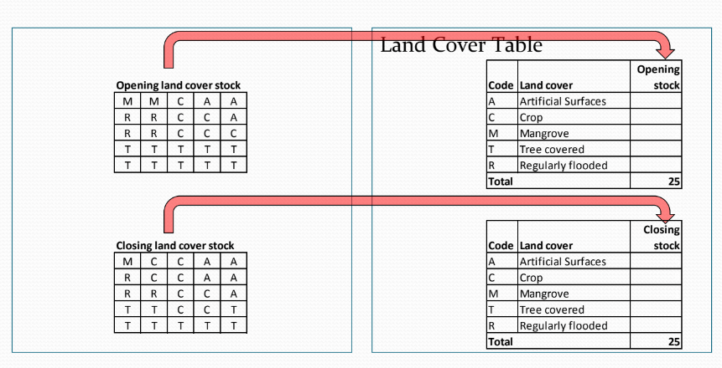
Turning a map into an account
© NABU/Holger Schulz
Photo credit to be given
as shown alongside
(in black or in white)

Slide 15
The data from the previous slide can be tabulated into statistics
Tabluate Area in ArcMaps (Spatial Analysis toolbox) was used to calculate the percentage for each type of land cover and then this was multiplied by the area of Afghanistan
Note: For illustrative purposes only.
© NABU/Holger Schulz
Photo credit to be given
as shown alongside
(in black or in white)

Slide 16
Example continued
This is the result of the ArcMaps Tabulate Areas in percentage of area (with totals added)
How much land was water bodies in 2015 versus 2000 (in percent)?
Based on this table what land class did most water bodies become between 2000 and 2015?
We can also bring protected areas into scope through this process.
Note: for illustrative purposes only.
Photo credit to be given
as shown alongside
(in black or in white)
© NABU/Holger Schulz

Slide 17
Conclusions
High potential for using Earth Observation to produce an initial land cover map and land account.
There is still a need for ground truthing of information, particularly for the information to be useful for national policy making.
Greater resolution would be useful to catch smaller changes and to ensure that small water bodies and small ecosystems are captured. (A 30m CCI-LC should be public within the next year or so. Higher resolution data is available to purchase, but then there would be a need to convert images to land cover maps through direct analysis of satellite images.)
© NABU/Holger Schulz
Photo credit to be given
as shown alongside
(in black or in white)

Slide 18
Thank you
Jillian Campbell
Statistician, UN Environment
www.unep.org

