Slide 1
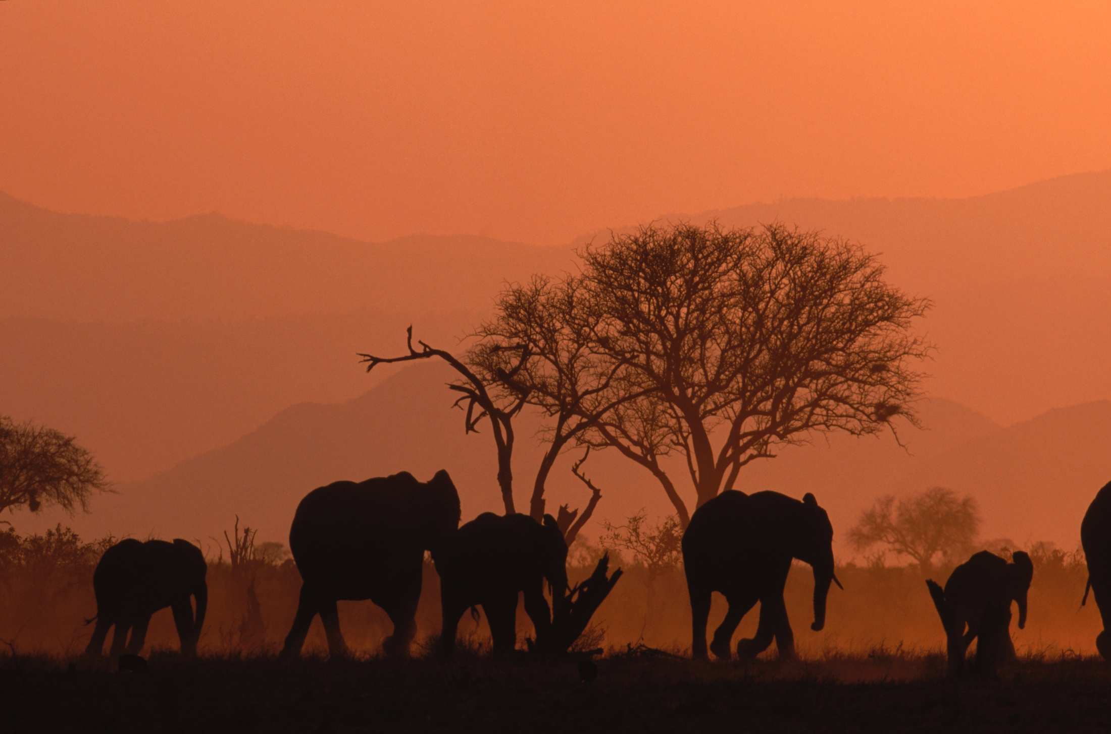
Gaborone Declaration for sustainability in Africa
December 2017
Nairobi, Kenya
© ROBERT CAPUTO

Slide 2
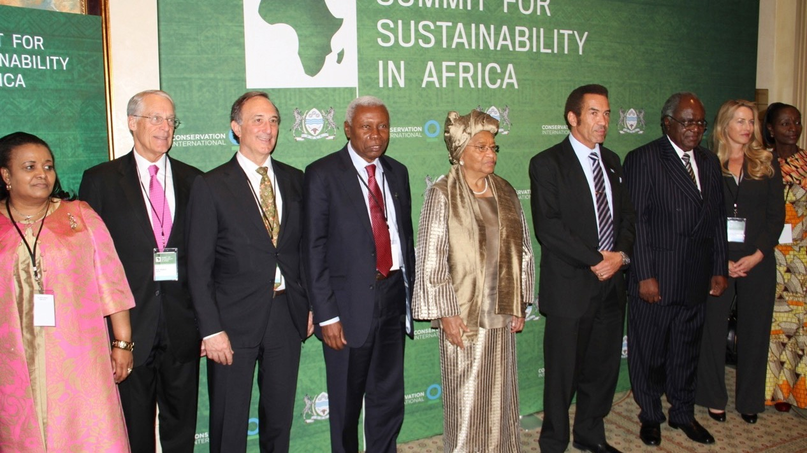

Slide 3
Original signatories

Slide 4
Notes:
10 countries with amplification to another 2 – Uganda and Madagascar

Slide 5
The GDSA Action Statements
Action Statement 1: Integrating the value of natural capital into national accounting and corporate planning and reporting processes, policies and programmes.
Action Statement 2: Building social capital and reducing poverty by transitioning agriculture, extractive industries, fisheries and other natural capital uses to practices that promote sustainable employment, food security, sustainable energy and the protection of natural capital through protected areas and other mechanisms.
Action Statement 3: Building knowledge, data, capacity and policy networks to promote leadership and new models in the field of sustainable development, and to increase momentum for positive change.

Slide 8
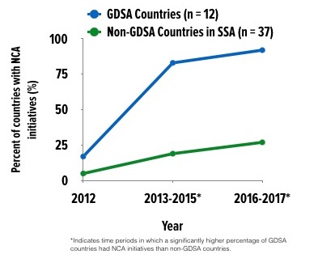
In mid-2016, 11 of the 12 GDSA countries had active, national, NCA initiatives
By early 2018, all countries will have active programming
GDSA, CI, + NASA = ecosystem accounting across four GDSA countries
GDSA NCA ‘Community of Practice’ – needs resources from partners for activities, but is a virtual network of experts working on NCA

Slide 9
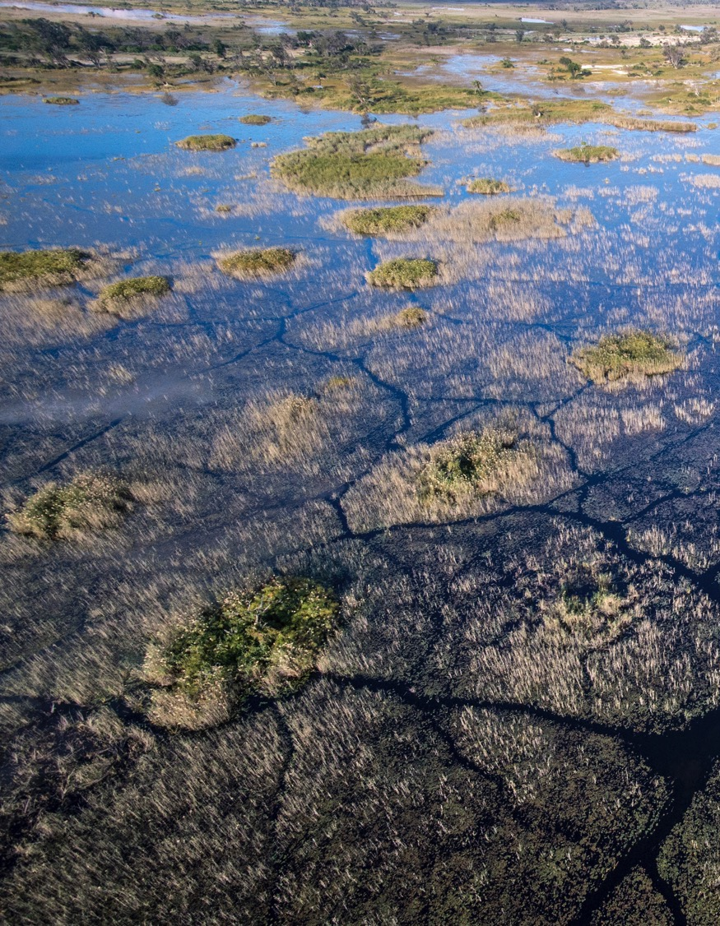
National planning for NCA
Successful progression of NCA requires clear country-level roadmaps that are understood and endorsed by all stakeholders
Across the GDSA
Varying degrees of understanding of what an NCA roadmap is
Several countries in the GDSA already have partial or complete NCA roadmaps – some are publicly available
Notes:
GDSA countries with roadmaps:
Namibia did an extensive, and publicly-documented project planning for their natural capital accounting, as part of the GIZ-funded biodiversity resource mobilization project
WAVES countries have all done project planning as part of the project implementation

Slide 10
National planning for NCA
GDSA Secretariat facilitates national planning for NCA in a range of ways
Botswana: member of the WAVES national steering committee
Resource mobilization
Liberia: supporting resource mobilization (first through pilot mapping and ecosystem project; then through NASA project; and now through USD$4.4 million GEF-6 initiative)
Tanzania: request for assistance (resulted in inclusion in NASA project)
Notes:
Sustainable coffee challenge: Eight GDSA countries export coffee (6 million farmers; 366k+ ha under production)
More than 80 partners, including Starbucks and Nespresso working towards sustainability in their coffee value chains

Slide 11
National planning for NCA
GDSA Community of Practice
GDSA ‘readiness’ scoping of 7 countries included review of national planning (available on the GDSA website)
GDSA NCA Statement – agreed to in mid-2016 during a 12-country workshop co-organized with WAVES and CI calls for the development country-specific NCA roadmaps
The GDSA, together with CI, is actively fundraising to support this work

Slide 12
Thank you
© ROBERT CAPUTO

Slide 13
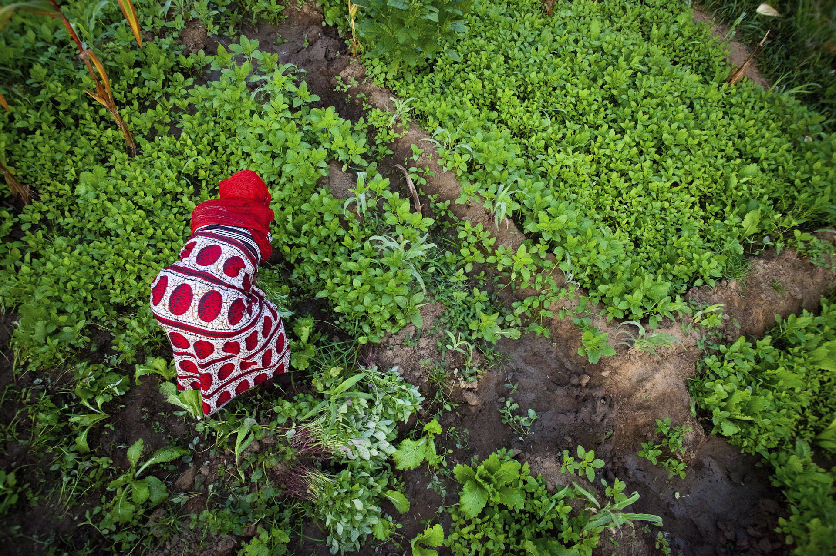
discussion

