Slide 1
REGIONAL WORKSHOP SEEA
ROADMAP FOR SYSTEM OF ENVIRONMENTAL-ECONOMIC
ACCOUNTING (SEEA), MALAYSIA
2016-2020
PRESENT BY:
Roslawati Yahya
Agriculture & Environment Statistics Division
Date :
28 November 2017
Time :
9.30 a.m
Venue :
Hotel Alilia
Jakarta, Indonesia
Notes:
Good morning ladies and gentlemen. First and foremost, I wish to thank UNSD for for giving us an opportunity to deliver the presentation on Roadmap for System of Environmental-Economic Accounting (SEEA), Malaysia 2016-2020
It is indeed a great honor for Malaysia to take part in this event.

Slide 2
PRESENTATION OUTLINE
ROADMAP SEEA MALAYSIA
WAY FORWARD
BACKGROUND
ISSUES & CHALLENGES
1
2
3
4
Notes:
The outline of my presentation:
Background
Roadmap SEEA Malaysia
Issues & Challenges
Way Forward

Slide 3
BACKGROUND
United Nations Statistics Division (UNSD) has conducted a development account project “Supporting Member States in Developing and Strengthening Environment Statistics and Integrated Environmental-Economic Accounting for Improved Monitoring of Sustainable Development” for the period of 2016 - 2017 :
To strengthen the regular and sustained production of environment statistics
To strengthen the compilation of environmental-economic accounts and supporting statistics by integrating environment and economic statistics and linking it to policy demand – Malaysia as a pilot country
Objective: To measure the effectiveness of environmental policies/programmes
Project’s outputs: Roadmap SEEA Malaysia and SEEA Water Account
National consultant: Dr. Mohd Yusof Saari from UPM
Notes:
Ladies & gentlemen,
As been mentioned earlier during the launching ceremony, DOSM has accepted the UNSD’s pilot project on “Supporting Member States in Developing and Strengthening Environment Statistics and Integrated Environmental-Economic Accounting for Improved Monitoring of Sustainable Development” on 2015. This project’s period is from 2016 to 2017. There are two modules in this project:
Module 1: To strengthen the regular and sustained production of environment statistics; and
Module 2: To strengthen the compilation of environmental-economic accounts and supporting statistics by integrating environment and economic statistics and linking it to policy demand
As for Malaysia, we have been selected to implement the module 2.
Objective of the project is to measure the effectiveness of environmental policies and programmes.
There are two outputs from this project i.e. Roadmap SEEA Malaysia and SEEA Water Account. Both of these outputs was prepared by Dr. Mohd. Yusof Saari, out national consultant from UPM.

Slide 4
ROADMAP
SEEA MALAYSIA

Slide 5
ACTIVITY ON PREPARING THE ROADMAP
June –Aug. 2016
9 Nov. 2016
2 Dec. 2016
Sept. 2016
7 Nov. 2016
2016
i. Appointment of national consultant
ii. Engagement with agencies
Awareness on SEEA
Policy requirement
Potential account
iii. Draft of Roadmap SEEA to agencies
Assessment Mission (UNSD)(19 - 23 Sept)
Buy in process –High level meeting & working visit
Review Roadmap SEEA – comment from UNSD & agencies
Training Workshop on SEEA (UNSD) (26 – 30 Sept)
Stakeholder Consultation Workshop
Present the draft of Roadmap SEEA:
Governance
Water account
SEEA Development Plan 2016 -2020
Meeting with EPU & ministries:
Set up governance
Membership
Term of reference
ii. Roadmap SEEA:
Water account
SEEA Development Plan 2016 -2020
Submit the draft of RoadMap SEEA to the UNSD
24 – 27 Jan. 2017
Feb. 2017
Mac – Oct. 2017
2017
Technical Assistance (UNSD & Stats Denmark):
Assess & evaluate the energy Account
Air Emissions Account
Main User Committee Meeting
Submit the Roadmap SEEA Malaysia to the UNSD
Development of the Water Account
5
Notes:
June-August 2017
The preparation of Roadmap started from June 2016 when UNSD appointed Dr. Mohd. Yusof as a consultant project.
On July 2016, the consultant organised a workshop with agencies to:
give awareness on SEEA;
Gathered information on the policy requirement; and
Identified the potential SEEA account to be developed
On early August 2016, DOSM has sent the first draft of Roadmap to agencies for review and comment.
Sept. 2016
On Sept 2016, the Assessment Mission by UNSD and UNESCAP was held and activities that have carried out during this mission were discussion, working visit and high level meeting with agencies as part of buy in process.
At the same time, DOSM also received comments from UNSD and agencies on the draft of Roadmap SEEA Malaysia
The Regional Training Workshop on SEEA with a focus in water accounting was held immediately after the Assessment Mission. The workshop was attended by
- Expert from UNSD, ABS and Statistics Canada
- 32 participants from various agencies, DOSM and delegations from Indonesia & Philippines
7 November
The stakeholder consultation workshop was held by the national consultant to present the amended draft of Roadmap SEEA Malaysia to agencies.
It was agreed during the workshop on :
the setting up of governance
Water Account to be developed in 2017; and
SEEA development Plan for 2016 – 2020
9 November
Meeting with EPU and ministries to:
set up the Planning & Development of Environment Statistics Committee and
Present Roadmap SEEA Malaysia.
It was agreed during that meeting on
The committee’s membership and term of reference;
Water account to be developed in 2017
SEEA development plan for 2016 – 2020
Dec. 2016
The draft of Roadmap SEEA Malaysia was submitted to the UNSD on December 2016
2017
In early 2017, the technical assistance was held by UNSD and expert from Statistics Denmark to evaluate the energy account and to share on the air emission account. This session was also attended by various agencies (EPU, Ministry of Natural Resources & Environment, Ministry of Energy, Green Technology and Water, Energy Commission and Department of Environment).
Feb 2017
The Roadmap SEEA Malaysia was table to the Main User Committee Meeting in February 2017 where the MUC also agreed on the Roadmap. Then, the final Roadmap document was submitted to the UNSD.
The compilation of the water account was started from March 2017.

Slide 6
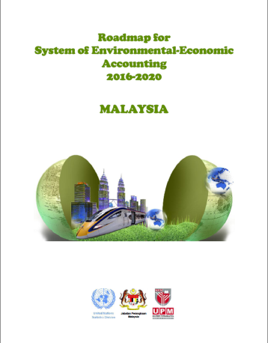
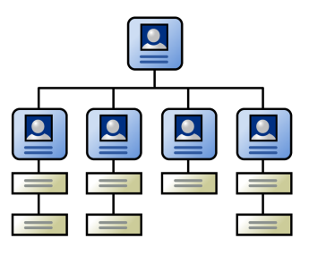
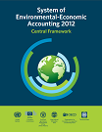
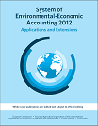
ROADMAP SEEA MALAYSIA
Policies/Programmes/Plan/Initiatives
Development Plan for SEEA Account
2016-2020
Governance structure
Membership - Agencies involve
Term of reference
Data requirements/sources/references
1
2
3
4
6
Notes:
Roadmap is a dynamic document. It can be changed/updated/amended based on policy and country’s need.
This document highlighted
policies/programmes/plans/intiatives related ton environment in Malaysia
Development plan for SEEA account for period 2016 – 2020
Governance structure including membership (agencies involves) and term of reference and
Data requirements/sources/references

Slide 7
THE PURPOSE OF ROADMAP SEEA MALAYSIA
Establishing the rationale for an integrated statistical system for sustainable development information
Summarizing the priorities and opportunities in Malaysia for further improvement of the National Statistical System with a focus on SEEA
Outlining the foundational activities needed to implement environmental economic accounting
Identifying the enabling factors, activities, outputs, impacts and long-term outcomes of engaging in these activities
1.
2.
4.
3.
Notes:
Purpose of the Roadmap are
Establishing the rationale for an integrated statistical system for sustainable development information
Summarizing the priorities and opportunities in Malaysia for further improvement of the National Statistical System with a focus on SEEA
Identifying the enabling factors, activities, outputs, impacts and long-term outcomes of engaging in these activities
Outlining the foundational activities needed to implement environmental economic accounting ready for use in fully developed and budgeted funding proposals.

Slide 8
SEEA ACCOUNT DEVELOPMENT PLAN 2016 - 2020
1. Energy Account
Supply and use of energy by product & industry
National Energy Balance (NEB), 2010 - EC
Energy use by product & industry
2017
MySEEA
PSUT Energy Account, 2010
a.
MySEEA
Air Emissions for Energy Use 2010
2. Air Emissions Account
2017
CH₄
+
b.
MySEEA
Air Emissions for Non Energy 2010
2018
c.
=
2018
MySEEA
Air Emissions Account 2010
Notes:
In the Roadmap, we have list out the mid term development plan for 2016 -2020. There are five accounts & table that were plan to be developed that is:
MySEEA PSUT Energy account in 2017. Our main data source is National Energy Balance from Energy Commission. This account has been developed by DOSM (reference year 2010) and released in August 2017.
Air Emission Account. First, we will start with Air Emission for Energy Use based on the MySEEA PSUT Energy Account. The reference year is 2010. After it has been completed, we will proceed with Air Emission for Non Energy. The Air Emission account will be completed with these two account.

Slide 9
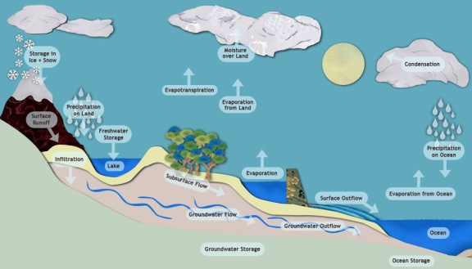
SEEA ACCOUNT DEVELOPMENT PLAN 2016 - 2020 (cont’d)
3. Water Account
MySEEA PSUT Water Account, 2010
2017
4. Environmentally Extended Input-Output
2018
Input-Output 2010
+ Air emissions statistics
Environmentally Extended
Input-Output 2010
5. Land Account
2019
MySEEA Land Account
(Focus on the agriculture land use)
Notes:
Next is MySEEA PSUT Water Account for reference year 2010. This is the account compiled by national consultant.
In 2018, the air emission account will integrate with Input Output table to produce Environmentally Extended Input Output Table.
Another account to be developed is Land Account in 2019 focusing on agriculture land.

Slide 10
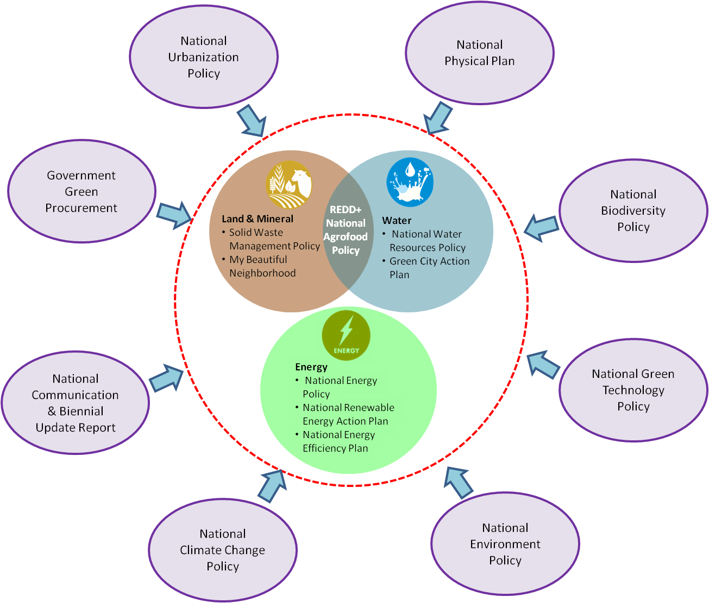
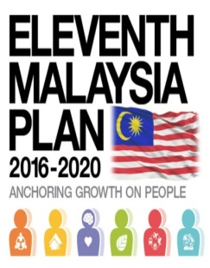
NATIONAL POLICY & PRIORITIES
Notes:
In the Roadmap, we also list national policies/plans/programmes related to the environment that SEEA can give an input as a monitoring tool.

Slide 11
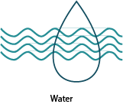
POLICIES/PLANS/PROGRAMMES RELATED TO SEEA
SEEA ENERGY ACCOUNT
Eleventh Malaysia Plan
National Energy Policy
National Environment Policy
National Energy Efficiency Action Plan
National Renewable Energy Policy and Action Plan
Second National Physical Plan
National Strategic Plan for Solid Waste Management
Third National Communications (TNC) and Biennial Update Report (BUR)
National Green Technology Policy
National Mineral Policy
National Climate Change Policy
Government Green Procurement Action Plan
Green City Action Plan
Green Technology Master Plan
SEEA WATER ACCOUNT
Eleventh Malaysia Plan
National Agro-food Policy
Second National Physical Plan
National Strategic Plan for Solid Waste Management
My Beautiful Neighbourhood (MyBN)
REDD+ Malaysia
Third National Communications (TNC) and Biennial Update Report (BUR)
National Climate Change Policy
National Green Technology Policy
National Biodiversity Policy
National Water Resources Policy
Green City Action Plan
National Environment Policy
National Urbanization Policy
Notes:
For example, SEEA Energy Account can an input to
Eleventh Malaysia Plan
National Energy Policy
National Climate Change Policy
National Environment Policy
National Green Technology Policy
National Mineral Policy
Green Technology Master Plan
National Energy Efficiency Action Plan
National Renewable Energy Policy and Action Plan
Second National Physical Plan
Government Green Procurement Action Plan
Green City Action Plan
National Strategic Plan for Solid Waste Management
Third National Communications (TNC) and Biennial Update Report (BUR)

Slide 12
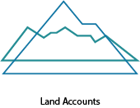
POLICIES/PLANS/PROGRAMMES RELATED TO SEEA
SEEA LAND ACCOUNT
National Agro-food Policy
National Climate Change Policy
National Green Technology Policy
National Biodiversity Policy
Second National Physical Plan
National Strategic Plan for Solid Waste Management
My Beautiful Neighbourhood (MyBN)
REDD+ Malaysia
Third National Communications (TNC) and Biennial Update Report (BUR)
Green City Action Plan
National Urbanization Policy
SEEA AIR EMISSION ACCOUNT
Eleventh Malaysia Plan
National Strategic Plan for Solid Waste Management
Third National Communications (TNC) and Biennial Update Report (BUR)
National Climate Change Policy
National Green Technology Policy
Green City Action Plan
National Environment Policy
National Urbanization Policy
Green Technology Master Plan

Slide 13
GOVERNANCE STRUCTURE
PLANNING & DEVELOPMENT OF ENVIRONMENT STATISTICS COMMITTEE
STEERING COMMITTEE
Chaired: Economic Planning Unit
TECHNICAL COMMITTEE
Chaired: DOSM
WORKING GROUP
MySEEA
ENERGY ACCOUNT
Co-chaired: DOSM & KeTTHA
Members: Various agencies/stakeholders/data provider/ academia/ researcher
WORKING GROUP
MySEEA
WATER ACCOUNT
Co-chaired: DOSM & NRE
Members: Various agencies/stakeholders/data provider/ academia/ researcher
WORKING GROUP FOR OTHERS STATISTICS AND ACCOUNT*
FDES Malaysia
GEI
NOTE:
* New environment statistics:
Latest UNSD’s manual
Project received from international organization
Membership will be reviewed from time to time
Notes:
To ensure the successfulness of the compilation of environment accounts and statistics, the Planning & Development of Environment Statistics Committee was set up on 9 November 2016. It consists of:
Steering Committee chaired by Deputy General Director (Macro) Economic Planning Unit. It will give guidelines and endorse the implementation of environment account/statistics.
Technical Committee chaired by Deputy Chief Statistician Social/Demographic Programme. It will provide technical coordination for the development of environment accounts/statistics; and
Technical Working Group. These working group will lead the development of environment account/statistics. Currently, we already set up the MySEEA Energy Account working group and Water account. The working group will be set up based on the new environment statistics to be developed.
Membership of the committee will be reviewed from time to time.
Note: New environment statistics is a existing statistics that need to be updated based on a latest manual released by the UNSD or if DOSM received any statistics project from the international organization.

Slide 14
ISSUES & CHALLENGES

Slide 15
ISSUES & CHALLENGES
Data limitation
Coordination and support
Data @ information are scattered
Dedicated focal person from agencies
Training @ courses
Data produced just for specific objectives
Technical assistance
Capacity Building
Level of data accessibility especially in the state level
Support from private sector
Estimation methodology
Convincing the policy makers on the relevance of SEEA for development planning in Malaysia
Statisticians less skills to explain to users in layman
Notes:
In process of compiling SEEA in Malaysia, we face issues & challenges in term of:
1. Data limitation
- Data/information are scattered
Data produced just for specific objectives
Level of data accessibility especially in the state level
Estimation methodology
2. Coordination
Full commitment and collaboration from all related agencies
Convincing the policy makers on the relevance of SEEA for development planning in Malaysia
Support from private sector
3. Capacity Building
- Training @ courses
- Technical assistance
- Statisticians less skills to explain to users in layman

Slide 16
ISSUES AND CHALLENGES
- Issues related to data
INCONSISTENCY DATA
Different method or classification.
Different sources have different aggregate values.
RELIABILITY OF NON-SURVEY APPROACH
Need to refer other country as a benchmark
Estimation might be undervalued or overvalued.
Notes:
In compiling statistics one of crucial issues is data. There are three main issues on data that is:
Inconsistency data
Missing data
Reliability of non-survey approach

Slide 17
CRITICAL SUCCESS FACTOR
6
1
Data dissemination “Merakyatkan statistik”
Promote & advocate thru:
Media – press release, launching by ministry via visualisation/social media
Journals – collaboration with academia/organisation
Roadshow
Commitment from management
5
2
Manual & reference for compiler
Specific subsystem
Simple explanation by modules
Examples
Presentation in simple table
Commitment & collaboration from agencies/other parties
Stakeholders
Data provider
Academia/Researcher
International organisation
Critical success factor
Capacity building
Courses & training
Workshop
Assessment
Attachment
Meeting with experts
Technical assistance
Valuation
4
3
Official agreement
Access data
Data verification
Note:
Current workforce in developing SEEA Malaysia-6 officers
No. of capacity building received:
Course & training – 4
Workshop – 2
Assessment – 2
Meeting with experts – 7
Technical assistance & valuation - 1

Slide 18
WAY FORWARD

Slide 19
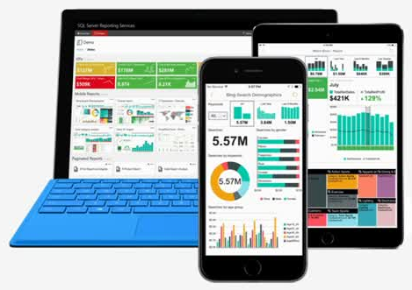
WAY FORWARD
Improving current economic and environmental surveys
To collect detailed data from establishment (e.g. consumption of energy, abstraction of water etc.)
Development of integrated data system
To integrate data from agencies with DOSM
Establishment of single data center
Strategic Communication
Capsule
Brochure
Exhibition booth
Statistics talk

Slide 20
CAMERA LENSE

Slide 21
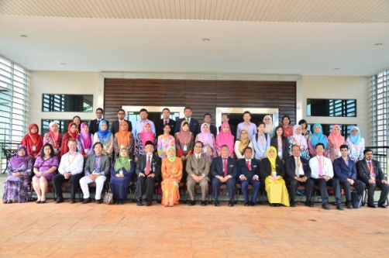
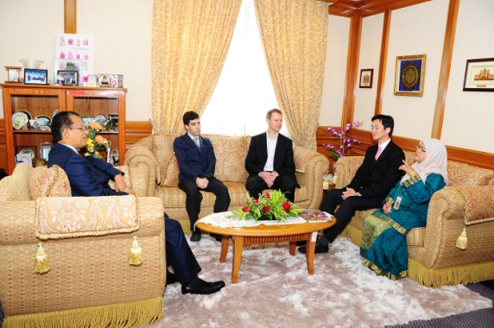
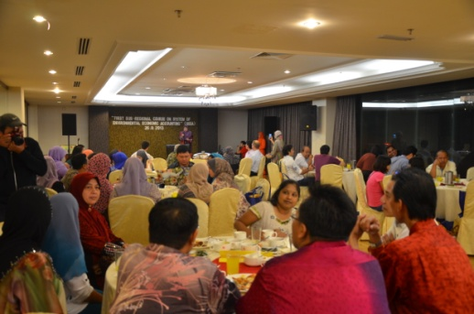
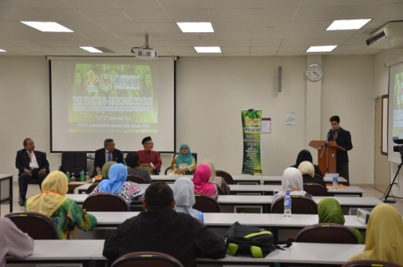
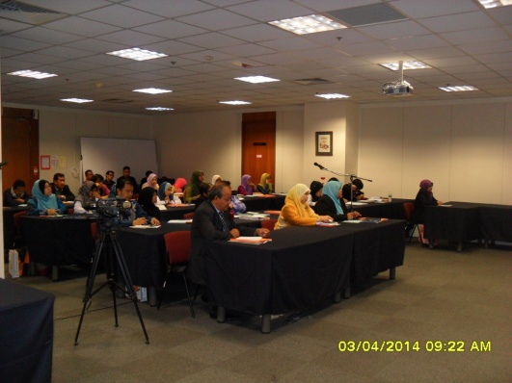
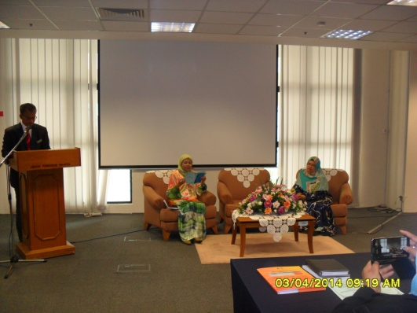
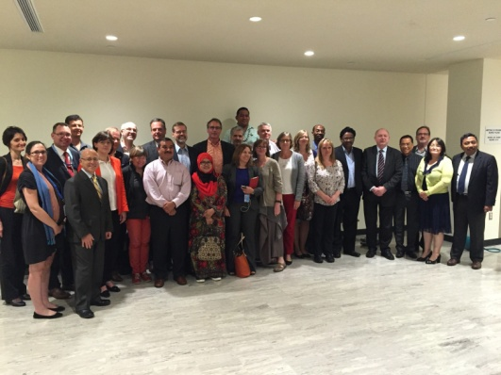
CAMERA LENSE
Assessment Mission on SEEA (30 Sept. – 1 Oct. 2013)
1st Subregional Course on SEEA (23 – 27 Sept. 2013)
SEEA Awareness Workshop with Agencies (3 April 2014)
11th Session of United Nations Committee of Experts on Environmental-Economic Accounting (22 – 24 Jun 2016)
Notes:
There are some activities during the SEEA development in DOSM.

Slide 22
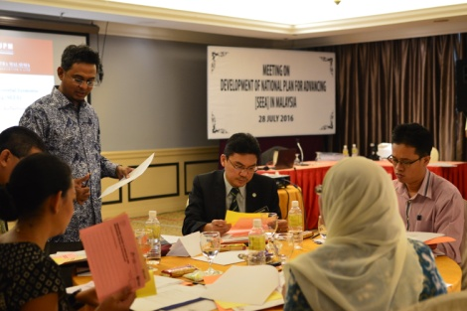
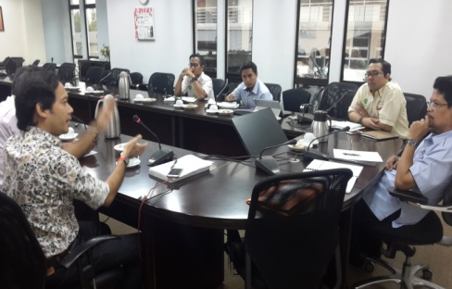
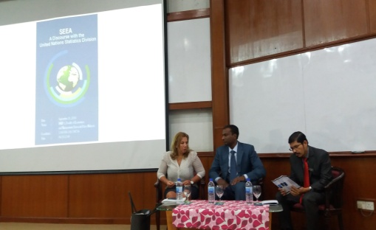
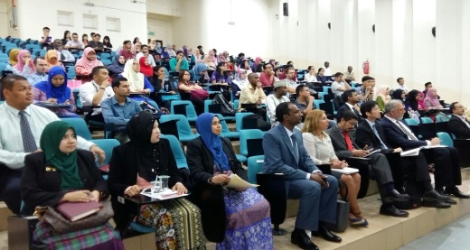
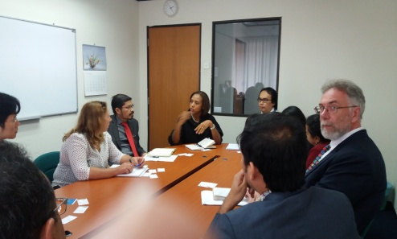
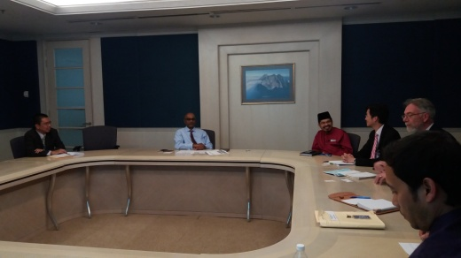
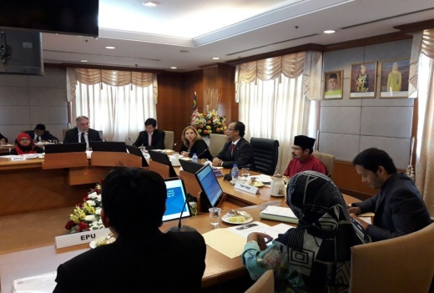
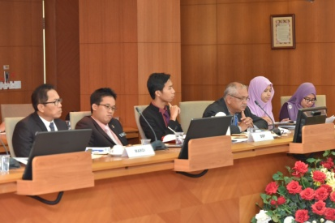
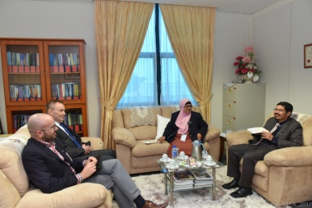
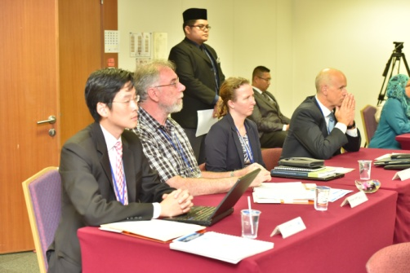
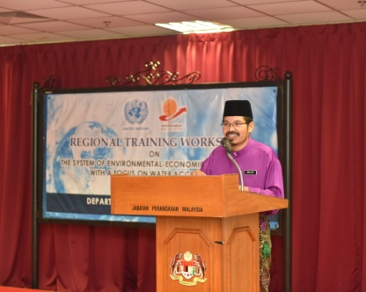
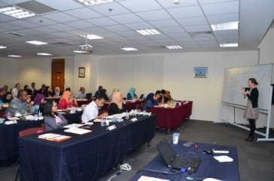
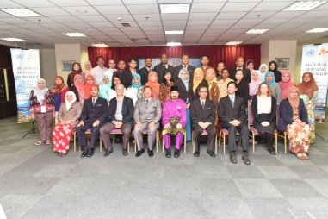
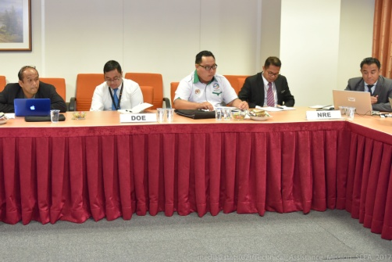
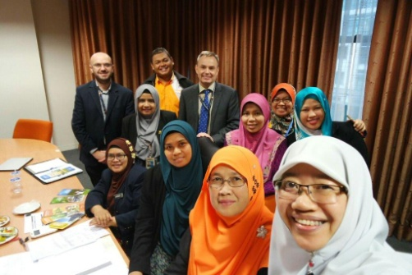
CAMERA LENSE (cont’d)
Engagement session with agencies(July – Nov. 2016)
Assessment Mission with UNSD & ESCAP (19 – 23 Sept. 2016)
Regional Training Workshop of SEEA with a focus on Water Accounting (26 – 30 Sept. 2016)
Technical Assistance on Air Emissions Account & Evaluation on Energy Account (24 – 27 Jan. 2017)

Slide 23
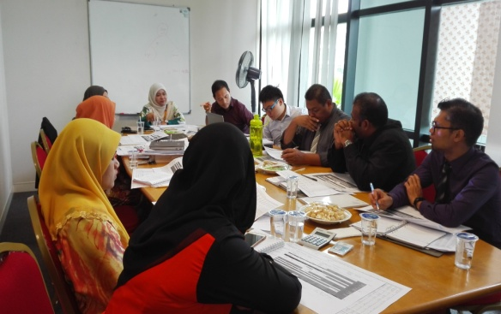
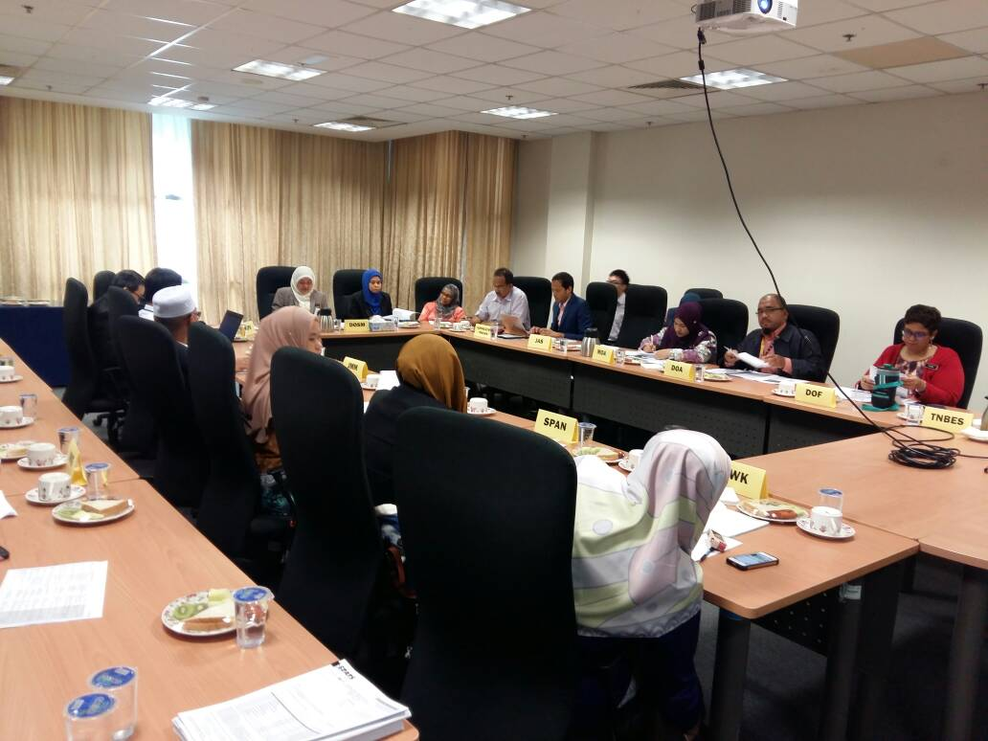
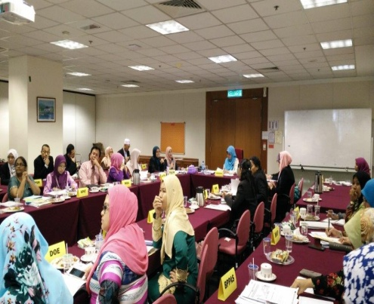
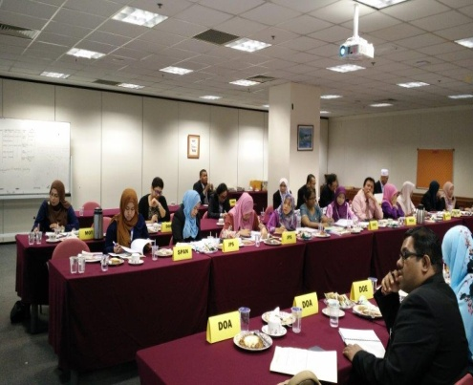
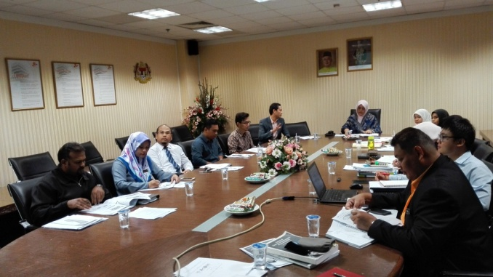
CAMERA LENSE (cont’d)
Pre-Technical Working Group Internal Committee Meeting of Planning and Development for Environment Statistics MySEEA – Water (11 Oct. 2017)
Technical Working Group Committee Meeting of Planning and Development for Environment Statistics MySEEA – Water (13 Oct. 2017)
Technical Working Group Internal Committee Meeting of Planning and Development for Environment Statistics MySEEA – Water
(1 Nov. 2017)
Technical Committee Meeting of Planning and Development for Environment Statistics (13 Nov. 2017)

Slide 24
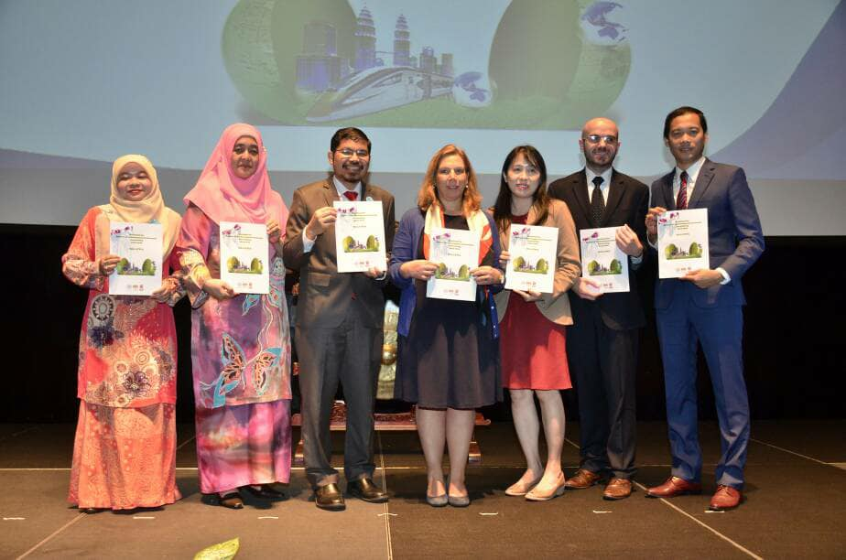
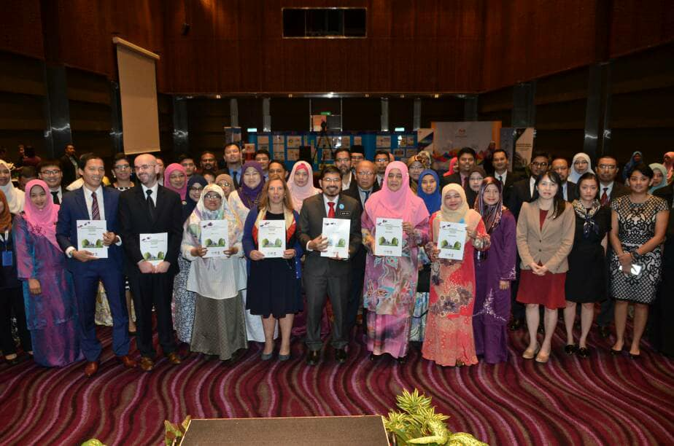
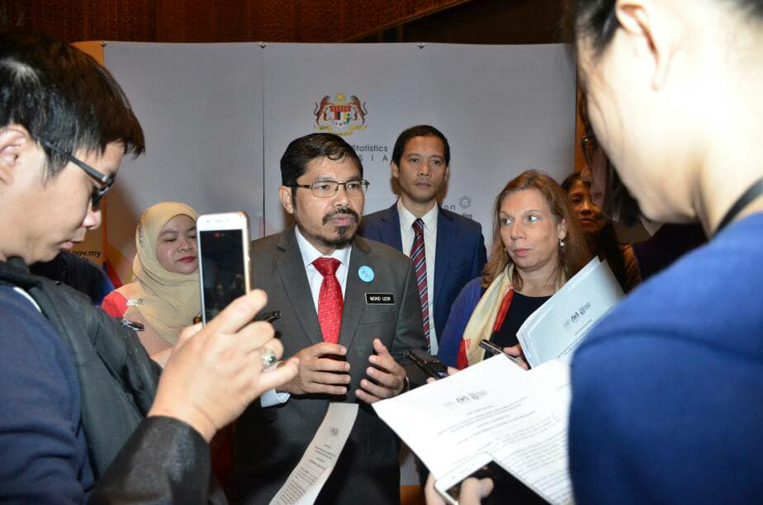
CAMERA LENSE (cont’d)
Launching of Roadmap SEEA Malaysia at National Closing Workshop on 27 November 2017

Slide 25
DEPARTMENT OF STATISTICS MALAYSIA
Blok C6, Kompleks C,
Pusat Pentadbiran Kerajaan Persekutuan, 62514 Putrajaya
Tel : 03-8885 7000 Faks : 03-8888 9248 E-mel : jpbkkp@stats.gov.my
“Statistics are the barometer that reflects the pulse of the country”
Dr. Mohd Uzir Bin Mahidin, The Star, 14th July 2016

