Slide 1
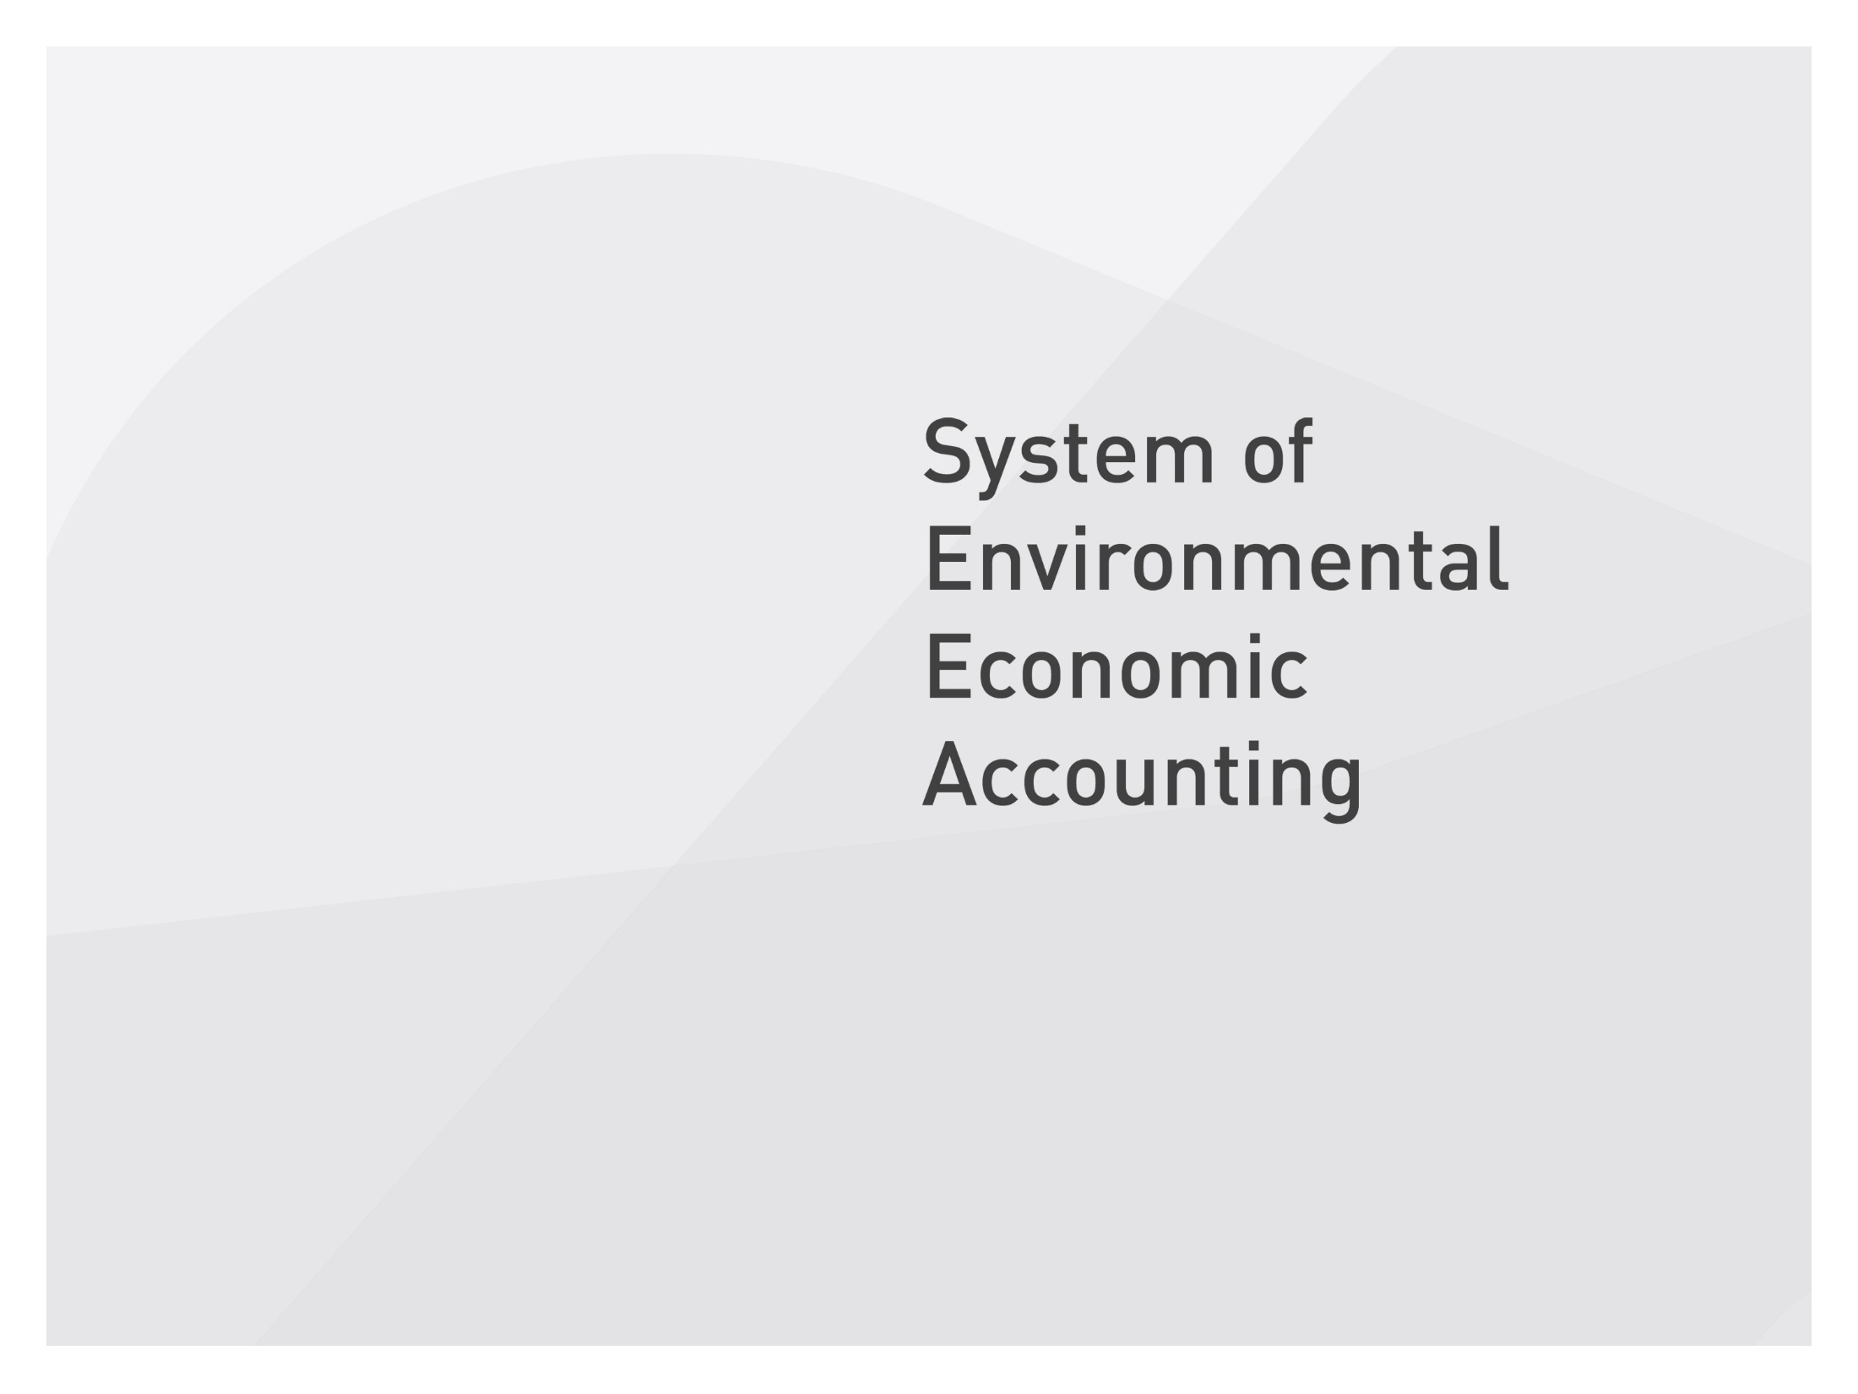




Slide 2
Sustainable Development Goals and the SEEA
Sokol Vako
United Nations Statistics Division

Slide 3
Content
Supply and use in physical terms
Asset account in physical terms
SDGs

Slide 4
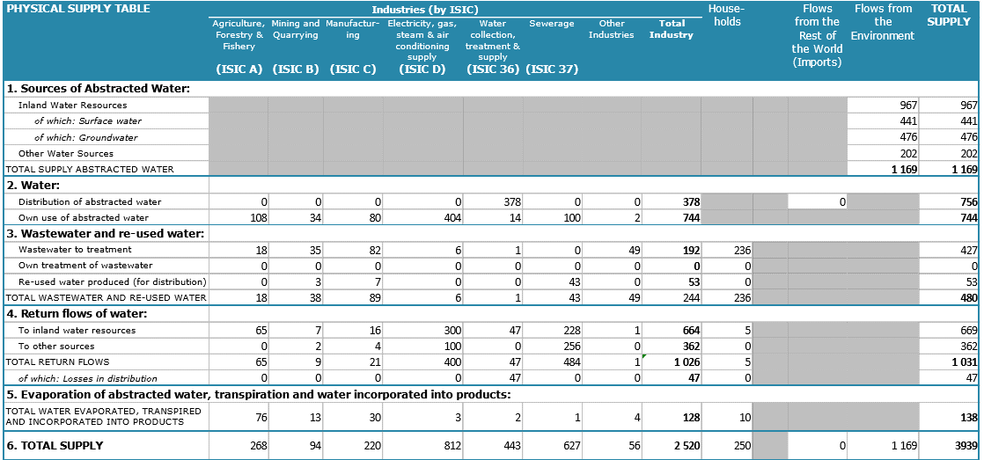
Supply and use

Slide 5
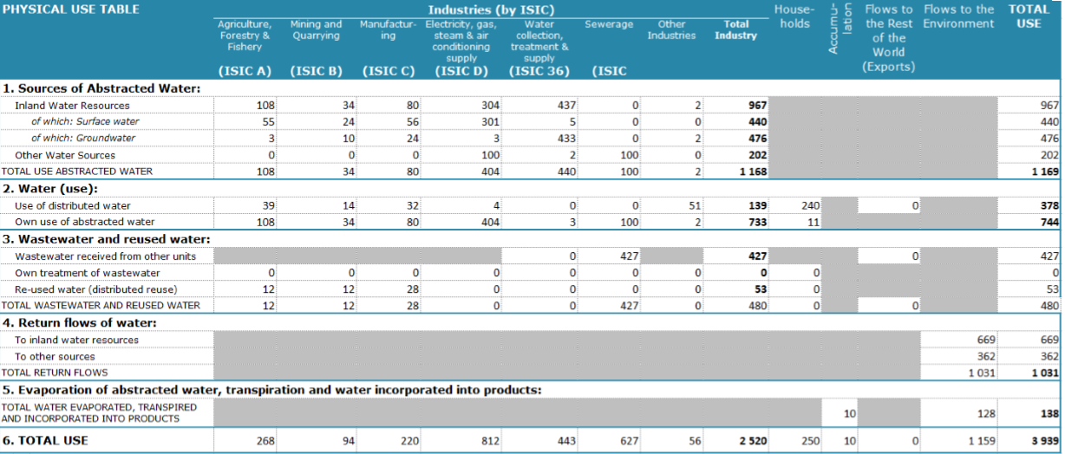
Supply and use

Slide 6
Questions
In looking at the data in the supply and use, what are some useful aggregates?
What additional information would be useful to provide more context that would be relevant for policy purposes?

Slide 7
Goal 6-Targets and indicators
Target | Indicator
6.3 By 2030, improve water quality by reducing pollution, eliminating dumping and minimizing release of hazardous chemicals and materials, halving the proportion of untreated wastewater and substantially increasing recycling and safe reuse globally | 6.3.1 Proportion of wastewater safely treated 6.3.2 Proportion of bodies of water with good ambient water quality
6.4 By 2030, substantially increase water-use efficiency across all sectors and ensure sustainable withdrawals and supply of freshwater to address water scarcity and substantially reduce the number of people suffering from water scarcity | 6.4.1 Change in water-use efficiency over time 6.4.2 Level of water stress: freshwater withdrawal as a proportion of available freshwater resources

Slide 8
Questions
Indicator 6.3.1—In practical terms, the numerator is the amount of wastewater treated while the denominator is the total return flows. How can this be calculated from the information we have?
Indicator 6.4.1—How can the accounts be used to calculate this indicator? What would be the value added of time-series data?
Indicator 6.4.2—The numerator can be though of as the total water withdrawal; denominator is total renewable water resources

Slide 9
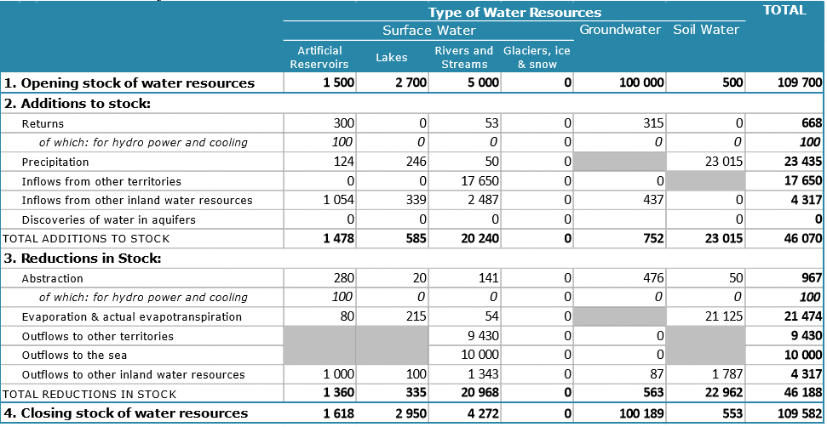
Asset account

Slide 10
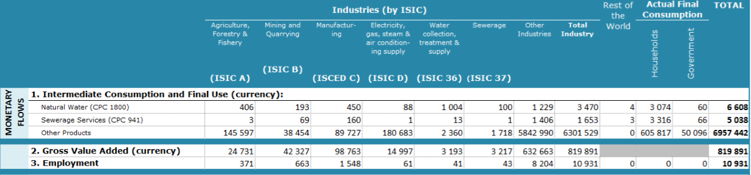
Additional information

Slide 11
Some thoughts on the questions raised

Slide 12
Questions
In looking at the data in the supply and use, what are some useful aggregates?
  Gross water input= total abstracted water + imports of water=1169
  Net domestic water use= return flows of water to the environment + evaporation, transpiration and water incorporated into products= 1031+138=1169
What additional information would be useful to provide more context that would be relevant for policy purposes?
  Time series data, monetary information, dependence of certain sectors of the economy on certain energy products

Slide 13
Indicators 6.3.1
  Numerator and denominator come from PSUT
  Numerator is wastewater sent to treatment = 427
  Denominator is total return flow =1081
  Indicator value is 0.395
  Can be done by industry

Slide 14
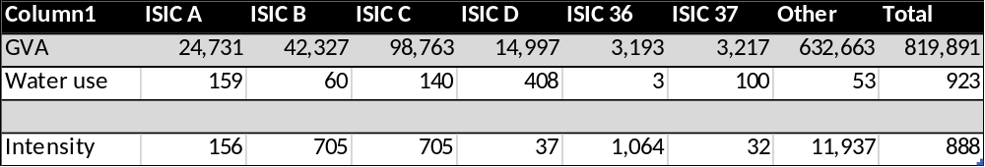
Indicators 6.4.1
  Importance of timeseries
  Numerator comes from national accounts; gross value added
  Denominator comes from PSUT; total use of water by each sector of the economy (including reused water)
    E.g. Agriculture total use of water is 39+108+12=159

Slide 15
Indicators 6.4.2
  Numerator comes form PSUT; total water abstractions (withdrawals)
  1,169
  Denominator comes from asset account; total renewable water sources = Precipitation + Natural transfer from soil water to groundwater + Inflows from other territories – Outflows to other territories (and a few other items that are usually not significant)
  23,435+437+17,650-9,430=32,092 (assuming all inflows to groundwater are from soil
  Indicator value is 0.036

