Slide 1
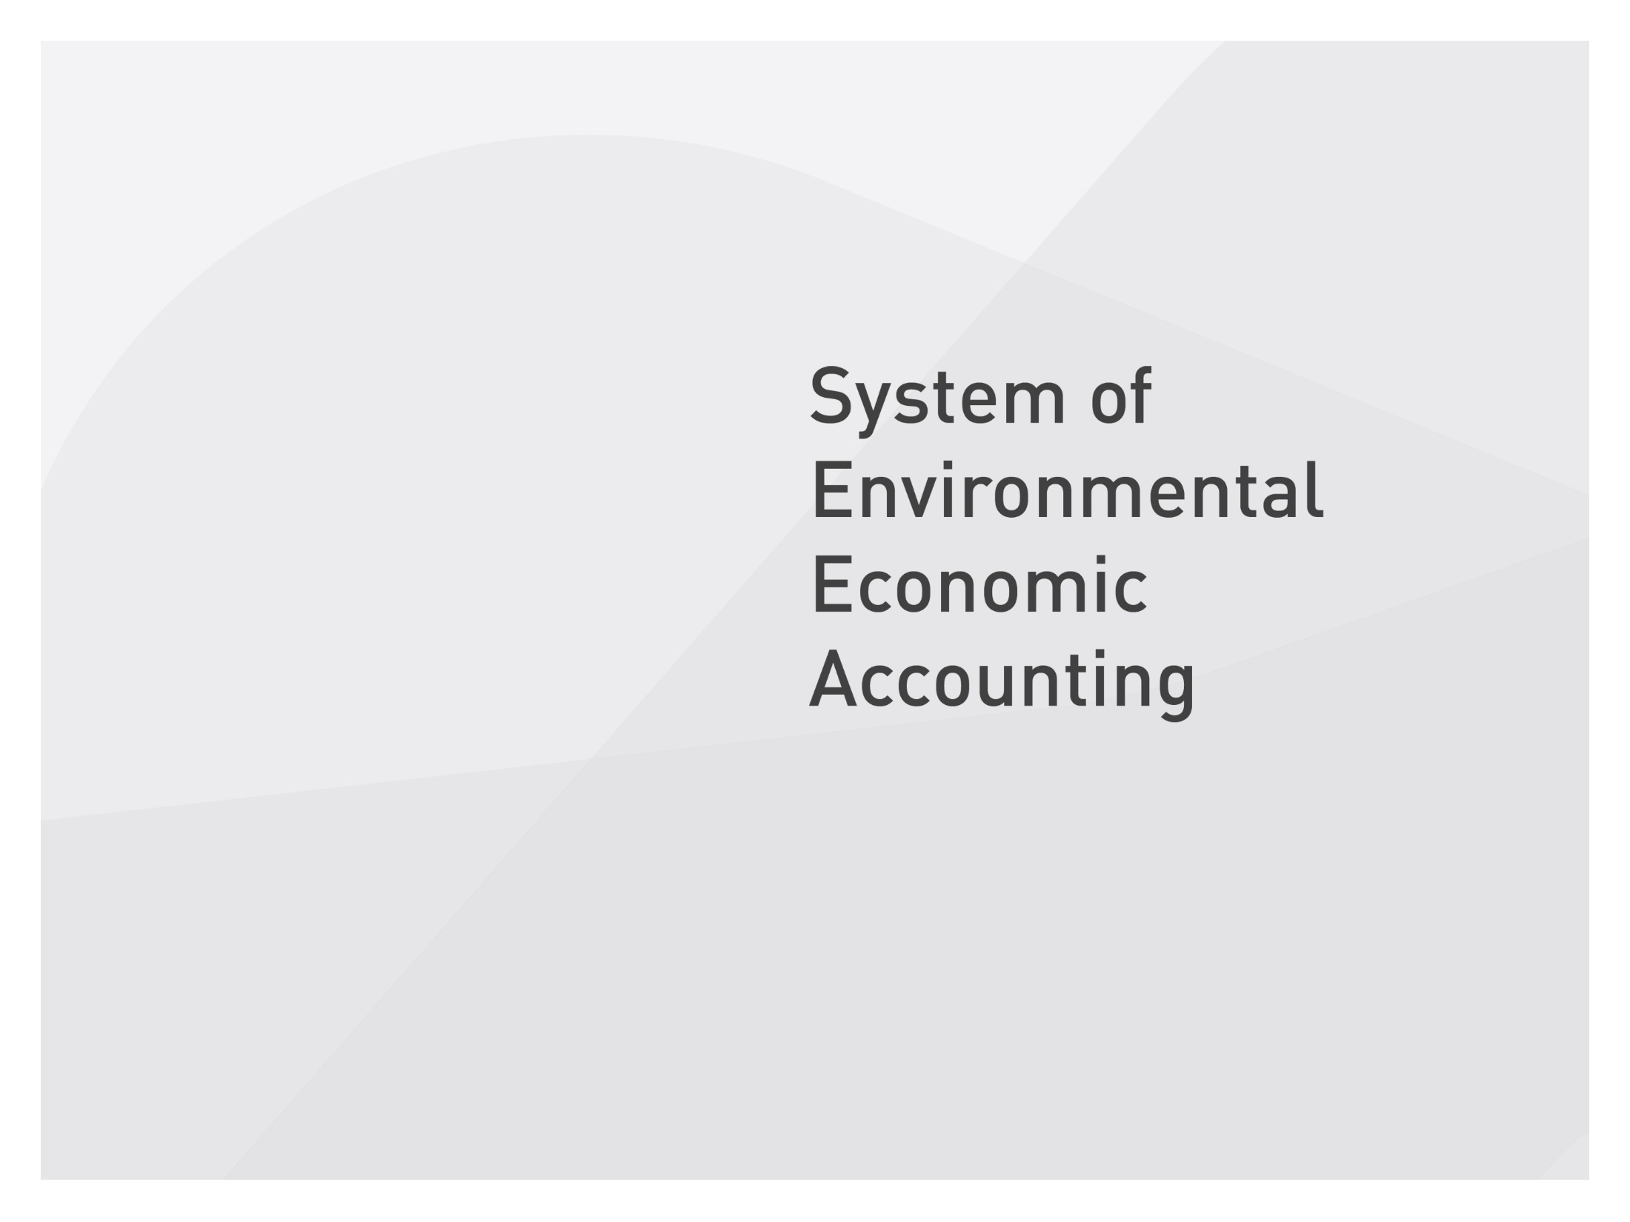




Slide 2
A quick overview of water accounts
Alessandra Alfieri

Slide 3
Contents
Water accounting overview
What are we measuring
An example
Core tables and accounts

Slide 4


Water accounting overview
The SEEA-Water is a subsystem of the SEEA that covers the physical and economic stocks and flows associated with water. It also covers, to some extent, emissions of pollutants and water quality.
The International Recommendations for Water Statistics (IRWS) was designed to assist countries in the implementation of SEEA-Water. Guidelines are being developed to provide additional support.
The SEEA-Water and the IRWS provide the framework for developing information that is comprehensive, consistent, and comparable through time and space.
4

Slide 5
Main water tables
Physical Supply and Use Tables (PSUT) measure, in physical (volume) terms:
  1) the flows of water entering the economy
  2) the flows of water and wastewater between different economic units within the economy
  3) the return flows of water from the economy to the environment
The Monetary Supply and Use Tables measure the monetary flows associated with water related products.
The Asset Account describes the inland water resources system in terms of stocks and flows

Slide 6
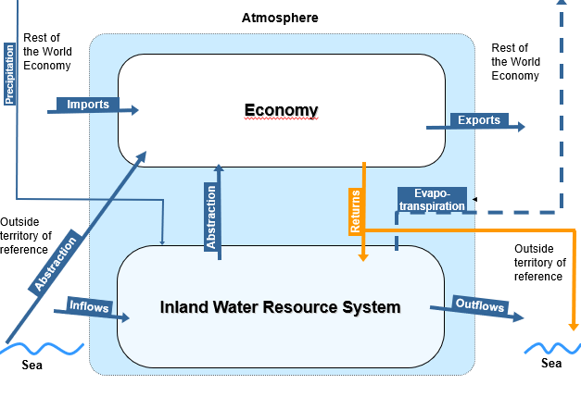
What are we measuring

Slide 7
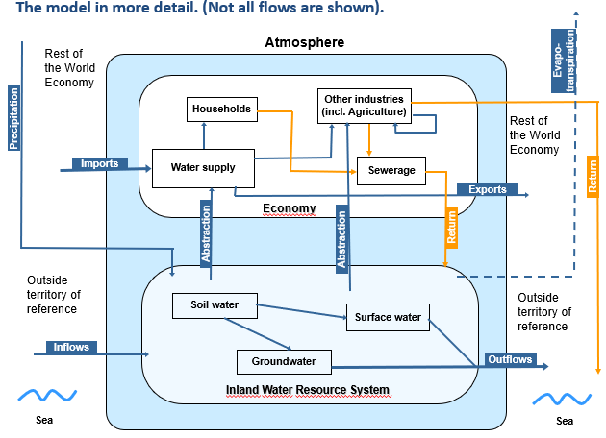
What are we measuring

Slide 8
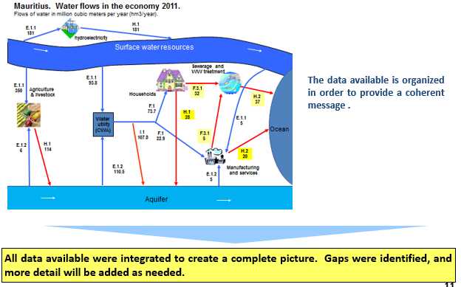
An example

Slide 9
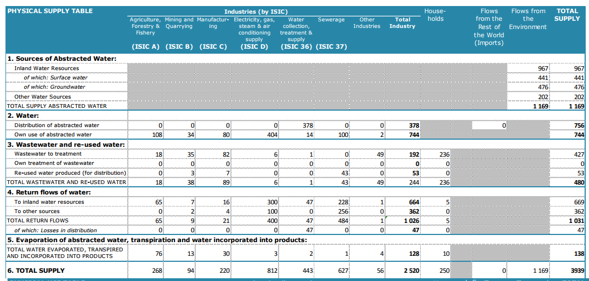
Core tables and combined presentations-water example

Slide 10
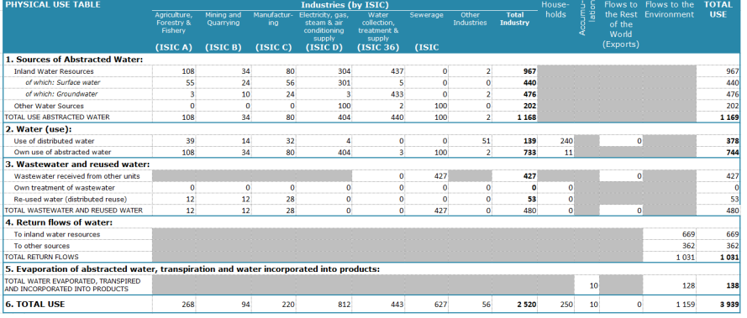
Core tables and combined presentations-water example

Slide 11
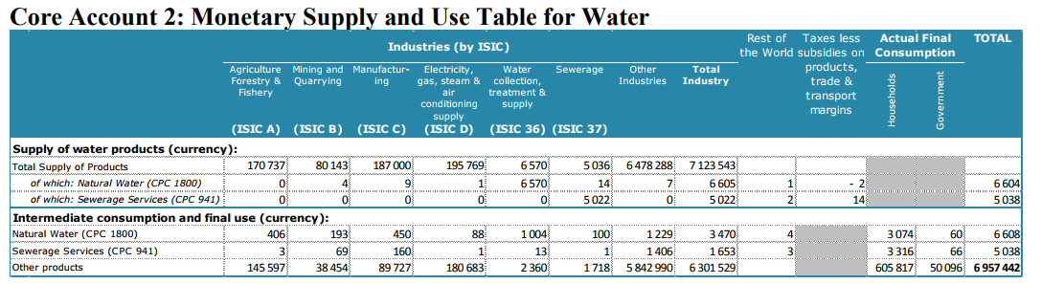
Core tables and combined presentations-water example

Slide 12
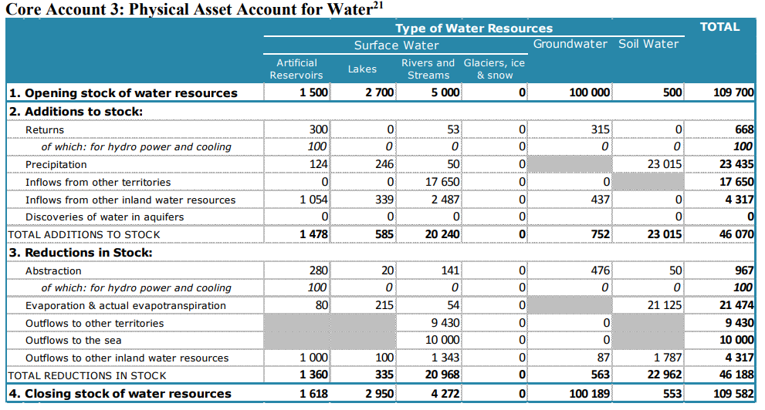
Core tables and combined presentations-water example

Slide 13
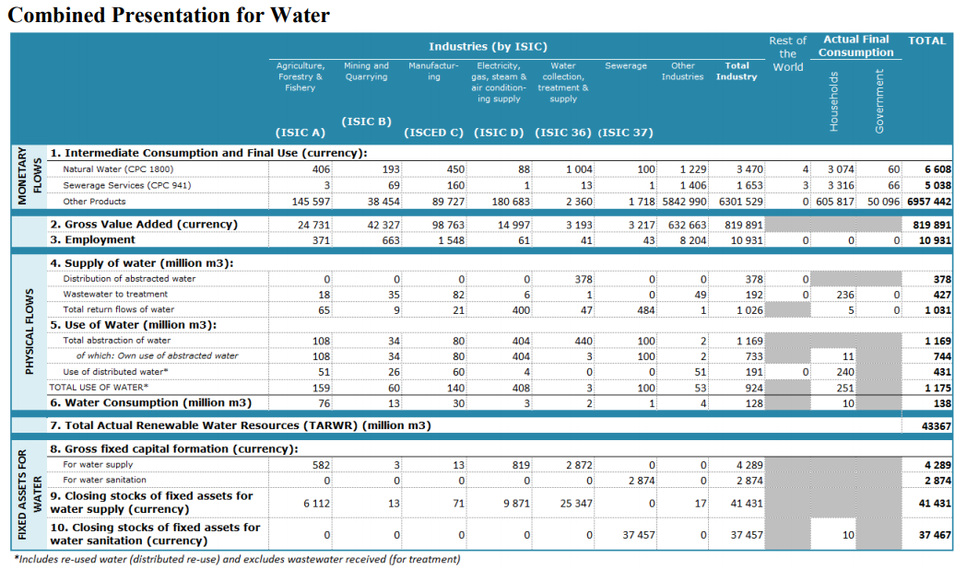
Core tables and combined presentations-water example

