Slide 1
Department of Water Affairs
EXPERIENCE SHARING ON COMPILATION OF WATER ACCOUNTS
BOTSWANA CASE
By Ireen Madilola
Regional Workshop on Environmental Economic Accounting
Nairobi
11-13 December 2017

Slide 2

PRESENTATION LAYOUT
Background (NCA,W.A)
Setup – W.A Technical Working Group
Main data providers
Progress made
Contributing factors
Usage/benefits of water accounts
Challenges
Botswana National plan on NCA
Roadmap

Slide 3
BACKGROUND
In 2012:
Botswana partnered with World Bank to develop Natural Capital Accounts under the Wealth Accounting and Valuation of Ecosystem Services (WAVES) programme.
Botswana Economic Advisory Council (BEAC) prioritized the up-dating of water accounts .
Botswana committed itself to natural capital accounting in the Gaborone Declaration on Sustainability in Africa (GDSA).
DWA with technical assistance from the local consultant (CAR) started the Water Accounting Project in 3 phases:
  Phase 1 (September – November 2012): preliminary account construction and analysis;
  Phase 2 (December 2012 – June 2013): Development of a road map towards full institutionalization of water accounts at DWA.
  Phase 3: (July 2013 – June 2016): full institutionalization, up-dating and expansion of water accounts and ensuring full integration of results in National Development Plan (NDP) 11.
February 2016: Consultant contract ended. Water Accounts fully institutionalised in DWA and updated annually.
Current Focus: Stock Accounts, Physical use and supply accounts and Partial Monetary accounts

Slide 4
NCA IN BOTSWANA
Botswana
MFDP-Permanent Secretary
Liaison & coordination of WAVES at national level
World Bank
WAVES Program
(Liaison on policy & technical support)
Division of Economic & Financial Policy
Secretary for Economic & Financial Policy
Deputy Secretary, Macroeconomic Policy (Chairman of WAVES National Steering Committee)
Macroeconomic Policy Section
Natural Capital Accounting Unit (Secretariat & coordination of WAVES-Botswana + other Macro Policy Sectional functions)
Chief Economist, Assistant Economist, Intern (3)
World Bank contracted WAVES Advisor
Water Accounts TWG
Department of Water Affairs – (Water Accounting Unit)
Energy Accounts TWG
Department of Energy – Modelling & Statistics Unit
Mineral Accounts TWG
Botswana Geoscience Institute
Tourism Sector Statistics Committee/TWG
Department of Tourism
Macroeconomic Indicators of Sustainability
Macroeconomic Policy Section

Slide 5
SETUP - W.A TECHNICAL WORKING GROUP (TWG)
Chair: DPS MLWS
(Mr. T Dedede)
Department of Water Affairs – (Water Accounting Unit)
Ministry of Agriculture Development and Food Security
Botswana Chamber of Mines
Water Utilities Corporation
Department of Mines
WAVES Secretariat
Statistics Botswana
DWA

Slide 6
MAIN DATA PROVIDERS
WUC – Water service provider
Ministry of Agriculture and Food Security
Statistics Botswana
Botswana Power Corporation
Mining companies

Slide 7
PROGRESS MADE
ACHIEVEMENTS
Institutionalisation at DWA
4 technical reports completed: UN SEEA-Water styled accounts
  5th report (2016/17) – Still at data collection stage
5 Policy briefs produced
  Policy brief on Findings of Botswana Water Accounts (2013)
  Policy brief on Irrigation and Water Resources (2014)
  Policy brief on Mining and Water Resources (2014)
  Policy brief on Botswana’s Agriculture and Water Resources (2015)
  Implications of increasing water demand on the source (2017)

Slide 8
ACHIEVEMENTS Cont..
Case studies and academic papers have been completed by the water accounting unit focusing on
  Accounting for water use by wildlife–conceptual and practical issues and a case study from Botswana
  Water abstraction by Households not connected to WUC network (Water service provider)
  Partial monetary accounts
  Water supply uncertainties and interruptions: impacts on BMC Lobatse operations
Stakeholders and DWA regional office sensitization workshops.

Slide 9
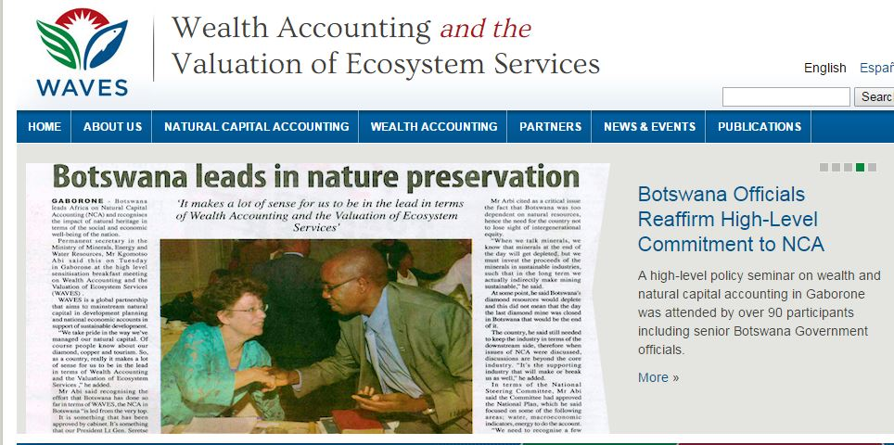
CONTRIBUTING FACTORS
High level buy-in
DWA changed mandate towards IWRM
Stakeholder buy-in: WUC, BCM, SB, MoA MFDP, MMEWR
Support from local and international consultants through WAVES.

Slide 10
USAGE/BENEFITS FROM THE W.A
Community of WA practitioners.
Water Accounts data has been used to inform:
  National Water Master Plan Update, using smart water management.
  Botswana’s National Water conservation and Water demand management strategy.
  Sustainable Development Goal 6.4.1 and 6.4.2.
  Raw water abstraction strategy project.
  Catchment management committees.
  A Cost-Benefit Analysis Process of Water Demand Management as an Adaptation Strategy in the Limpopo River Basin.
Establishment of (better) linkages between key stakeholders.
Shared understanding among stakeholders for the need to allocate & utilize water efficiently.

Slide 11
CHALLENGES
There is a need for accredited training/capacity building on environmental economics.
Need for a better data management platform.
Gaps still exist for other self providers.
Waste water estimates should be improved.
Agriculture data (irrigation) can be further improved.

Slide 12
Country National Plans
Priority areas for NDP11 includes Sustainable use of Natural Resources and will focus on improving the following;
Water Supply: Funding for construction of various pipelines, rehabilitation of water treatment plants and implementation of emergency water projects to provide adequate water
The Botswana National Water Master Plan Review and its related legislation (BNWMPR) which provides a guide on national water demand, use, and development strategies to give more perspective on emphasis on the role that trans boundary water resources play in Botswana’s water security as the country will depend heavily on international waters.
Electricity Supply: A comprehensive renewable energy strategy which is aimed at attracting domestic and foreign investments is being developed

Slide 13
National plan continued;
the water accounting component of the natural capital accounting, provided information about water supply and use (flow accounts) as well as costs and revenues (monetary accounts) in order to improve the performance indicators and management of the resource. The information assisted in the monitoring of the IWRM/WE Plan, the National Water Master Plan and the Water Policy

Slide 14
FUTURE ASPIRATIONS
Quantification of Waste Water
Compile Physical Stocks for small streams and small dams
Quantification of Ground Water Stocks
Expansion of Water Accounts to include soil moisture experimental accounts
Water Quality and Water Emission Accounts

Slide 15
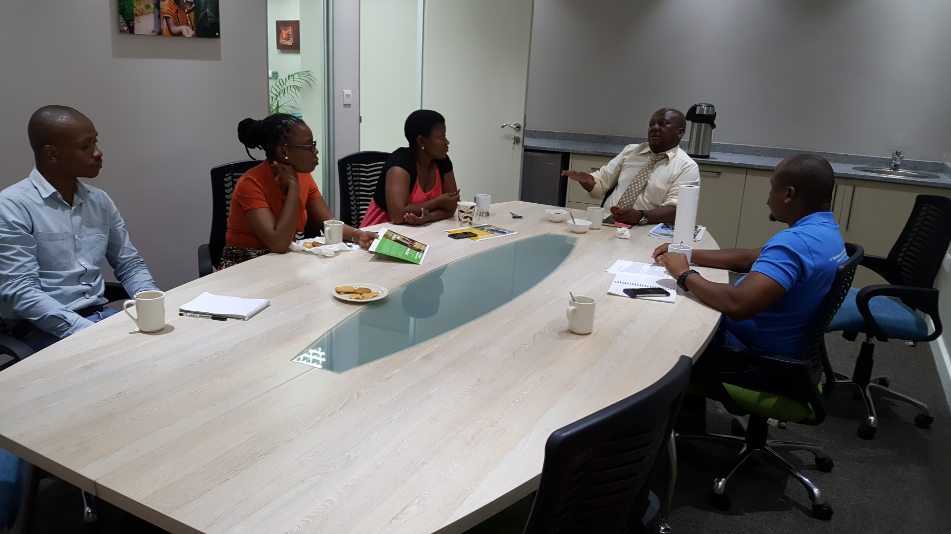
THE END!
THANK YOU

