Slide 1
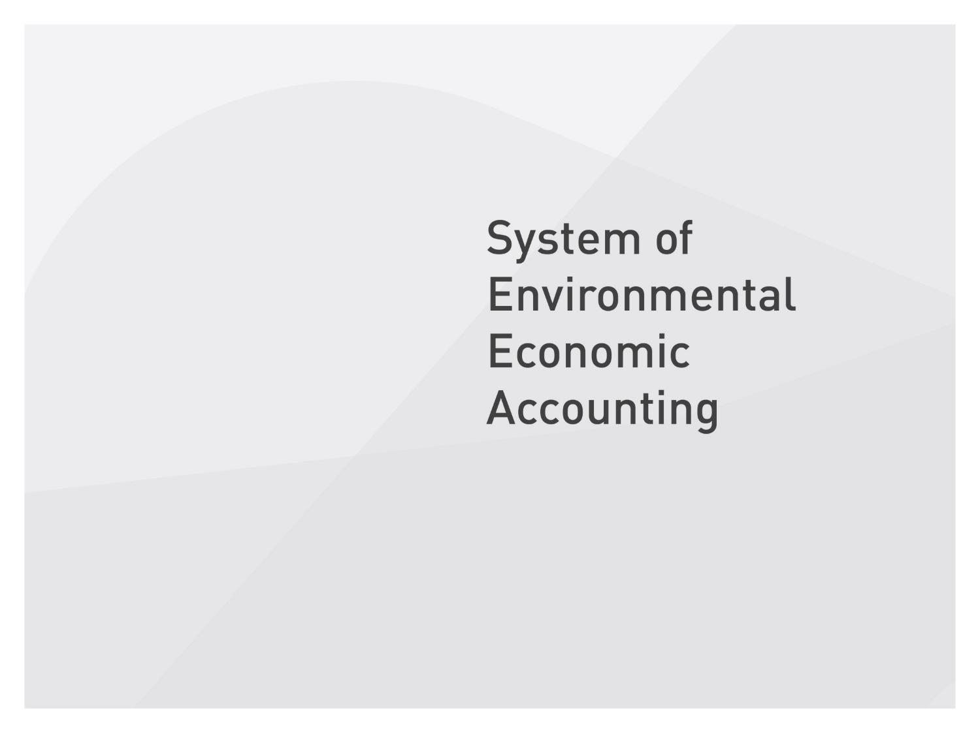
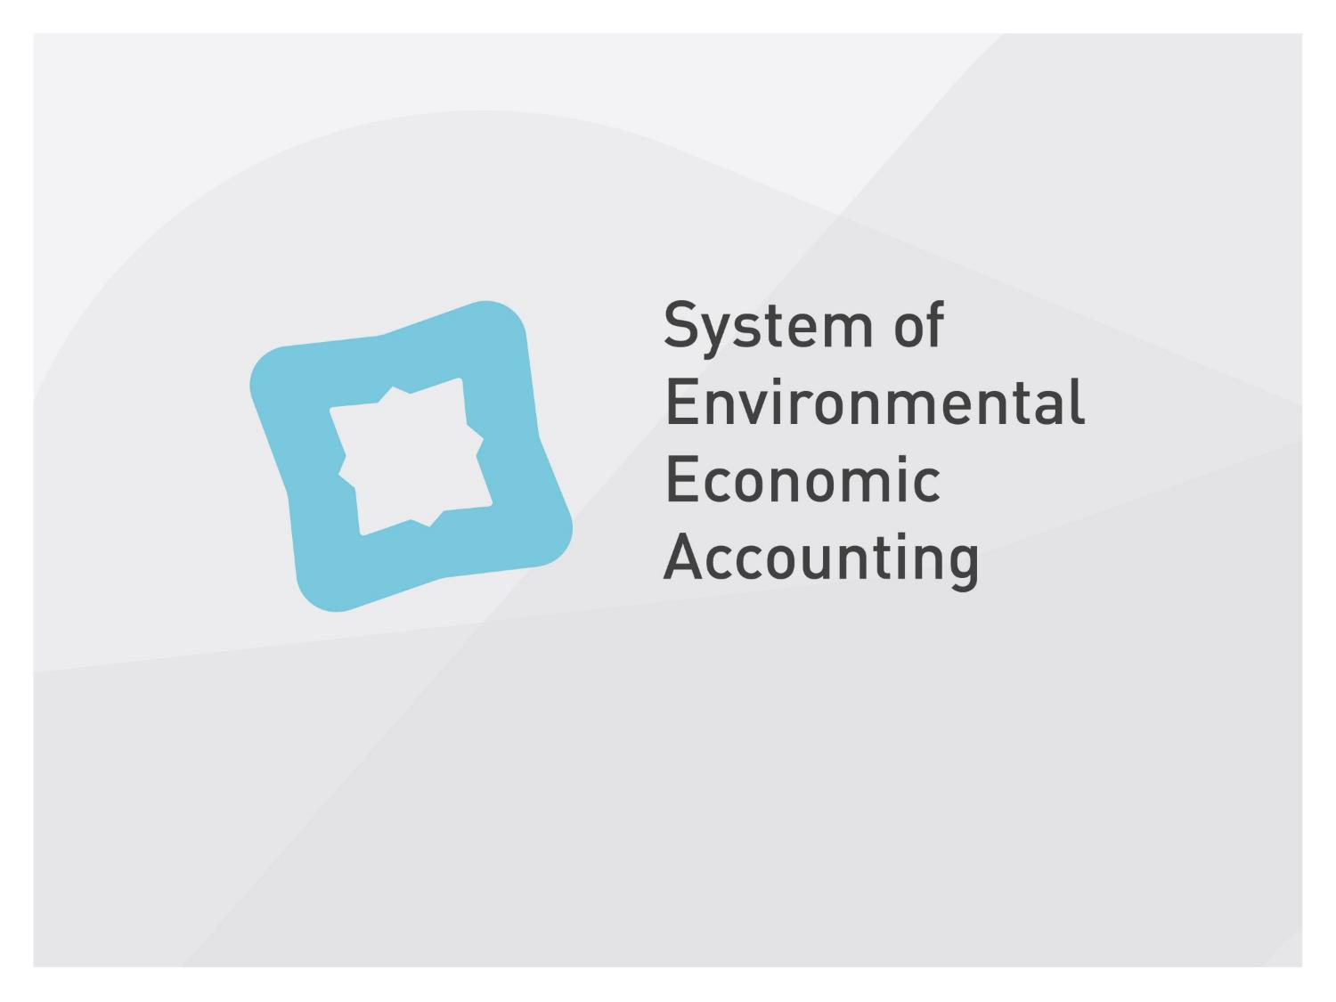
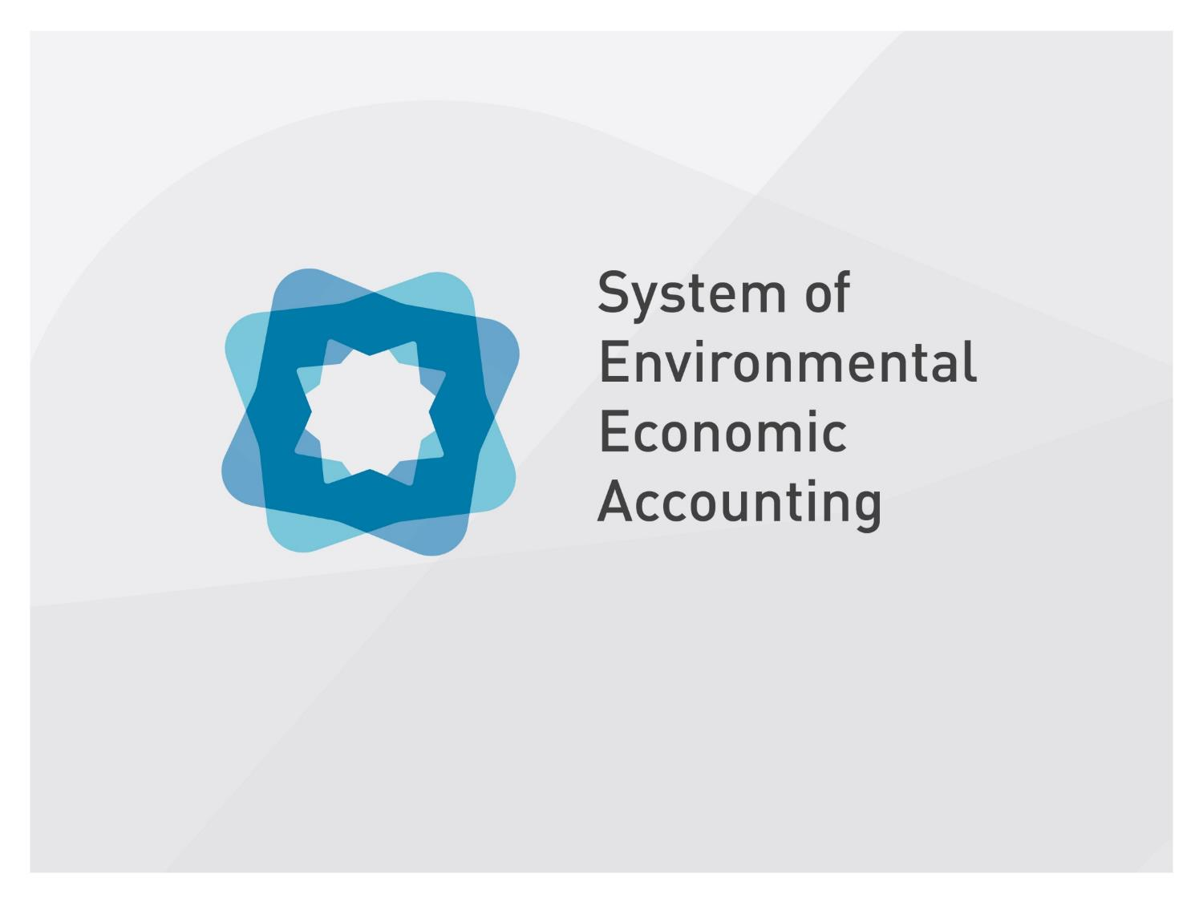
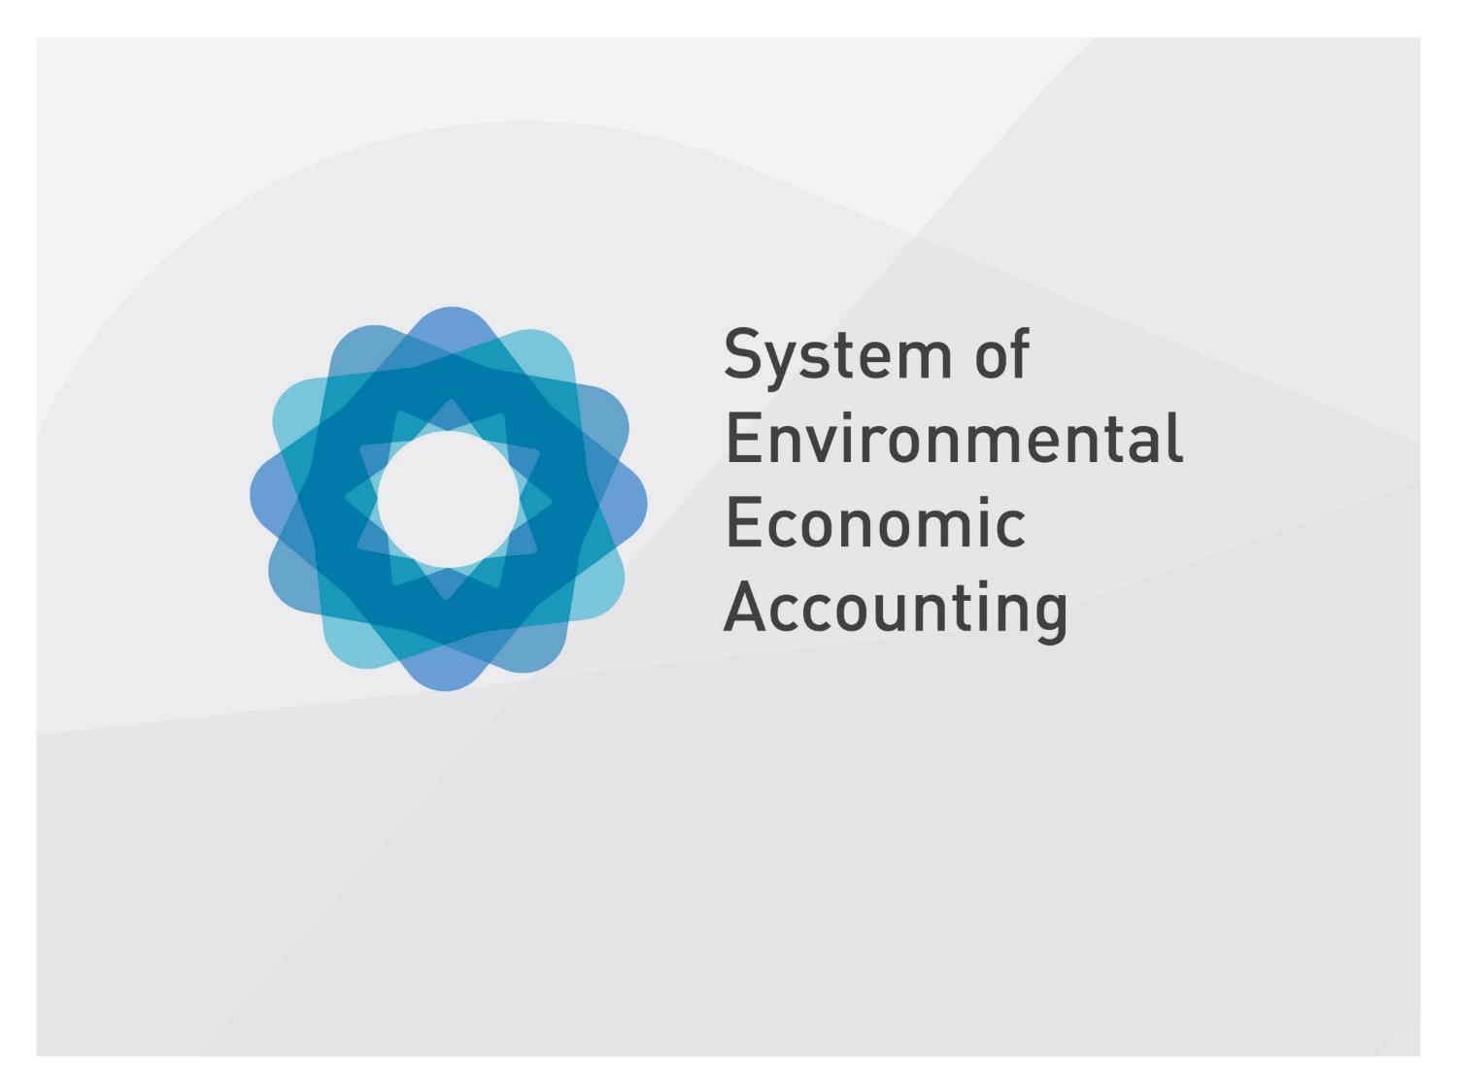

Slide 2
Natural Capital Accounting: Connecting the Pillars of Sustainability
Side event at the United Nations Statistical Commission 2019
Bert Kroese
Chair of the United Nations Committee of Experts on Environmental-Economic Accounting (UNCEEA)

Slide 3
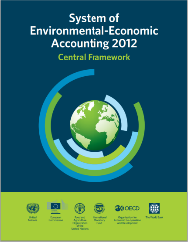
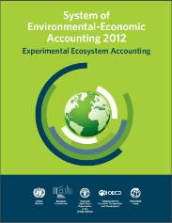
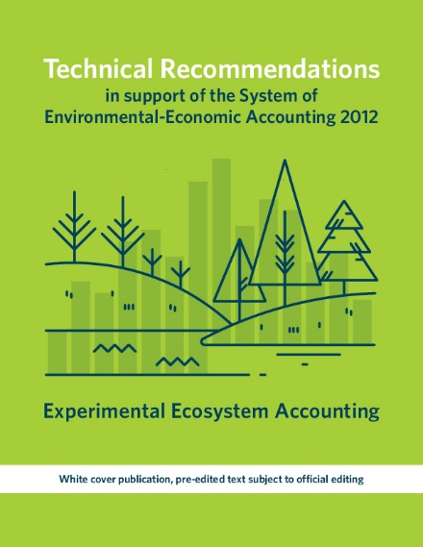
The System of Environmental-Economic Accounting (SEEA)
An internationally agreed statistical framework to measure the environment and its interactions with economy.
The SEEA Central Framework was adopted as an international statistical standard by the UN Statistical Commission in 2012
The SEEA Experimental Ecosystem Accounting complement the Central Framework and represent international efforts toward coherent ecosystem accounting
  Technical Recommendations (2017) present updates and extensions of ecosystem accounting concepts, methods and structure, and providing practical guidance on its implementation
SEEA EEA Revision by 2020
Notes:
The SEEA records as completely as possible the stocks and flows relevant to the analysis of environmental and economic issues. An accounting approach distinguishes the SEEA from independent sets of statistics on environmental and economic issues because it demands coherence and consistency with a core set of definitions and treatments. As such, the SEEA provides a framework to combine a wide range of data to create aggregates, indicators and trends across the broad spectrum of environmental and economic issues.
The SEEA has its roots in the System of National Accounts (SNA), from which the key economic indicator Gross Domestic Product (GDP) emerges. The System of National Account is a system approach to measure the stock of economic asset and the economic activity and transaction among different economic actors including household, enterprise, government, etc. The SNA also provides estimates of wealth, via the compilation of national balance sheets. The SNA identifies standard industries (e.g. agriculture, mining, manufacturing, transport, education, finance, etc.) as well as sectors (public, private, not-for-profit and households). Information from the national accounts can be re-arranged to show other industries, some of which are particularly relevant to ecosystem accounting such as tourism.
The SEEA extends the measurement boundaries of the SNA beyond economic consumption, production and ownership and records environmental data in both monetary and physical units (that is, hectares, megalitres, parts per million, petajoules, etc.).
The SEEA Central Framework was adopted as an international statistical standard by the United Nations Statistical Commission in 2012.
The SEEA Experimental Ecosystem Accounting was released by the same body the following year.

Slide 4

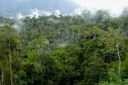
SEEA – two sides of the same coin
Individual environmental assets & resources:
Timber
Water
Soil
Fish
Ecosystems: Biotic and abiotic elements functioning together:
Forests
Lakes
Cropland
Wetlands
SEEA Central Framework (SEEA-CF) starts with economy and links to physical information on natural assets, flows and residuals
SEEA Experimental Ecosystem Accounting (SEEA-EEA) starts with ecosystems and links their services to economic and other human activity
Together, they provide the foundation for measuring the relationship between the environment, and economic and other human activity
Notes:
The Central Framework and the EEA represent two different perspectives of measuring the environment.
The CF takes the perspective of the economy, looking at individual environmental assets in terms inputs of given natural resources into the economy, use of given environmental products within the economy, and associated flows back to the environment. Examples of such environmental assets include water, timber, mineral and energy resources.
Environmental assets are the naturally occurring living and non-living components of the Earth, together constituting the biophysical environment, which may provide benefits to humanity.
The EEA complements this by taking the perspective of ecosystems, looking at how individual environmental assets and ecosystem characteristics function as part of a system of natural processes. These systems, or ecosystems, are considered within a spatial area.
Ecosystems are a dynamic complex of plant, animal and microorganism communities and their non-living environment interacting as a functional unit
In general, a simple way to understand the different perspectives is that Ecosystem assets are environmental assets as viewed from a systems perspective.
NOTE:
These approaches are complementary because a complete accounting for environmental assets requires both the SEEA Central Framework and SEEA EEA, as not all individual environmental assets function within ecosystems. An example of this is mineral and energy resources. In addition, in order to measure ecosystem condition in the SEEA EEA, information contained in the SEEA Central Framework asset accounts for individual resources, such as water or timber resource, is very useful.

Slide 5
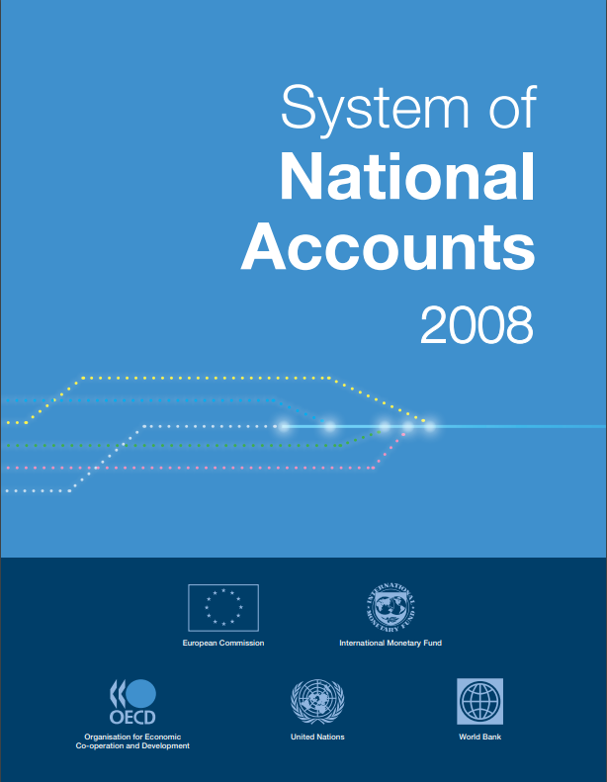
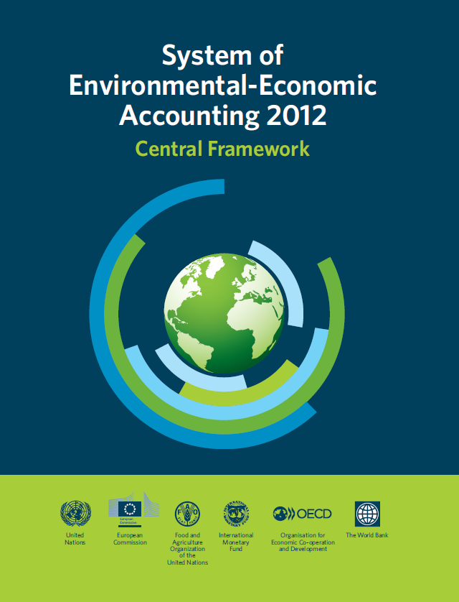
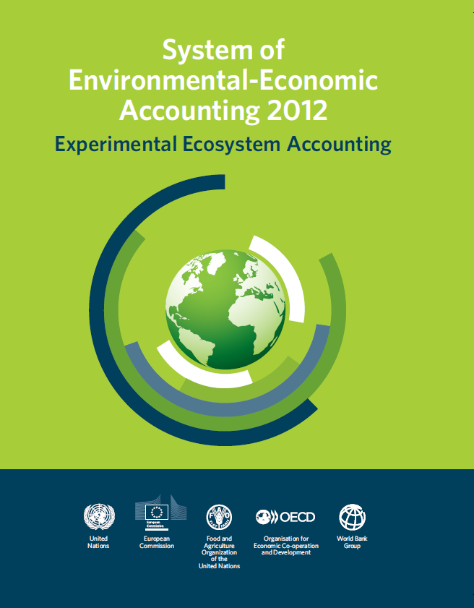
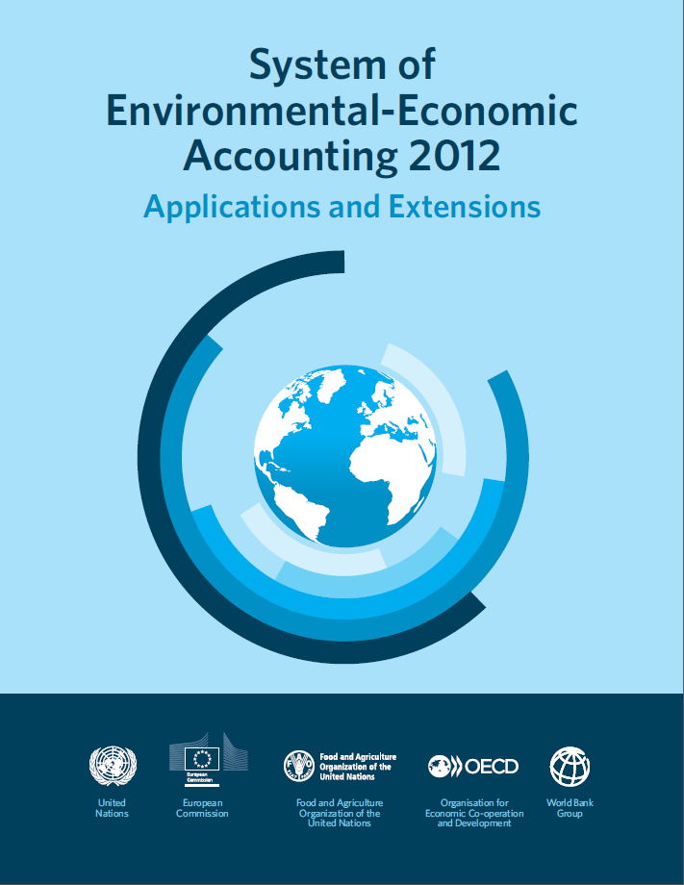
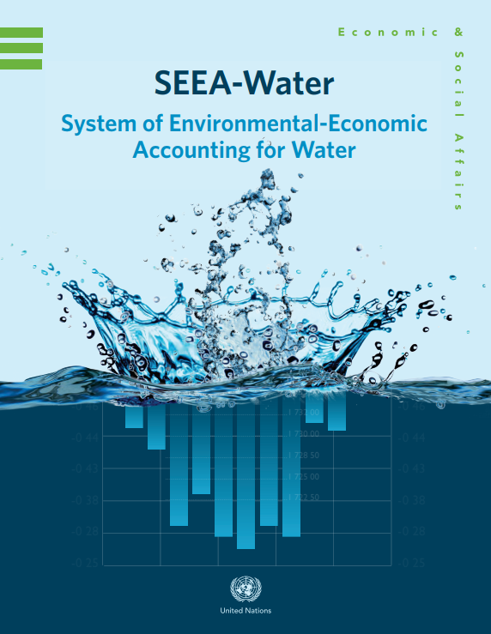
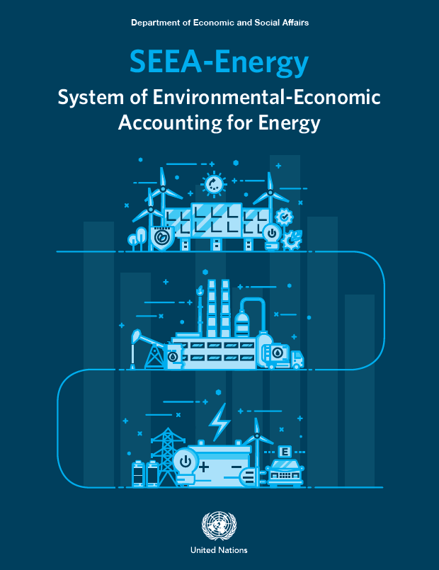
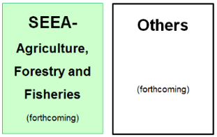

The SNA and SEEA: Systems of integrated information

Slide 6
SEEA Experimental Ecosystem Accounting
POLICY AND DECISIONMAKING
ENVIRONMENTAL-ECONOMIC ACCOUNTING
Measurement
Valuation
Asset
Classifying ecosystem types
Extent
Condition
Measuring ecosystem health
Services
Flow of
services to beneficiaries
Benefits
Value of the benefits people receive

Slide 7
SEEA as Supporting Framework
SEEA
WAVES
TEEB
BIOFIN
Green
Economy
Aichi Targets
SDGs
Notes:
Develop agreed methodologies on Ecosystem Accounting to:
Support SDG monitoring – e.g., support indicator 6.3.2 on “proportion of bodies of water with good ambient water quality”
Inform the Post-2020 Biodiversity Framework (new Aichi targets)
Inform the discussion on Climate Change
Demand for a statistical framework for natural capital accounting is strong
Scientific, economic and geospatial communities have been mobilized and are committed to support the statistical community

Slide 8
Revision of the SEEA EEA
Scope of the revision
  Agreed concepts, definitions and methodologies
  Wide engagement of various communities
Research agenda for the revision
  Spatial units
  Ecosystem condition
  Ecosystem services
  Valuation and integration into the accounts
  Cross cutting issues: ocean, urban, freshwater accounts
Timeline of the revision
  Started in 2018, to be finalized by the end of 2020 and submission to UNSC in March 2021

Slide 9
Scope of revision of the SEEA EEA
Elevation to an agreed methodological document – international statistical standard
Engagement with various stakeholders – wide engagement of various communities, including ecologists, environmental economists, etc.
Obtaining buy-in – national statistics and other communities
Launched in March 2018 with the aim to finish by the end of 2020 – for endorsement by UN Statistical Commission in March 2021
Seek for broad involvement of partners and experts in the process – in less than a year over 80 experts contributed to drafting of the discussion papers
Process aligned with the Post-2020 biodiversity framework, review of SDG and Climate change process

Slide 10
Research agenda for the revision
Revision structured around four research areas:
  Spatial areas: Classification of ecosystem types
  Ecosystem condition: Characteristics and indicators of ecosystem condition
  Ecosystem services: The description and classification of ecosystem services
  Accounting treatments and valuation:
    Valuation concepts for ecosystem services and ecosystem assets
    Valuation methods for key ecosystem services
    Accounting for ecosystem capacity, degradation and enhancement
There is also a number of crosscutting domains, such as oceans and marine ecosystems, freshwater ecosystems, urban ecosystems, etc..
Testing and experimentation of specific topics (e.g., SDG indicator 6.6.1 on freshwater extent and 6.3.1 on land degradation, etc.)

Slide 11
Revision process: keystones & timeline
Establishment of four Working Groups according to the research issues
January 2018
Broad consultation of the revision issues
March 2018
Establish discussion paper topics and draft work plans at the 2018 Forum of Experts
June 2018
Form Expert Review Groups
July 2018
Progressive drafting and review of individual discussion papers
Dec 2018
Discussion papers discussed at the 2019 Forum of Experts
Feb 2019
Expert review of the discussion papers and their finalization
June 2019
Establishment of the Editorial Board to oversee the drafting of the chapters
Drafting of SEEA EEA draft chapters and rounds of Global Consultation
May 2020
Final 2020 Forum of Experts
Sept 2020
SEEA EEA is finalized for discussion at UNSC
Dec 2020
Notes:
No need to discuss all the different events and milestone but more to say that there are a lot of activities going on with various subgroups working on the revision process. The idea is to put the issue on the tables and then develop the SEEA EEA as a statistical document with agreed concepts, methods definitions and classificaitons.

Slide 12


Natural Capital Accounting and Valuation of Ecosystem Services (NCA&VES) project
Implementing partners
  United Nations Statistics Division
  United Nations Environment Programme
  Secretariat of the Convention on Biological Diversity (CBD)
Sponsor
  European Union through a Partnership Instrument
Five partner countries
  Brazil, China, India, Mexico, South Africa
Project duration
  4 years from 2017-2020

Slide 13


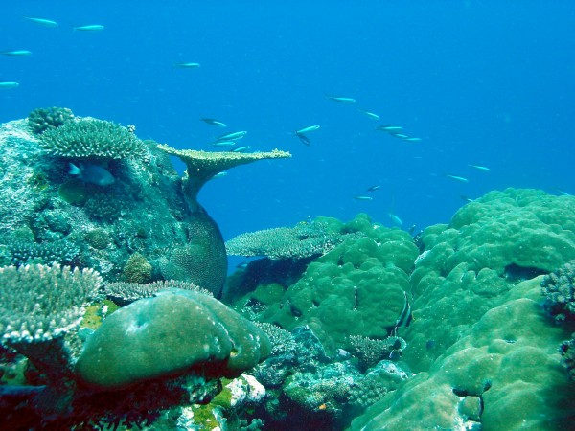
Overall objectives
Advance the knowledge agenda on Natural Capital Accounting, in particular ecosystem accounting
By initiating pilot testing of SEEA EEA, with a view to:
  Improve measurement of natural biotic resources, ecosystems and their services at the (sub)national level
  Mainstream biodiversity and ecosystems in (sub)national level policy-planning and implementation
  Contribute to the development of internationally agreed methodology and its use in partner countries.

Slide 14
SEEA around the World
Target:
  100 countries implement the SEEA Central Framework by 2020
  50 countries test the SEEA Experimental Ecosystem Accounts by 2020
Global assessment is undertaken every 3 years
Progress is tracked on a yearly basis through informal consultation with donors, international agencies, recipient countries, etc.
28%
increase in number of countries with a programme from 2014 to 2017
Currently over 80 countries have compiled SEEA accounts

Slide 15
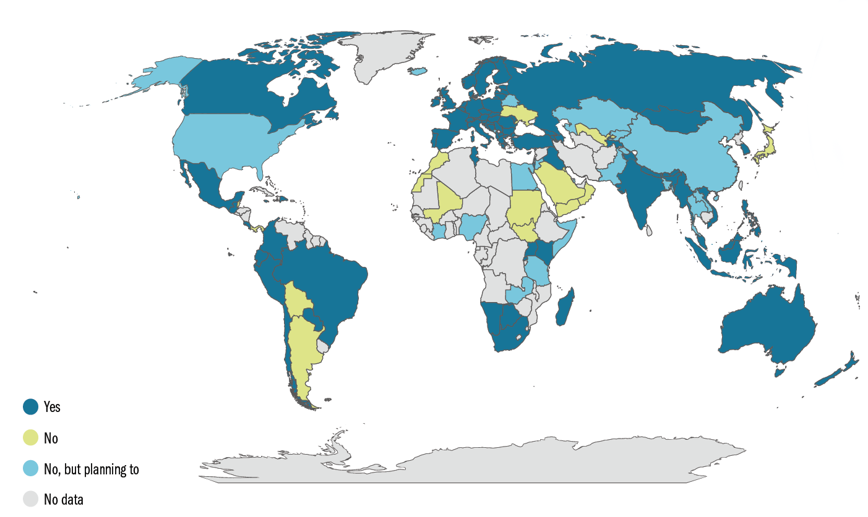
Status of the implementation of SEEA
80 countries and counting are compiling SEEA accounts

Slide 16


