Slide 1
Supporting African countries in developing and strengthening environmental-economic accounting
Jackie Crafford
Consultant to the United Nations Statistics Division
13 December 2017

Slide 2
“A Perfect Storm?”
Most African economies are highly dependent on natural resources
Agriculture – “the rule of 30”
Energy – Oil, gas
Mining
Informal economic activity
A rapidly changing future:
Urbanisation
Commodity price pressure
Resource scarcity
A large dependence of the economy on:
Natural capital
And its benefits
Key natural resources:
Energy
Fish stocks
Forests
Minerals
Water

Slide 3

Hot off the press
Rand Merchant Bank

Slide 4
Statistics for sustainable development
Sustainable Development Policy
Integrated
Evidence Based
Integrated Information System
Applies a uniform standard approach
Captures synergies and trade-offs
Integrates environmental, economic and social information
Notes:
Sustainable Development Policy should:
Take an integrated approach: Policy should be based on a better understanding of interactions and tradeoffs between the different realms of sustainability
Be based on evidence: Policy should, to the greatest extent possible, be informed by rigorously established evidence
To achieve this, an information system is needed to support policy analysis and decisions, which provides integrated information on;
The multiple issues relevant to sustainable development
The interconnections between these issues
Recognising and understanding these synergies and building them into sectoral policy analysis and design is made difficult by the fact that the information on food production, water and energy is produced within sectoral silos.
These initiatives for sustainable development raise a number of challenges and priorities for Statistics.
In particular, the implication for the statistics is that we need to work towards developing an information system to support integrated policy which captures the connections and trade-offs between the different environmental, economic and social variables associated with the SDGs.

Slide 5

International statistical standard
The SEEA Central Framework was adopted as an international statistical standard by the UN Statistical Commission in 2012
The SEEA Experimental Ecosystem Accounting complements the Central Framework and represents international efforts toward coherent ecosystem accounting

Slide 6
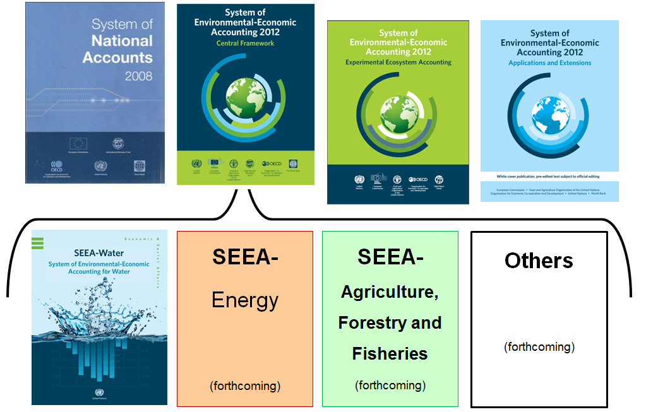
The SNA and SEEA: Systems of integrated information
Notes:
The SEEA has a number of different components.
First there is the SEEA Central Framework which is an international statistical standard to measure the environment and its relationship to the economy. It is fully consistent with the SNA which is the standard to measure the economy, and is essentially a satellite account of the SNA o extend to the environmental dimension.
The SEEA CF has various subsystems, which serve to provide more detailed guidance on accounting for specific environmental assets. Water is the most established, and energy is in the process of being finalized. FAO and UNSD have also developed a SEEA-AFF and is currently under global consultation. More will be developed in time.
Other modules will be developed in due course depending on policy need. In addition, technical notes are being developed to provide more detailed guidance about accounting for specific topics.
In addition, we have the SEEA EEA which is still in the experimental stage, and represents a synthesis of current knowledge on ecosystem accounting.

Slide 7
Ecosystem Services:
Classification Systems
Millennium Ecosystem Assessment (http://www.millenniumassessment.org/en/Index-2.html)
The Economics of Ecosystems and Biodiversity(TEEB) (http://www.teebweb.org/)
International Classification of Ecosystem Services(CICES) (http://cices.eu/)
United States final ecosystem goods and services(US-FEGS) (http://unstats.un.org/unsd/envaccounting/seeaRev/meeting2013/EG13-3-FEGS.pdf)

Slide 8

Challenges
“Unconventional” national accounts
“Unconventional” data sources and onerous data mining processes (initially)
Unique production processes
A new product
Resource constraints within statistical agencies

Slide 9
Theory of Change
Participative
  Multi-disciplinary
  Partnerships with data providers
  EEA user requirements
Evolutionary approach built on existing institutional arrangements
  Building on significant skills set in the region
  Data partnerships and data mining
  Building on existing reporting initiatives
  Data quality assessment system
Technical guidelines focusing on simplicity and user applications
  Developmental approach through a piloting process
  Innovative and smart applications

Slide 10

Assignment: Summary of lessons of success
UNSD assistance to Kenya Bureau of Statistics
UNSD assistance to Uganda Bureau of Statistics
Combined with experience from UN Environment in:
  Kenya, Morocco, Gabon, Côte d’Ivoire, Nigeria, Uganda
Combined with lessons from other countries

Slide 11
Principles for successful SEEA implementation
Mandate
Readiness
Policy imperative
Application
Publication pathway
Timeframe and timing
Human Resources
Structure / architecture
Data availability
Developmental process

Slide 12
Mandate – No confusion
Can we imagine life without a country statistical office?
  What would the Central Bank do?
  What would international investors do?
  How many jobs would politicians promise?
  What would rating agencies do?
  How would we develop policies and measure progress?
Country statistical office need to be mandated, via Statistics Act, or similar instrument to:
  Collect and publish official data that
  Enable environmental accounts
Risks
  Lack of collaboration
  Lack of data sharing

Slide 13
Statistical Office Readiness
Country statistical offices are often under budgetary pressure
Conventional National Statistics deliverables takes precedence
Therefore sufficient priority for SEEA implementation has to exist
  Interest
  Resources
  Capacity

Slide 14
Policy imperatives
Political priority is a large driver of demand for SEEA
  Kenya: Energy security, Deforestation
  Uganda: Water resource efficiency, Deforestation
  South Africa: Water security, -equity, -tariffs, Energy security, Mining resource depletion
  Côte d’Ivoire: Cocoa production and deforestation
  Morocco: Desertification, climate change
  Nigeria: Extreme deforestation
  Gabon: Economic development
Environment is for people
Policy intent:
  Strategic to support policy design and development
  Tactical to support policy instrument development

Slide 15

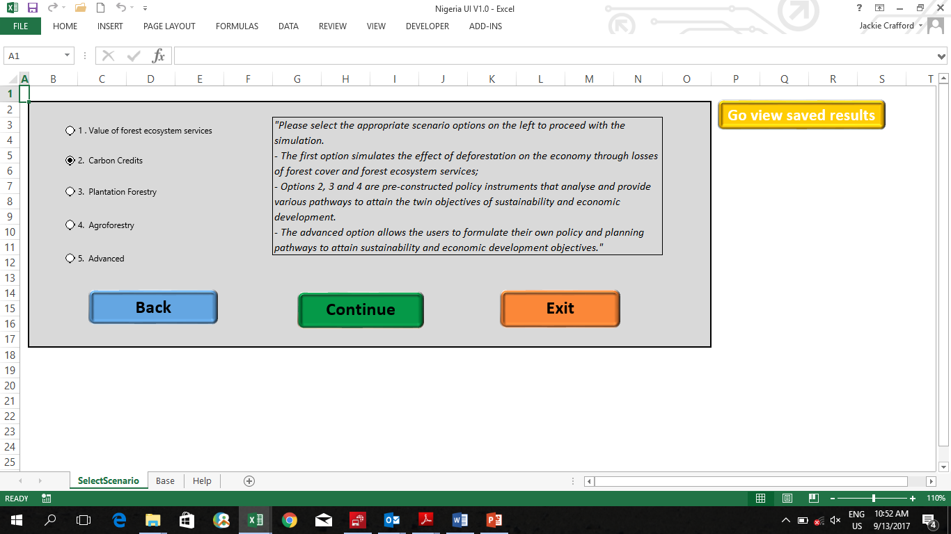
Applications
Publication: regular and relevant
Toolset
Value add to physical data
Inputs into: SDG reporting, apply to key policy questions
http://pursuitmag.com

Slide 16
Publication Pathway
Publication process is an institutional process
Evolutionary publication process that builds on existing institutional process
  Timeframes
  Quality Control
  Budgets
E.g. “Statistical Survey”, “Economic Survey”
Progressing to: “Compendium of EEAs”
Value added applications

Slide 17
Human resources
Consider capacity within statistical office
Technical skills within statistical office
Experience of compiling EEAs, especially because each EEA is so unique
Entrenching EEAs though KPAs

Slide 18
Structure / Architecture
Policy and data relevant
Decisions on:
  Stock and/or Flow
  Physical and/or monetary
  Quality / ecosystem services
Sources and methods document
User-friendly and National Accounts compatible
Applications and policy relevance

Slide 19
Data availability
EEAs require non-traditional data sources to be incorporated into official statistics
  Data availability
  from line ministries
  From data mining within statistical agency
Classification – align domain-specific classification with ISIC, and formalize these definitions
Data quality assessment – to enable publication to proceed in absence of perfect data, and also to ensure continuous improvement of data quality
Frequency of reporting – ideally data need to enable annual reporting update

Slide 20
Developmental process
Piloting, prototyping
On the job “training”
Use of technology:
  Remote sensing
  Visual Basic programming
Regional cooperation and sharing of experience

Slide 21
Goal and Output: Identify and publish priority accounts
Simplified Log Frame
Summary | Indicators | Outputs and Impacts
Enabling factors | Assessment of principles UNSD enabled NPAEEA launch | Mainstreamed EEAs
Participation | Technical Working Committees / Data Forums
Action Plan | Policy relevant architecture Data mining (line ministries and own) Prototyping Technical quality control Publication Continuous improvement

Slide 22
Participation
Actors
Statistical Agency
Political Leadership
Data providers
Data users
Mandates, roles, responsibilities to be carefully considered AND Intensive and constant consultations necessary
Statistical office to coordinate the implementation of the plan; compile and publish the EEAs
Political leadership: at the highest level will be to give policy guidance and allocate resources
Data providers: Technical Working Groups or Data Forums to be convened as sub-committees, ideally out of the existing committees, or out of new committees; MOUs; data providers training required
User requirements carefully considered, user training required

Slide 23
Action Plan
Building priority accounts:
    Design architecture - application of concepts, classification, and standards
    Data inventory and data mining
    Data quality control
    Prototyping and piloting
    Verification by TWGs
    Publication
    Evolutionary approach
    Develop applications
Capacity development:
    Regional networking
    Technical support during prototyping
    Training and application workshops for users

Slide 24
Outputs
Pilot accounts for priority accounts
Sources and methods guideline
Publication of accounts
Additional or improved indicators for policy priorities
Publicly-available environmental-economic information

Slide 25
Impacts Outcomes
Environment-economic accounts mainstreamed into planning and decision making
Sustainable statistical infrastructure with integrated data
A civil service and civil society that is informed about environment and development
Improved statistical collaboration among government agencies and public-private cooperation
Better policies, decisions on trade-offs between development and environment
A set of integrated environmental-economic accounting information
Enhanced institutional coordination within Kenya
Increased technical and decision-making capacity development
Key aggregate macro-environmental statistics and indicators

Slide 26
Recommendations
Participation
Evolutionary approach built on existing institutional arrangements
Technical guidelines focusing on simplicity and user applications

Slide 27
Recommendations - Participation
Statistical Agency
Political Leadership
Data providers
Data users
Regional collaboration
UN Agency collaboration
Participative approach
  Multi-disciplinary
  Educating data providers
  EEA user requirements
Continued technical training of compilers
Capacity development under data providers and EEA users
Regional collaboration forum for sharing of experience, both formally and tacit sharing

Slide 28
Recommendations – Developmental
Evolutionary approach built on existing institutional arrangements
  Recognize and build on significant skills set in the region
  Data
    Data partnerships with line Ministries – prevent duplication, improve data quality, reduce budget burden
    Data mining – Statistical offices are custodians of vast amounts of official data which may be useful
    Feedback back into questionnaire design
    Data quality assessment system – Quality assessment framework with a practical classification system for non-official data
  Pursue annual update, ideally aligned with existing publication initiatives

Slide 29
Recommendations – Technical guidelines
Examples:
UBOS – Green Growth Development Strategy
KNBS – Need for an Energy Balance by the Energy Regulatory Commission
StatsSA – Annual publication of detailed SUTs, interest in disaggregation of water sector
Technical guidelines focusing on simplicity and user applications
  Developmental approach through a piloting process
  Complimentary with existing initiatives and needs, allowing for intuitive and complimentary approaches
  Sources and methods documents
  Regional collaboration forum to share experience
Efficient use of limited resources (staff and budgets)
Need to build experience, build confidence and share tacit knowledge
Need to institutionalize the know-how required for EEA development

Slide 31
Recommendations to UNSD from the Region
Continue the good work, thank you. In addition:
Continued technical training of compilers
Capacity development under data providers and EEA users
Regional collaboration forum for sharing of experience, both formally and tacit sharing
Organizational integration to support development of applications of EEAs (e.g. policy instrument development, FDES)
Technical recommendations:
  Sources and methods guidelines
  Data quality assessment framework

