Slide 1
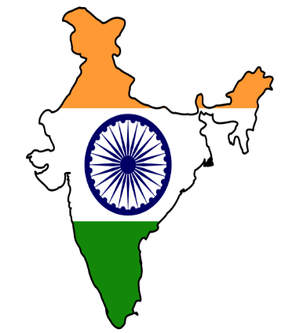
Environmental-Economic Accounting in India
(Natural Capital Accounting & Valuation of Ecosystem Services)
Ministry of Statistics and Programme Implementation (MoSPI)
Government of India
Notes:
Presentation on the Activities taken for environmental economic accounting in India, especially under the project on Natural Capital Accounting & Valuation of Ecosystem Services

Slide 2
Natural Capital Accounting & Valuation of Ecosystem Services
EU-funded Project launched by UNSD on pilot basis in five countries
UNSD, UN Environment, CBD & MOSPI
To encourage and enable greater consideration of natural assets, and the services they provide, in monitoring and planning related to economic activity
Main objective is to mainstream natural capital accounting and valuation of ecosystem services in data-driven decision and policy-making

Slide 3
Earlier activities
Expert Group on “Green National Accounting for India” constituted in 2011 under Sir Partha Dasgupta to implement SEEA in India.
Inter Ministerial Group (IMG) constituted in January 2015 as a collaborative mechanism
  To assess different aspects of data available – timeliness, accuracy, level of disaggregation
  To recommend measures for improving the quality and coverage of data and strengthening the existing data systems
  To identify agencies which can help evolve methodologies for valuation of stocks of natural assets
Notes:
Parties in the Inter-Ministerial Group: Agriculture / EF&CC / Water Resources/ Land Resources/ Mines/ P&NG/ Power/New & Renewable Energy /Earth Science/ Coal/ CPCB/ FSI/ BSI/ ZSI/NRSC

Slide 4
EnviStats-India 2018
Supplement on Environmental Accounts
First official publication based on SEEA released in September 2018.
Provides asset accounts in physical terms for
  forest, land, minerals and water
  at National and State-levels
Depicts aggregate changes in the cohort of environmental assets of States
http://www.mospi.gov.in/publication/envistats-india-2018-supplement-environmental-accounts-0
Notes:
Analysis of changes in assets can help policy makers identify areas warranting focused interventions for taking remedial action and evaluation.

Slide 5
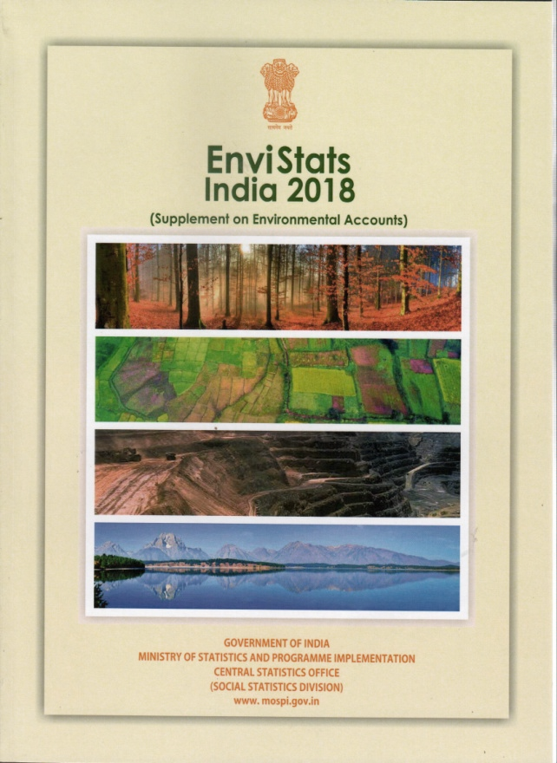
EnviStats India 2018
Supplement on Environmental Accounts
Land account – land cover: stock and change over 2005-06 and 2011-12
Mineral account – proved and probable reserves, remaining resources: 2005, 2010 and 2015
Water account – availability in river basins and groundwater
Forest accounts – forest cover, growing stock of timber and carbon: 2004-05, 2010-11 and 2015-16

Slide 6
Highlights of the Asset Accounts
Mixed signals being observed in the different assets making total assessment of natural capital difficult
Positive changes
  Change from fallow to farmland, increases in forest cover, carbon stock, proven reserves and resources of minerals
Effect of climate change
  Fluctuations in land under ‘snow and glacier’ and ‘wetlands/water bodies’
Urbanization
  Increase in built-up area - in some cases, at the cost of farmland
Decline in resources
  Growing stock in some States and groundwater resources

Slide 7
Initial Activities undertaken under the Project
October 2017 to July 2018:
Interaction with different agencies on activities to be taken up under the project
Stock-taking landscape assessment of
  existing ecosystem accounting initiatives and literature in India
  data sources for compiling ecosystem accounts
  institutions and agencies active in this field
  states where a detailed study for compilation of ecosystem accounts could be launched

Slide 8
Outcome of the Landscape Assessment
State of Karnataka selected for pilot on compilation of ecosystem accounts since
  Many studies conducted in the state on various ecosystem services;
  Presence of diverse ecosystems in the State;
  Good data availability especially in terms of geo-spatial datasets; and
  Strong technical capacity with institutions like Indian Institute of Science
  Efforts underway to complete the modalities to launch the survey

Slide 9
Current Activities under the Project
Notes:
Presentation on the Activities taken for environmental economic accounting in India, especially under the project on Natural Capital Accounting & Valuation of Ecosystem Services

Slide 10
Soil Accounts
Relevant in the Indian context with more than 250 million earning their livelihood from agriculture
For farmers, soil is the asset which limits production and defines farm investment performance
Soil fertility assessment vital for determining nutrient requirement for desired production
Soil health and quality of concern since objective is to double farmers’ income by 2022
Several programmes launched to address soil health and quality
  Distribution of Soil Health Cards –106 million cards issued during 2015-17
Soil condition accounts can help in
  identifying land covers susceptible to change and soil resources most at risk
  Balancing between soil erosion and production
Notes:
Census 2011 – 118.7 million farmers and cultivators; 144.3 million agricultural worker/labourer
Other schemes related to agriculture –
Nutrient-based subsidy(NBS) policy for P and K fertilizers,
Paramparagat Krishi Vikas Yojna,
National Mission on Sustainable Agriculture,
National Water Mission,
National Mission for a Green India under NAPCC,
Mission for Integrated Development of Horticulture, and
National Mission on Oilseeds & Oil Palm etc.

Slide 11
Soil Accounts
Examining the proposal on ‘Development of Soil Condition Accounts’ using S-World Model
Discussion held with agencies maintaining data sets on soil in India
  National Remote Sensing Centre (NRSC)
  National Bureau of Soil Survey and Land Use Planning (NBSS&LUP) - mandated for soil resource inventory and land use planning at different levels.
  Soil and Land Use Survey of India (SLUSI) – mandated for providing scientific database for soil and water conservation planning and watershed development
Support sought – methodological details of the S-World model, associated software and operational guidelines
Notes:
Census 2011 – 118.7 million farmers and cultivators; 144.3 million agricultural worker/labourer
Other schemes related to agriculture –
Nutrient-based subsidy(NBS) policy for P and K fertilizers,
Paramparagat Krishi Vikas Yojna,
National Mission on Sustainable Agriculture,
National Water Mission,
National Mission for a Green India under NAPCC,
Mission for Integrated Development of Horticulture, and
National Mission on Oilseeds & Oil Palm etc.

Slide 12
Other Activities
Compilation of biodiversity accounts
Indicators for air and water quality
Compilation of following ecosystem services:
  Carbon sequestration (as part of climate regulation services);
  Nature based tourism related services (based on Domestic Tourism Survey and Tourism Satellite Accounts) ;
  Harvested living resources (agriculture – provisioning of crops and forestry); and
  Air filtration services.

Slide 13
Other Activities
Contemplating creation of a system similar to ‘Environmental Value Look-up’ Tool of UK-DEFRA
Possibility of leveraging on existing datasets
  Administrative
  Remote-sensing
  Surveys conducted by official agencies
  Research studies
Handholding required for examining their ‘fitness-for-use’

Slide 14
THANKS

