Slide 1

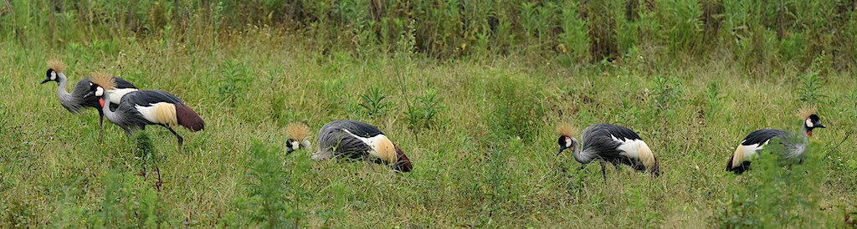

Natural Capital Accounting: Uganda Experience
Dr. Sam Mugume,
Macroeconomic Policy Department
Ministry of Finance, Planning and Economic Development
February 05, 2019

Slide 2
Overview of the presentation
Introduction
2. Natural capital accounting in Uganda.
3.Achievments
4. Challenges

Slide 3
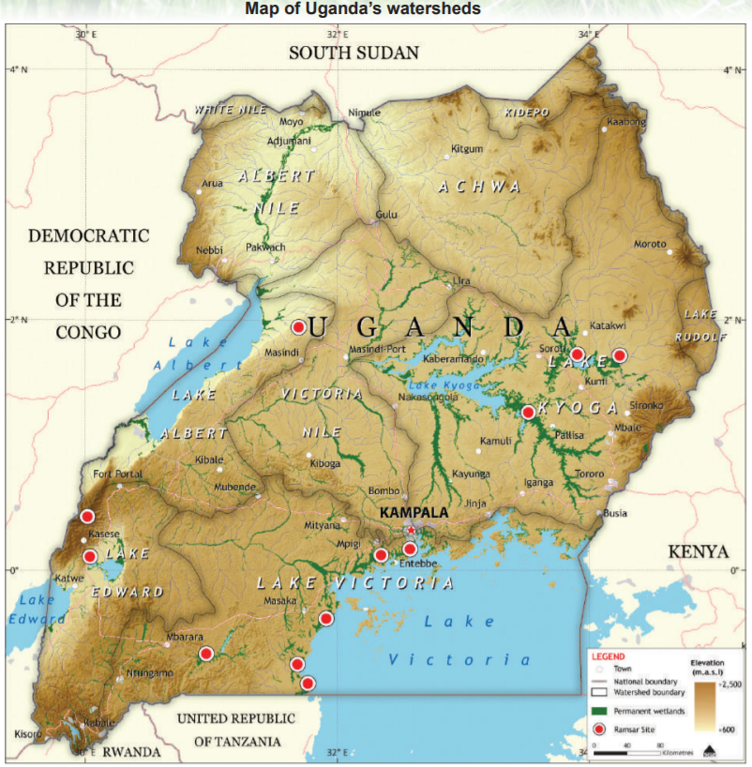
Introduction_ Facts about Uganda
Coverage,
Population: Approximately 40 Million. Popn growth rate 3.5%.
Confluence of 8 ecological zones
High biodiversity with endemic and threatened species; 364 mammals, 1062 birds
Main economic activity
Agriculture, heavily reliant on weather
High potentials for tourism development
80% of the population employed in agriculture sector
Population highly dependant on natural resources for survival
Forestry and wetlands very important in rainfall formation and climatic moderation. Habitat to endangered and threatened species
Economic development
Agriculture, forestry and tourism major contributors to GDP
GDP about 29 Billion USD
GDP growth rate 6.1% (2017/18) mainly dependant on agriculture
Challenges: Forest, wetlands; and other natural resources being depleted
Solution: Policy makers and technocrats to fully appreciate the contribution (direct and indirect) of Natural capital to development

Slide 4
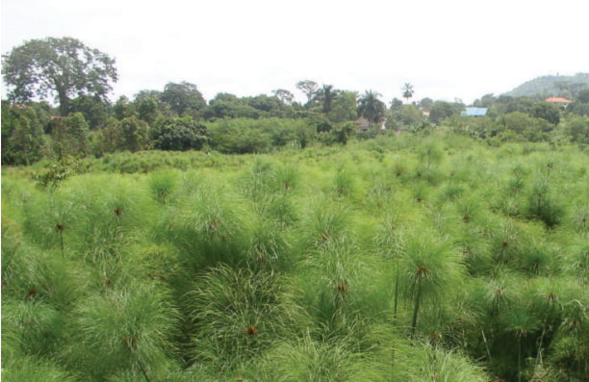
NCA in Uganda _Achievements
Forest account
Wetlands account
Species account
Land account

Slide 5
What has Uganda done in the past?
Feasibility study on Natural capital accounting such as 2004 and 2008
Forest and ecosystem accounts?
Experimental species account
Undertaken specialised studies such as the five year biomass study under National Forest Authority
Strategic environment assessment for Albertine region
Conducted National censuses of some endangered species such as chimpanzees, gorillas and elephants
A number of studies on natural capital by academic institutions

Slide 6
Findings from the initiatives
There is a lot of data available that remains unpublished
Forest loss by 89 percent between 1990 to 2015. Approximately 200,000 hectares every year with major losses on privately owned land
The biggest driver of deforestation and forest degradation is Agriculture
Forests in protected areas still intact but under intense pressure.
Endangered species are getting more threatened through degradation of their habitat by human activities
96% of electricity supply is from hydro power generation from River Nile which is a shared resource
Excessive dependency on biomass energy. Leading to degradation of endemic and endangered flora such as prunes African.

Slide 7
Some uses of findings
Government instituted a ban on the cutting of Shea and Prunus Africana tree species as these were considered endangered and are currently on the IUCN Red list
Continued effort to fund gazetted areas especially forest reserves in urban areas where there is a lot of pressure to degazzete them.
Increased efforts to protect endangered species such as chimpanzees and gorillas
Informing the the development of National Biodiversity Strategy Action Plan (NBSAP) which will in turn inform the next National Development Plan three (NDPIII)
Further facilitated efforts of Private Public Partnerships through promotion of commercial plantation development on public land and overall improved natural capital management

Slide 8
Existing challenges/gaps
Capacity on compilation, use, and communication of NCA
Work done so far by various agencies not well communicated to the relevant change agents including policy makers, policy implementers and natural resources users
Capacity in use of NCA in economic modelling and forecasting
Data gaps
Limited institution collaboration and coordination
Limited Enforcement

Slide 9
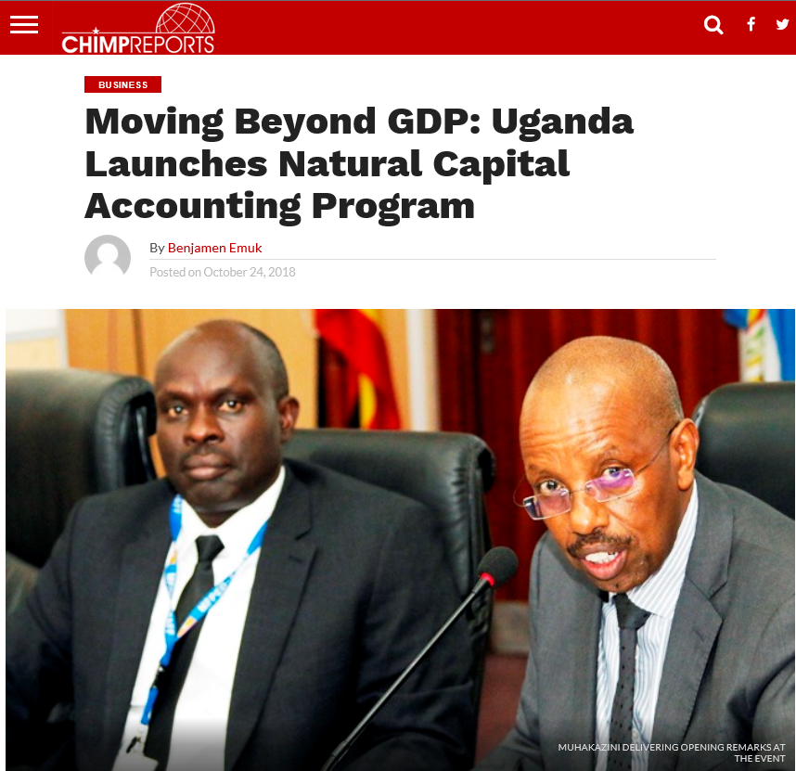
Major ongoing work: Forests and Wetlands in Uganda

Slide 10
Current focus in Uganda is on forests and wetlands.
What is the real contribution of natural assets and the ecosystem services to the national economy?
How does the economy and its sectors affect the natural asset base?
What is the impact of the informal forest economy on forests and wetlands?
What is the value of critical ecosystem services?
Having natural capital account influencing resource allocation and descision making
Increasing collaboration between ministries and agencies

Slide 11
Expected outputs
Accounts development
Land accounts
Forest resource accounts
Forest and wetland ecosystem accounts
National SEEA Compendium
2. Studies and activities to enhance accounts development
The forest energy nexus
Assessment of ecosystem services at watershed level (Abertine Rift)
Environment Macroeconomic indicators
Issue papers
3. Institutional engagement, capacity building and policy dialogue
Technical training for each component
Exchanges
Awareness raising and communications activities

Slide 12
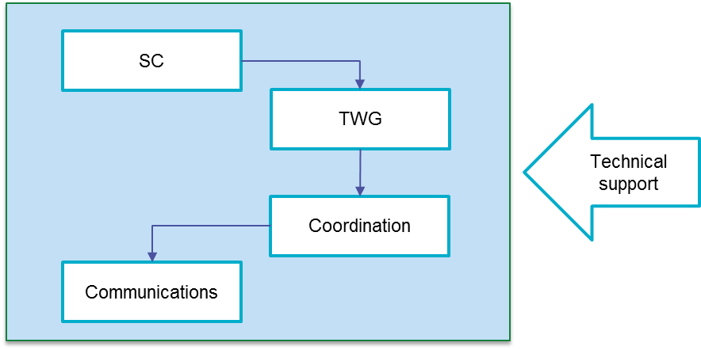
Institutional arrangements for NCA in Uganda
Technical Working Group (TWG)
The TWG is chaired by MOFPED with NPA as co chair. It includes, OPM, NEMA, NFA, MWE MTA and UWA.
Steering Committee (SC)
The Water and Environment Sector Working Group (WESWG) takes the role of the Steering Committee.

Slide 13


