Slide 1
23rd London Group Meeting
Contribution to the panel discussion
Complementing CICES and NESCS [work in progress]
San José, 18 October 2017
Alessandra La Notte

Slide 2
Conflicting or complementing?
CICES
NESCS

Slide 3
How does it work in practice?
CICES classification | JRC rephrasing for accounting purposes | NESCS
 |  | Ecological Endpoints [SNA and non-SNA Benefit] | “Use” | “User”/Beneficiary

Slide 4
How does it work in practice?
CICES classification | JRC rephrasing for accounting purposes | NESCS
 |  | Ecological Endpoints [SNA and non-SNA Benefit] | “Use” | “User”/Beneficiary
Arable cropping | Agro-biomass growing
Animal husbandry | Forage biomass growing
Materials from plants | Tree biomass growing
Pollination and seed dispersal | Wild crop pollination
Dilution by freshwater ecosystems | Water purification (nitrogen removal)
Global climate regulation | Carbon sequestration
Filtration by plants | Air filtration
Control of erosion rate | Erosion control
Flood protection | Flood control
Interactions with natural environment | Provision of outdoor recreation opportunities

Slide 5
CICES classification | JRC rephrasing for accounting purposes | NESCS
 |  | Ecological Endpoints [SNA and non-SNA Benefit] | “Use” | “User”/Beneficiary
Arable cropping | Agro-biomass growing | Flora ([22].2.) [SNA:crops] | Raw material for transformation (.1101.) Direct consumption (.1109.) | Agriculture (111) [22.]2.1101.111 Households (2) .2.1109.2
Animal husbandry | Forage biomass growing | Flora ([2(2/4/5)].2.) [SNA: livestock] | Support of animal breeding ([2().2.1105.111 | Agriculture (111)
Materials from plants | Tree biomass growing | Flora (.2.) [SNA: timber] | Raw material for transformation (.1101.) | Agriculture (111) .2.1101.111
Pollination and seed dispersal | Wild crop pollination | Fauna (.3.) [SNA: wild pollinators depending on crops] | 2(2).1105. Support of plant or animal cultivation [for Agric and for HHs] | Agriculture (111) 2(2).3.1105.111 Households (2) 2(3).3.1105.2
Dilution by freshwater ecosystems | Water purification (nitrogen removal) | Water ([1(1/2/3/6)].1.) Liquid water ([1(1/2/3/6)].12.) [non-SNA: cleaned water] | Support of plant and animal cultivation (.1105.) Support of human subsistence (.1106.) | Agriculture (111) .12.1105.111 Households (2) .12.1106.2
Global climate regulation | Carbon sequestration | Combined End-Products (WW.82.) [non-SNA: mitigation of CC effects] | Protection of human health, life and subsistence (.1205.) | All: .WW.82.1205.1(/2/3)
Filtration by plants | Air filtration | Air ([3].51) [non-SNA: clean air] | Protection of human health (.1205.) | Households (2) [3].51.1205.2
Control of erosion rate | Erosion control | Soil ([2(1/2/3/4)].6.) [non-SNA] | Support of plant cultivation (.1203.) | Agriculture (111) [2W].6.1203.111
Flood protection | Flood control | Regulation of extreme events ([2(1/2/3/4)].82.) [non-SNA] [SNA] | Protection of human life (.1205.) Protection of human property (.1206.) | Industry (1) 2W.82.1206.1 Households (2) 2W.82.1205.2
Interactions with natural environment | Provision of outdoor recreation opportunities | Scapes (.81.) [non-SNA] [SNA] | Recreation (.1207.) Tourism (.1207.) | Households (2) .81.1207.2 Accommodation and Food services (172) .81.1207.172

Slide 6
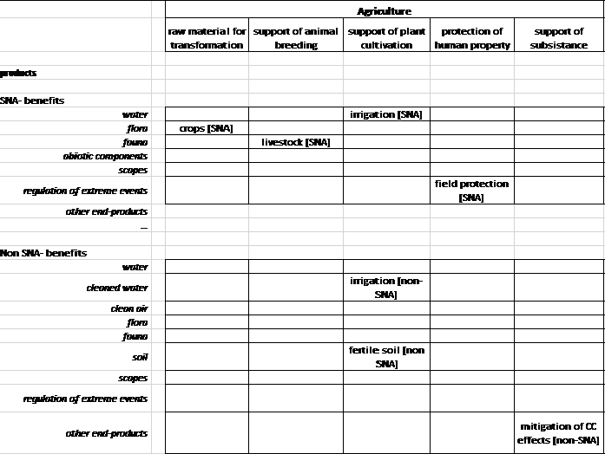
Better allocation of flows through the NESCS Use-category

