Slide 1


National Plan for Advancing
Environmental-Economic Accounting in Kenya

Slide 2
Outline of the Presentation
Rationale for EEAs in Kenya
History of Environmental Economic Accounting in Kenya
Policy environment
Priority Environmental Economic Accounts for Kenya
Process of developing NPAEEA for Kenya
Log frame for Environmental Economic Accounting implementation for Kenya
Notes:
Log frame An LFA is a management tool for effective planning and implementation of developmental projects. It provides clear, concise and systematic information about a project through a framework. We know about various components of a project such as goal, objectives, activities, results and indicators.

Slide 3
Rationale for EEAs in Kenya
Why develop EEAs for Kenya?
Need to internalizing the benefits produced by natural capital into development planning, policy development and economic decision-making (Millennium Ecosystem Assessment, 2005; Guerry et al., 2015)
Kenya relies heavily on natural capital, which supports a variety of economic sectors including energy, forests, water, fisheries, tourism and other sectors
Lack of an integrated framework for compilation of environment data that can inform policy design.
Current framework for compilation of environment statistics does not provide for linking interactions among sectors and the impact these sector activities have on the others
Notes:
Log frame An LFA is a management tool for effective planning and implementation of developmental projects. It provides clear, concise and systematic information about a project through a framework. We know about various components of a project such as goal, objectives, activities, results and indicators.

Slide 4
History of Environmental Economic Accounting in Kenya
KNBS has been collecting and disseminating environmental data on water, energy, forestry etc through Economic Survey and statistical abstract publications and other high frequency releases
KNBS is currently working on a framework of improving environment statistics under the KNBS/Statistics Sweden Statistical collaboration project- environment component
KNBS uses Framework for Development of Environment Statistics (FDES) 2013 which structures environment statistics into Components, Subcomponents, Topics and Statistics

Slide 5
History of Environmental Economic Accounting in Kenya
However, the data has not been integrated as structured in SEEA, rather a silo approach for each sector has been applied. Data on physical flows is also not captured according to the SEEA framework
In 2009, different government agencies, UNEP and FAO developed a forest account for Kenya
In 2013, KNBS lead the development of a proto-type Forest SEEA and forest ecosystem services analysis for Kenya.

Slide 6
Policy Environment
SEEA is being developed in an environment of different national and sectoral policies and legislation touching on the environment but which are not integrated.
There are also Multilateral Environment Agreements (MEAs) at the global level which influence environmental regulation in Kenya- Ratification of SDGs by UNGA
Development of SEEA will be critical in informing implementation of these policies, legislation, plans and strategies.

Slide 7
Policy Environment
Environment and Natural Resources issues are provided for in the constitution of Kenya, 2010 in Chapter 5, Part 2
  Obligations in respect of the environment: Article 69(1) and 69(2)
Environmental policies, legislation and plans supporting the environment include
      National environment Policy 2014
      National Environment Action Plan
      The Environmental Management and Co-ordination (Amendment) Act 2015
      State of Environment

Slide 8
Policy environment
National climate change documents include
      Draft Climate Change Policy
      Green Economy Strategy and Implementation Programme (GESIP)
      National Climate Change Response Strategy (NCCRS) 2010
      National Climate Change Action Plan (NCCAP):
      National Adaptation Plan (NAP) 2015-2030
      Intended Nationally Determined Contribution
National climate change and environmental policies and legislation are supported by MEAs

Slide 9
Policy environment
Some of the MEAs and other commitments
      The Convention on Biological Diversity and Aichi Targets 2020
      United Nations Framework Convention on Climate Change (UNFCCC)
      Sustainable Development Goals
      Green Growth
      Gaborone Declaration
Given the MEAs and other international commitments, environmental policies and legislations, and climate change policies, strategies and plans, development of SEEA is expected to integrate the different initiatives to produce better environmental management

Slide 10
Priority Environmental Economic Accounts for Kenya: SEEA-Energy
Why start with Energy Accounts?
Power supply has shifted from dependence on hydro-power to geothermal sources
Private investment in renewable (mainly solar and wind energy) and non-renewable power generation.
Sector of chosen for greatest reduction in GHGs emission in Green Economy Strategy and Implementation Plan (GESIP)
Increased development of improved cook stoves to reduce biomass fuel consumption
Crude oil and gas resources discovery and exploration
Energy demand has also been increasing in tandem with expansion and diversification of the economy
Ease of data collection- mostly administrative

Slide 11
Priority Environmental Economic Accounts for Kenya: SEEA-Forest
Important national asset in terms of economic, environmental, social and cultural values
Source of different ecosystem services and livelihoods for communities around
Supply of raw materials to the wood industry
Climate regulation and REDD+ projects
Notes:
REDD+ (or REDD-plus) refers to "reducing emissions from deforestation and forest degradation in developing countries

Slide 12
Priority Environmental Economic Accounts for Kenya: SEEA-Water
Basic human right according to Constitution of Kenya (2010)
Important resource for different economic sectors
Water shortages and rationing especially in cities
Catchments degradation due to environmental degradation and climate change
Improved management of water catchment by government and communities

Slide 13
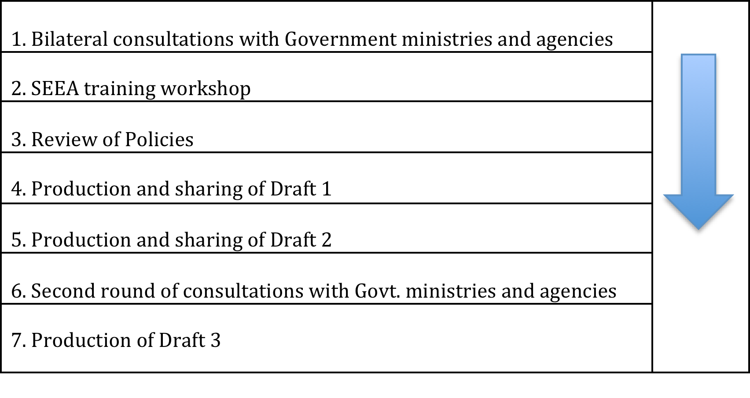
NPAEEA development process

Slide 14
Log frame for Environmental Economic Accounting implementation for Kenya

Slide 15
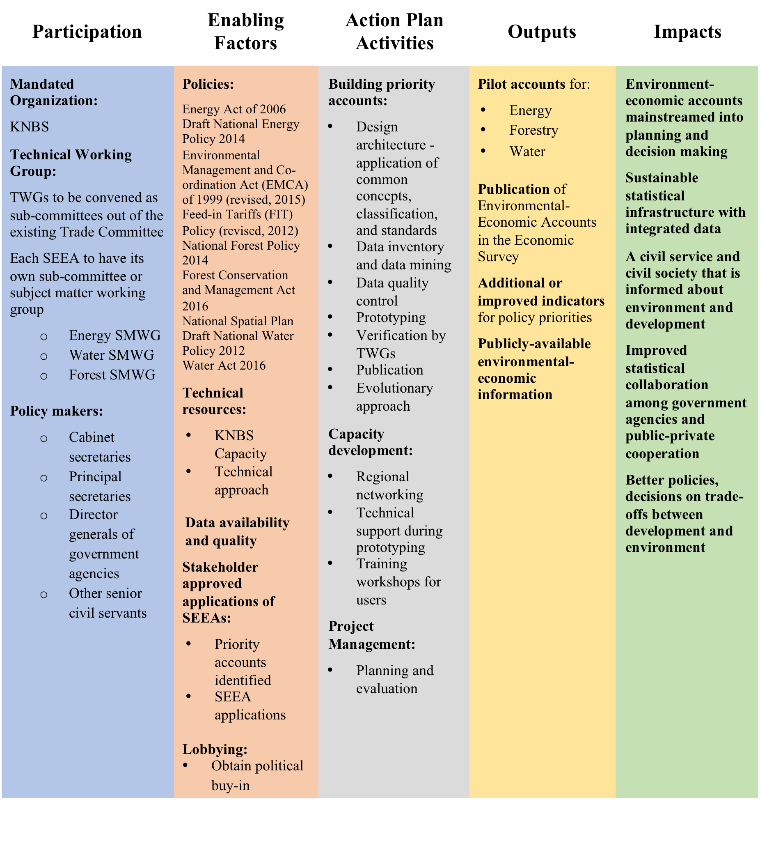

Slide 16
Participation
KNBS will be coordinating the implementation of the plan
At the highest level will be to give policy guidance and allocate resources. They will include:
Principal secretaries, Director generals of government agencies, Other senior civil servants
Technical Working Groups
TWGs to be convened as sub-committees out of the existing Trade and energy Committee. Each will have its own SEEA
At the lowest stage will be the subject matter working groups for each SEEA i.e. Energy SMWG, Water SMWG, Forest SMWG

Slide 17
Enabling factors
Policies: there are a number of sectoral and national policies supporting the implementation of SEEA
Technical resources: KNBS has qualified and well trained staff which will be complimented by expertise from other countries
Data availability and quality: KNBS has been collecting volumes of environmental data which will be supplementation by more date from collaborating organizations
Stakeholder approved applications of SEEAs: There is demand for SEEAs across the organization which encourages development of the account
Lobbying: there has been lobbying in different organization to boost the acceptability of the SEEA.

Slide 18
Action plan activities
Building priority accounts:
    Design architecture - application of concepts, classification, and standards
    Data inventory and data mining
    Data quality control
    Prototyping
    Verification by TWGs
    Publication
    Continuous improvement
Capacity development:
    Regional networking
    Technical support during prototyping
    Training workshops for users
Project Management:
    Planning and evaluation

Slide 19
Outputs
Pilot accounts for:
      Energy
      Forestry
      Water
Publication of Environmental-Economic Accounts in the Economic Survey & statistical abstract
Additional or improved indicators for policy priorities
Publicly-available environmental-economic information

Slide 20
Impacts
Environment-economic accounts mainstreamed into planning and decision making
Sustainable statistical infrastructure with integrated data
A civil service and civil society that is informed about environment and development
Improved statistical collaboration among government agencies and public-private cooperation
Better policies, decisions on trade-offs between development and environment

Slide 21
Outcomes
A set of integrated environmental-economic accounting information
Enhanced institutional coordination within Kenya
Increased technical and decision-making capacity development
Key aggregate macro-environmental statistics and indicators

Slide 22
Way forward
Regional and National workshop
Revision and printing final version of NPAEEA
Preparation of a budget for EEA activities to be part of the NPAEEA
going forward
Formation of High level committee, TWGs and SMWGs
KNBS officially requesting data and manpower from organizations
Continued development and completion of energy account
Publication of SEEA energy in economic survey 2018
Signing of MoUs between KNBS and collaborators
Development of SEEA-Water and SEEA-Forest and publication

