Slide 1
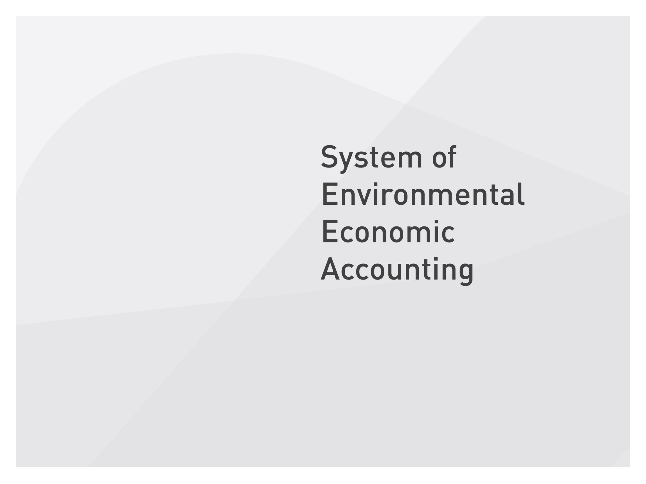
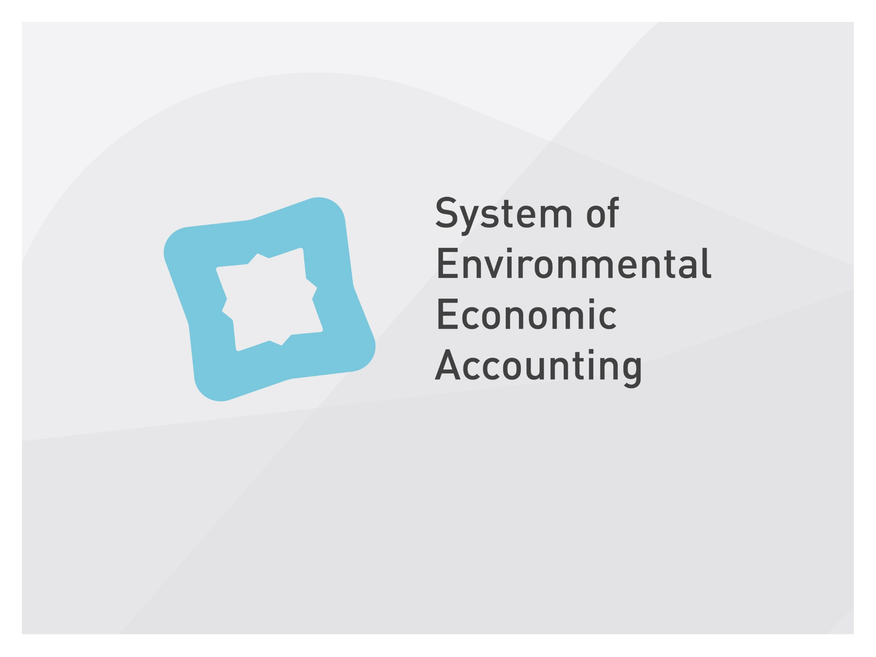
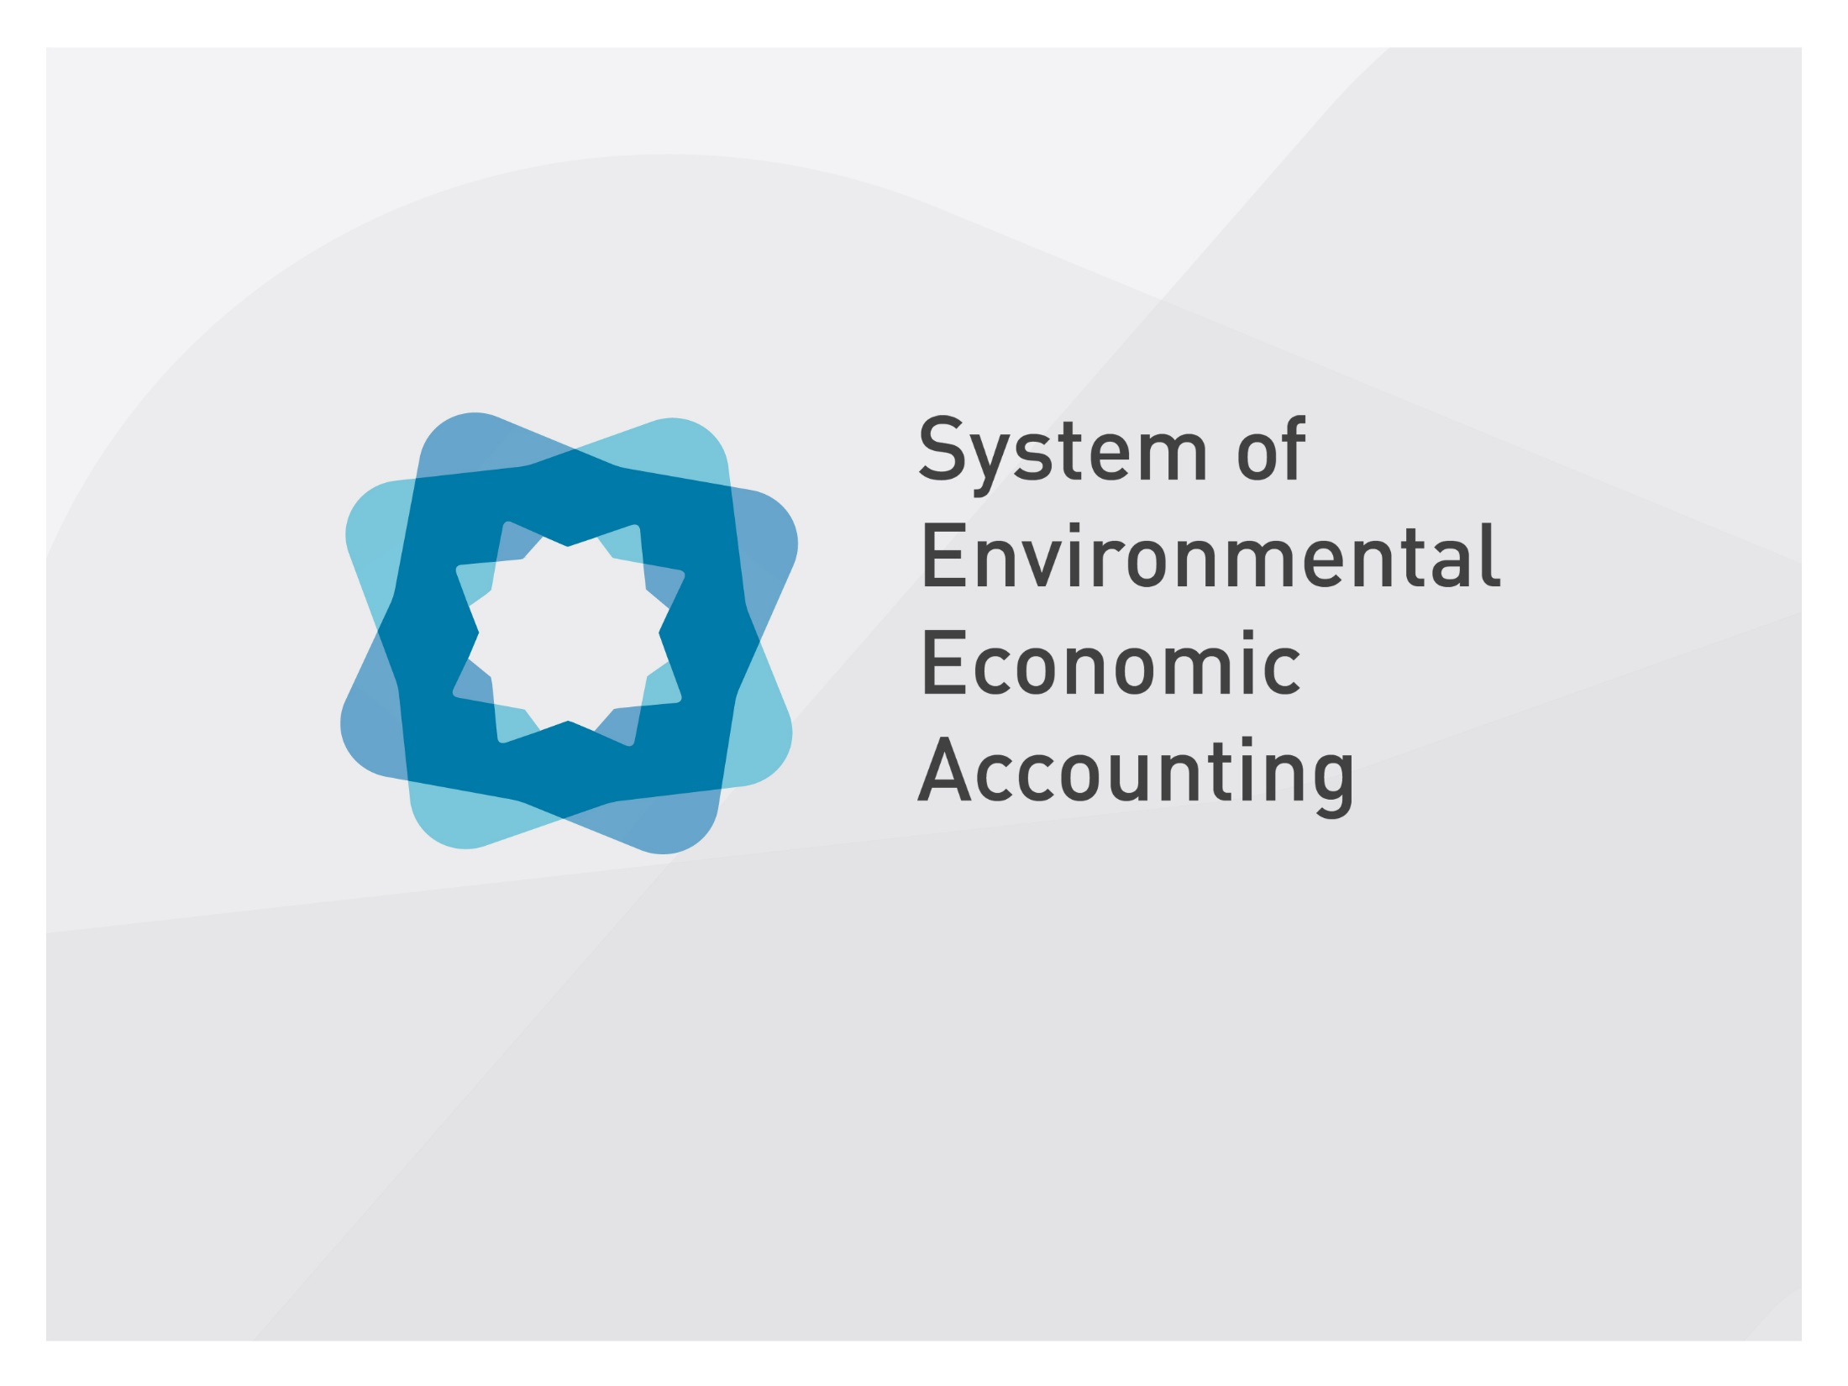
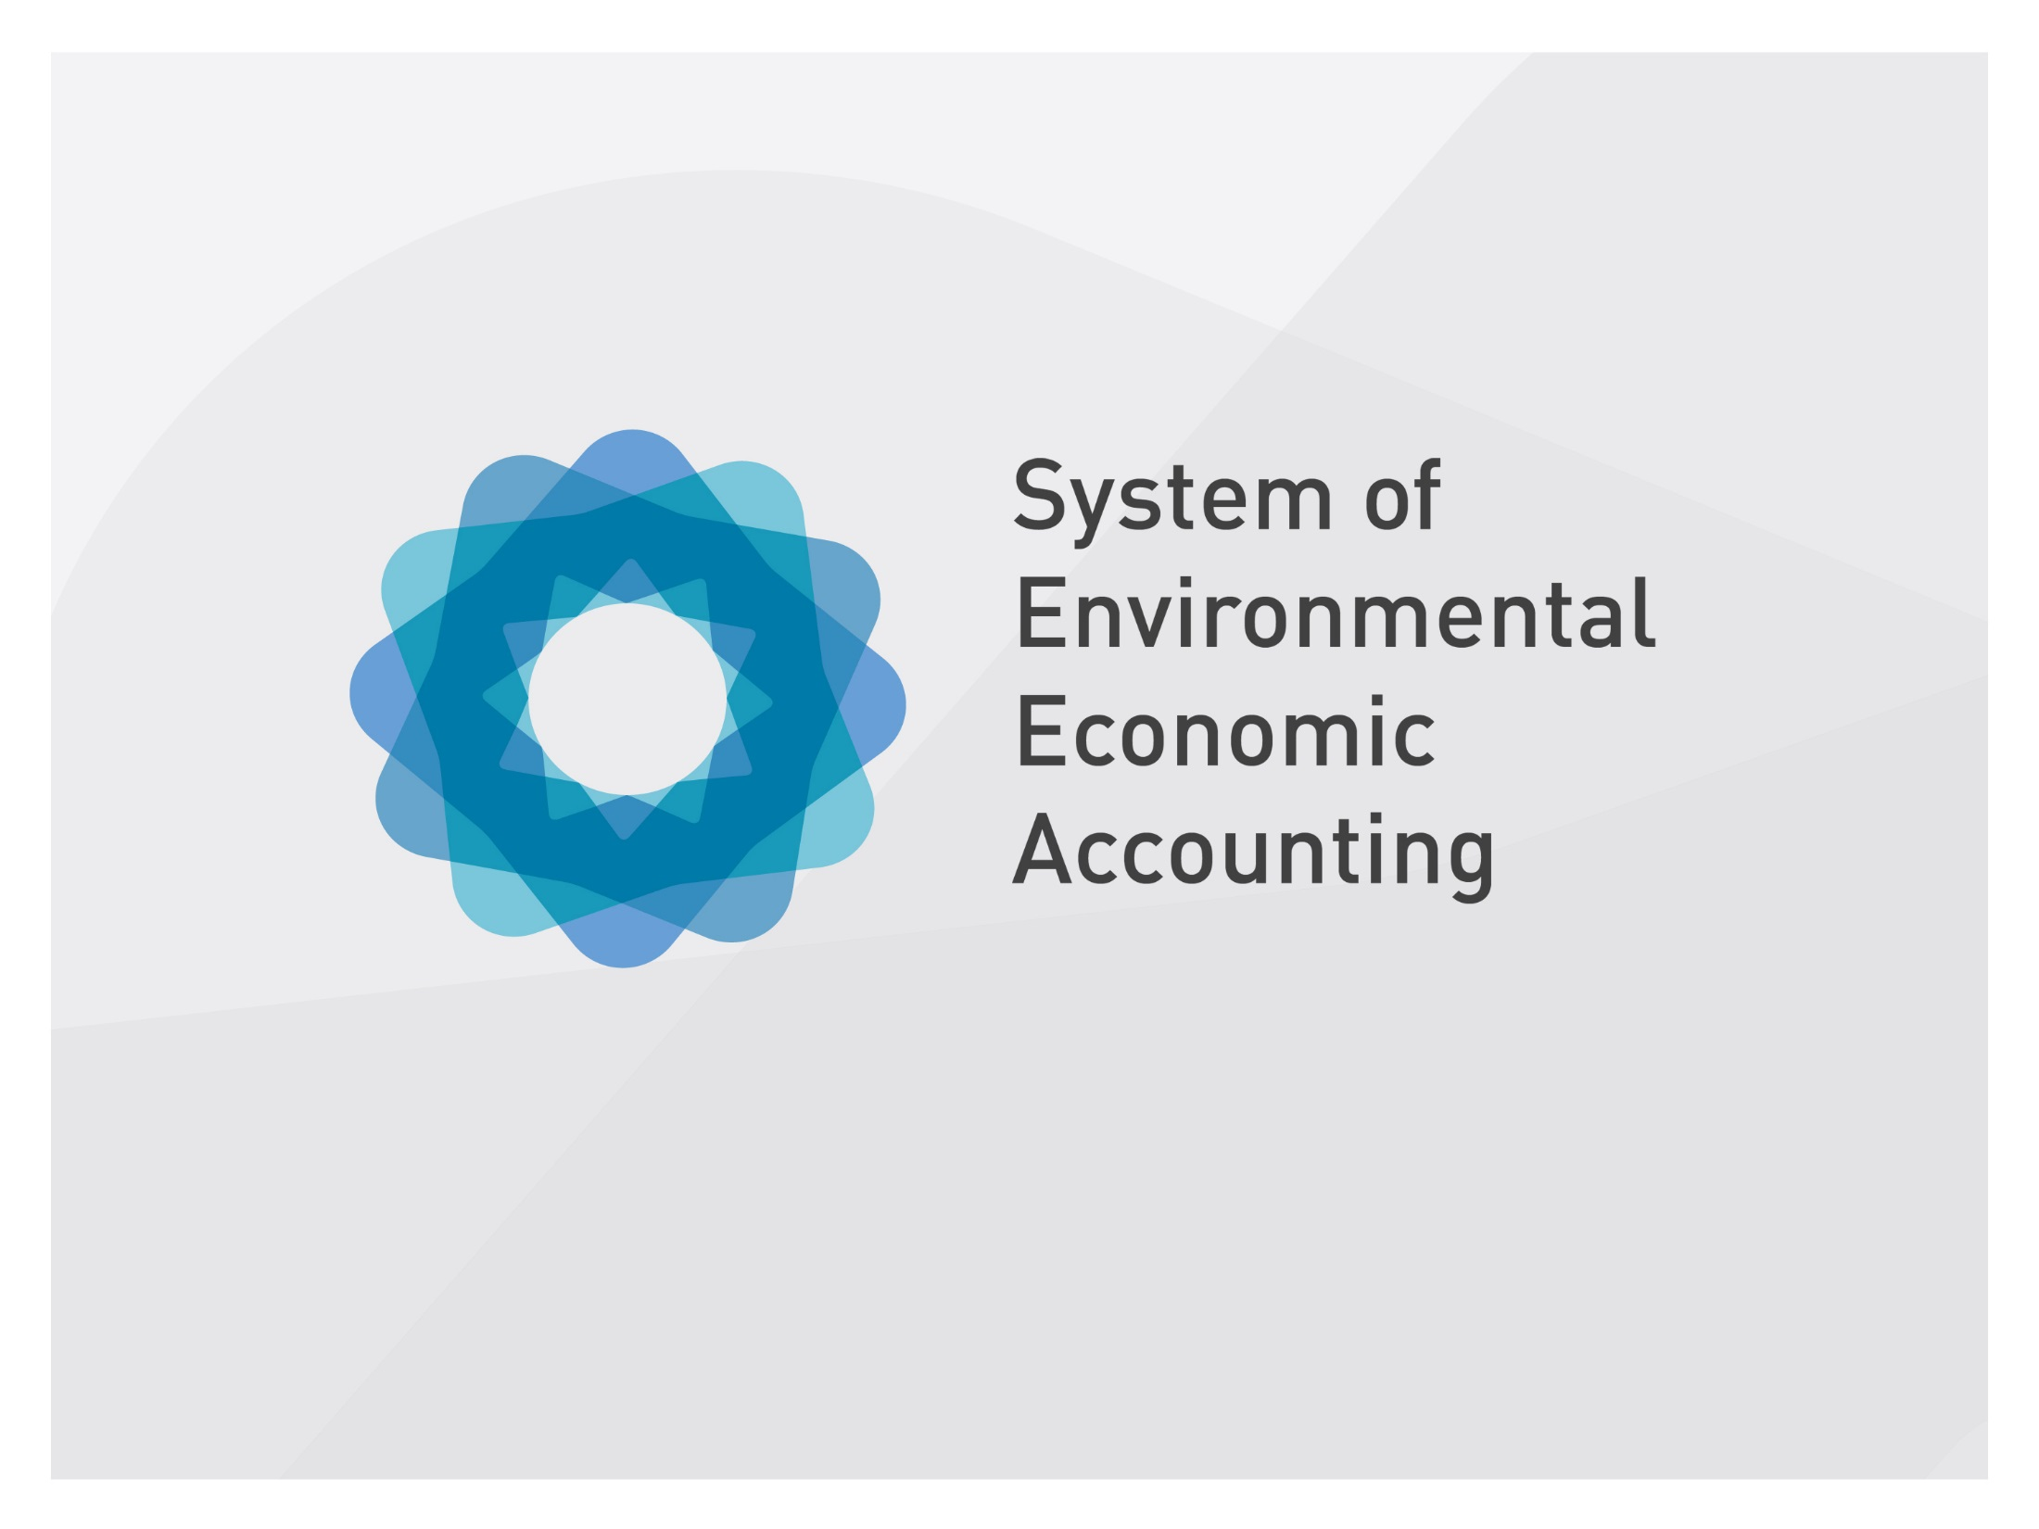

Slide 2
Session 6: Forest accounting
Introduction to forest accounting
Marko Javorsek
United Nations Statistics Division

Slide 3
Forest accounts in SEEA
SEEA Central Framework
  Physical descriptions of forestry-relevant stock assets (e.g., land and standing timber),
  Monetary accounts (e.g., for forestry and logging)
SEEA Agriculture, Forestry and Fisheries add:
  Physical and monetary supply and use tables of wood and wood products
  Edible and other non-wood forest products
  Facilitate carbon accounting related to forests
SEEA Experiential Ecosystem Accounting
  Provision of ecosystem services, e.g., mitigation to climate change, protection of biodiversity, soils, recreation, cultural services, etc.

Slide 4
Definitions
Types of forests:
  Naturally regenerated forest: primary forest and other naturally regenerated forests
  Planted forests
  Other wooded land
Timber resources:
  Cultivated timer: under control, responsibility and management of institutional units and therefore is recorded as an increase (decrease) in inventories
  Natural timber resources: recorded as entering the production boundaries only when removed from the forest as timber
Notes:
Forest: land spanning more than 0.5 hectares with trees higher than 5 metres and a canopy cover of more than 10 per cent, or trees able to reach these thresholds in situ
Other: land spanning more than 0.5 hectares; with trees higher than 5 metres and a canopy cover of 5-10 per cent, or trees able to reach these thresholds in situ; or with a combined cover of shrubs, bushes and trees above 10 per cent.

Slide 5
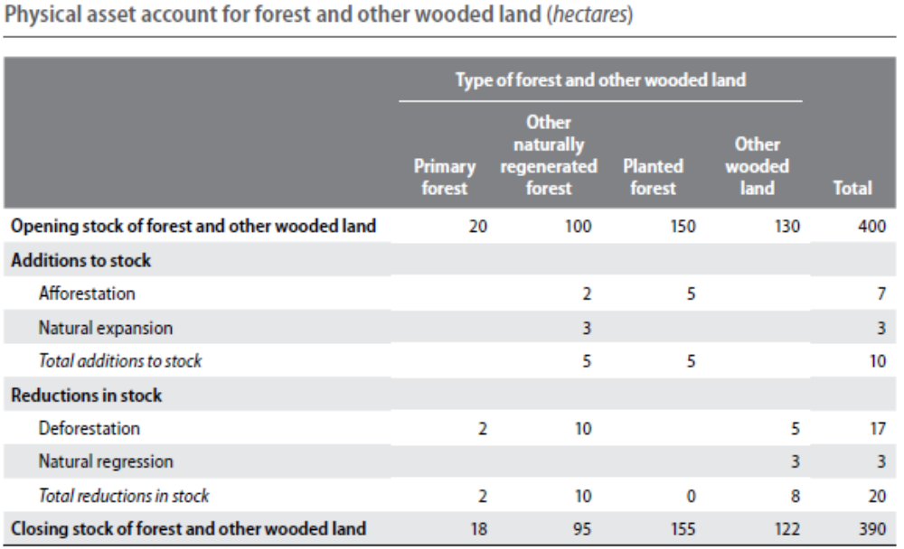
Asset accounts: forest land
Physical asset account for forest and other wooded land (hectares)
Notes:
The underlying stock of the Physical Asset Account for Forestry is the physical area under forestry land use. Thus the scope of the account is to track changes in area over time, due to additions and reductions in stock, for example deforestation and afforestation.
The account records the opening and closing stock and the different types of changes in the stock over an accounting period.
At the outset, a key distinction in scope between the two of timber resources should be noted. Specifically, the SEEA CF states that the scope of the timber account extends beyond timber located on forestry areas. Thus, for example, depending on their significance, wood extracted from agricultural orchards may be within scope of the timber account, regardless of the underlying land use. In other words, while the ‘Asset account for Forestry’ may be mapped univoquely to the relevant SEEA CF land use classification, the timber account, with a focus on products, may be mapped on multiple land use categories, and univoquely only to the SEEA CF land cover category ‘tree-covered areas.’ Therefore the focus of the Forestry account is on land areas, while the focus of the Timber account if on timber quantities and values.

Slide 6
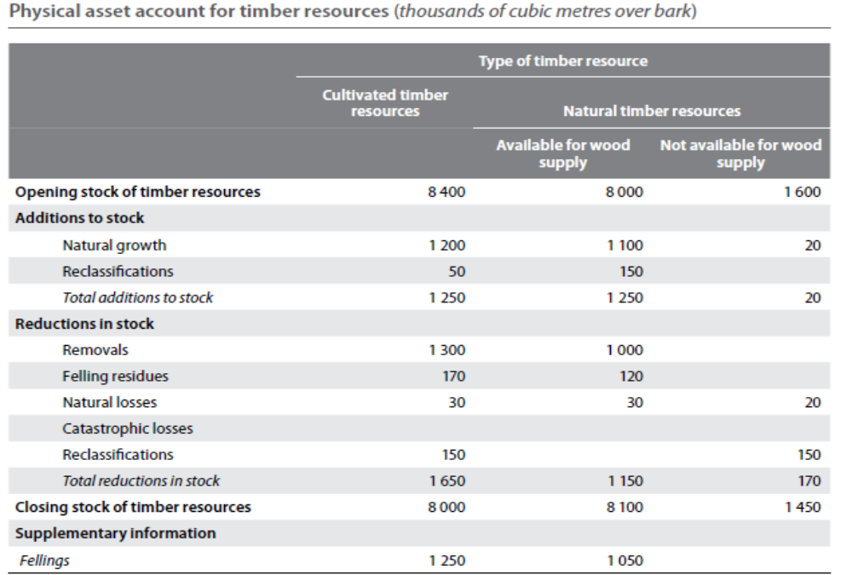
Asset accounts: timber resources (physical)
Physical asset account for timber resources (thousands of cubic metres over bark)

Slide 7
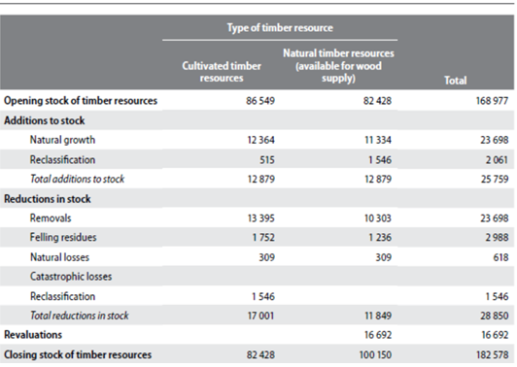
Asset accounts: timber resources (monetary)
Monetary asset account for timber resources (thousands of cubic metres over bark)
Notes:
Valuation of timber resources may be done through: i) Net present value; ii) Cost of forest management (including a mark-up for net operating surplus/mixed income); and iii) Consumption value or stumpage value methods. The first two valuation methods however require information such which may be difficult to identify and assess. For this reason, both for removals and fellings, the last is usually the applied methodology. Stumpage price is the amount paid per cubic metre of timber by the harvester to the owner of the timber resources.
The valuation methods are described in paragraph 5.8.4 of the SEEA CF.
EFA explanatory note 2016 defines the stumpage price as “the price paid for timber as it stands – before being cut – in the forest” (https://circabc.europa.eu/sd/a/4b0d0b1d-aa7d-4b86-9b63-7a8cacaf5415/EFA_Explanatory%20notes_21JUL2016.doc.pdf).

Slide 8
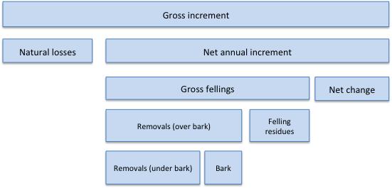
Forestry concepts
Source: adapted from Päivinen et al., 1999

Slide 9
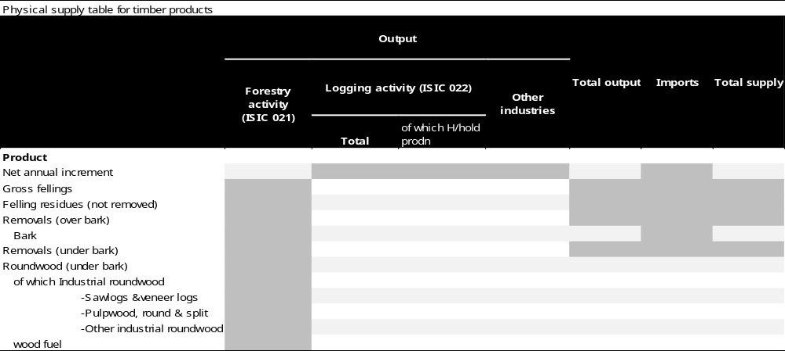
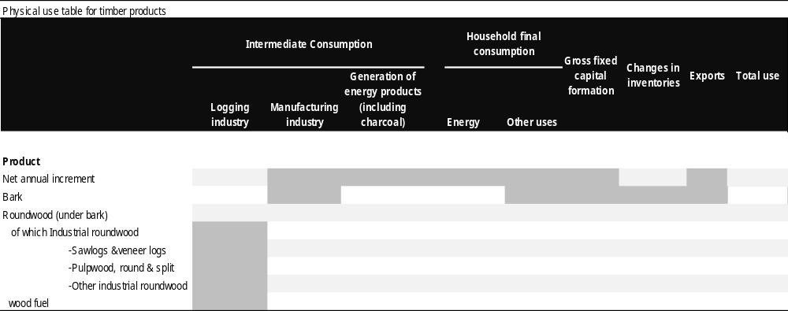
Physical flow accounts

Slide 10
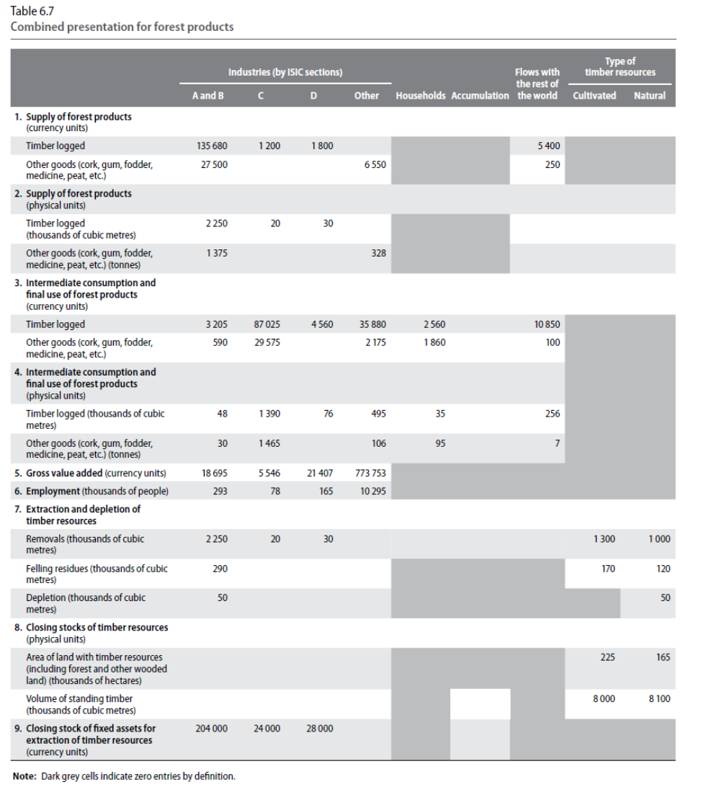
Combined presentation for forest products

Slide 11
Data sources
National Forest inventories and statistics
Survey data
Earth observation sources (geospatial)
International data collection initiatives:
  FAO Forest Resource Assessment
  Joint Forest Questionnaire
  Reporting to UNFCCC and REDD+

Slide 12
Examples: international data sources (1)
1. Global Forest Resources Assessment (FRA)
Forest area and characteristics: (for forest land asset account)
  Area of Forest types and Other wooded land (1000 ha);
  For additions to stock: Forest expansion, of which afforestation, reforestation and natural expansion of forest (ha/yr)
  For reductions to stock: Deforestation, and deforestation of which human induced (ha/yr)
  Forest expansion, of which natural expansion of forest (ha/yr)
  Planted forest area change (1000 ha)
  Production forest (1000 ha)
Production: (for physical asset account for timber resources)
  Forest growing stock and other wooded land growing stock (Mill. m³)
  Net annual increment (m³/ha/yr)
  Production forest (1000 ha)
  Multiple use forest (1000 ha)
  Dead wood in forest and other wooded land (Mill. tonnes (t)
  Value of most important commercial NWFPs” under the topic “Production

Slide 13
Examples: international data sources (2)
2. United Nations Framework Convention on Climate Change (UNFCCC)
Land use changes:
  Forest land remaining forest land
  Land converted to forestland (cropland, grassland, wetlands, settlements, other land) (Total area, 1000 ha)
  Forest Land converted to other land (cropland, grassland, wetlands, peat extraction, flooded land, settlements, other land) (Total area, kha)
  C stock change (gains, losses and net change in kt C) for the land-use categories of LULUCF (Forest Land, Cropland, Grassland, Wetlands, Settlements, and Other Land) (tC)
  Biomass burning from controlled burning or wildfires (ha or kg dm)
  HWP consumed domestically – gains and losses in tC (solid wood, paper and paperboard, other)
  HWP inventory – production, imports, exports of sawnwood, wood panels, paper and paperboard (in m³)

Slide 14
Links and extensions to other accounts
Link to air emission account: carbon accounting
Extension to ecosystem accounting: provision of ecosystem services

Slide 15
Link to policy and users
Policy questions:
  Is economic growth based on deforestation?
  Which social groups benefit from goods and services provided by forests?
  Are there benefits maintained for future generations?
  Are forests used optimally?
  What is the influence of macroeconomic and non-forestry policies on forests?

Slide 16
Examples of policy goals and indicators
SDG 15: Protect, restore and promote sustainable use of terrestrial ecosystems, sustainably manage forests, combat desertification, and halt and reverse land degradation and halt biodiversity loss
  15.1 By 2020, ensure the conservation, restoration and sustainable use of terrestrial and inland freshwater ecosystems and their services, in particular forests, wetlands, mountains and drylands, in line with obligations under international agreements
    15.1.1 Forest area as a proportion of total land area
  15.2 By 2020, promote the implementation of sustainable management of all types of forests, halt deforestation, restore degraded forests and substantially increase afforestation and reforestation globally
    15.2.1 Progress towards sustainable forest management
Aichi Biodiversity targets:
  Target 5: By 2020, the rate of loss of all natural habitats, including forests, is at least halved and where feasible brought close to zero, and degradation and fragmentation is significantly reduced.
  Target 7: By 2020 areas under agriculture, aquaculture and forestry are managed sustainably, ensuring conservation of biodiversity.

