Slide 1
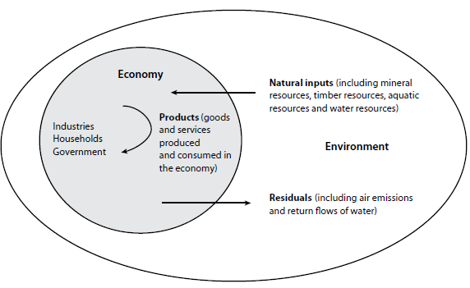
The Environment-Economy Nexus

Slide 2
Conceptual representation of the Central Framework
A
Material inputs
SNA
Economy
Environment
Flows within economy
Changes in stocks
Returns
B

Slide 3
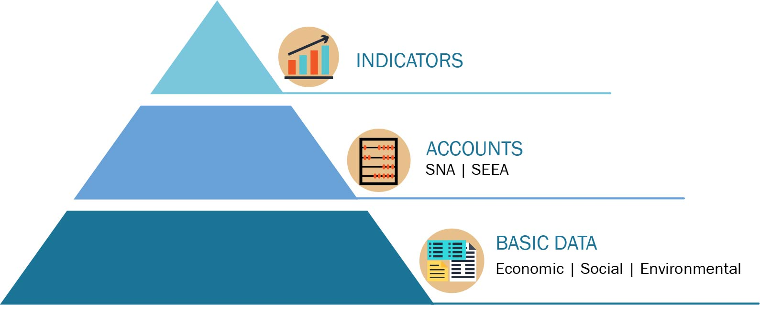
From data silos to integrated information

Slide 4
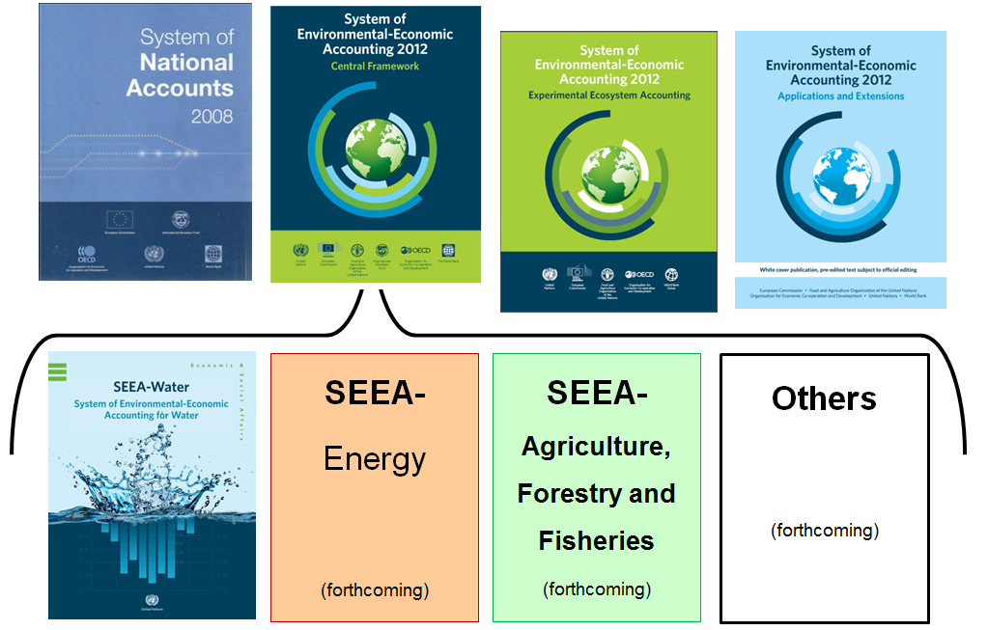
The SNA and SEEA: Systems of integrated information

Slide 5
Components of the SEEA
SEEA-CF (Central Framework) | Assets Physical flows Monetary flows | Minerals & Energy, Land, Timber, Soil, Water, Aquatic, Other Biological Materials, Energy, Water, Emissions, Effluents, Wastes Protection expenditures, taxes & subsidies
SEEA Water; SEEA Energy; SEEA Agriculture, Forestry and Fisheries | Add sector detail | As above for Water Energy Agricultural, Forestry and Fisheries
SEEA-EEA (Experimental Ecosystem Accounting) | Adds spatial detail and ecosystem perspective | Extent, Condition, Ecosystem Services, Thematic: Carbon, Water, Biodiversity

Slide 6
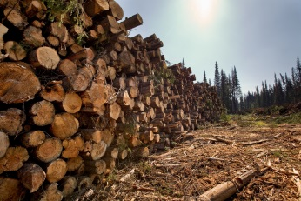
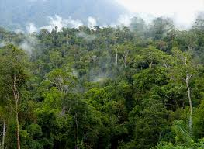
One Environment: Two perspectives
Individual environmental assets & resources:
Timber
Water
Soil
Fish
Ecosystems: Biotic and abiotic elements functioning together:
Forests
Lakes
Cropland
Wetlands
SEEA Central Framework (SEEA_CF) starts with economy and links to physical information on natural assets, flows and residuals
SEEA Experimental Ecosystem Accounting (SEEA-EEA) starts with ecosystems and links their services to economic and other human activity
Together, they provide the foundation for measuring the relationship between the environment, and economic and other human activity

Slide 7
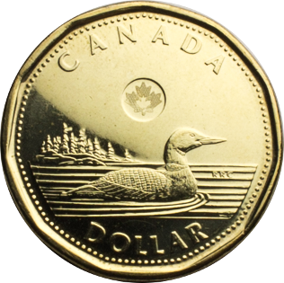
SEEA – two sides
Environmental assets are the naturally occurring living and non-living components of the Earth, together constituting the biophysical environment, which may provide benefits to humanity.
Ecosystems are a dynamic complex of plant, animal and microorganism communities and their non-living environment interacting as a functional unit
SEEA Central Framework:
Individual environmental assets/ resources
SEEA Experimental Ecosystem Accounts:
Ecosystem assets
(spatially based)
Timber
Water
Soil
Fish
Forests
Lakes
Agricultural areas

Slide 8
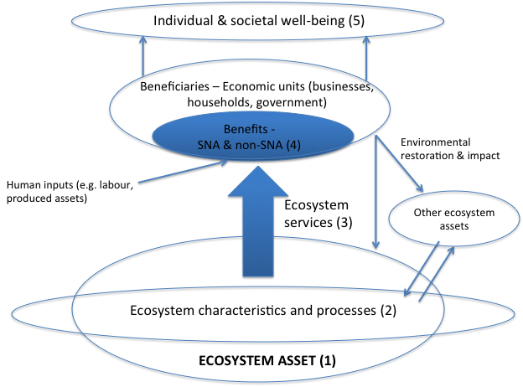
Ecosystem Accounting model

Slide 9
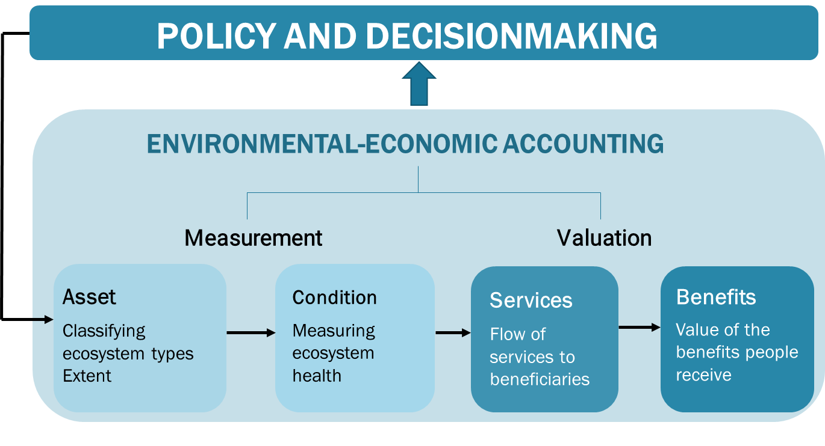
SEEA Experimental Ecosystem Accounting

Slide 10
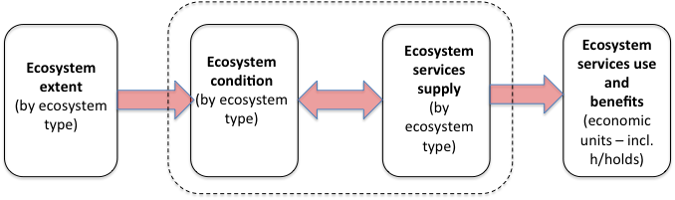
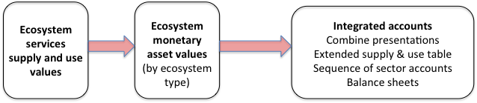
Broad steps in ecosystem accounting
a. Physical Accounts
Ecosystem thematic accounts: Land, Carbon, Water, Biodiversity
Supporting information: Socio-economic conditions and activities, ecological production functions
Tools: classifications, spatial units, scaling, aggregation, biophysical modelling
Source: Official statistics, spatial data, remote sensing data
b. Monetary Accounts
Supporting information: SNA accounts, I-O tables
Tools: Valuation techniques

Slide 11
SEEA as a Supporting Framework
SEEA
WAVES
TEEB
BIOFIN
Green
Economy
Aichi Targets
SDGs

Slide 12
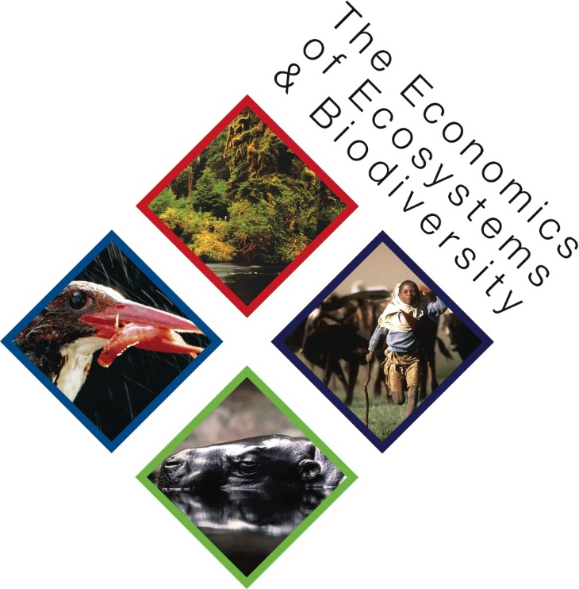





The SEEA supports multiple ongoing initiatives

Slide 13
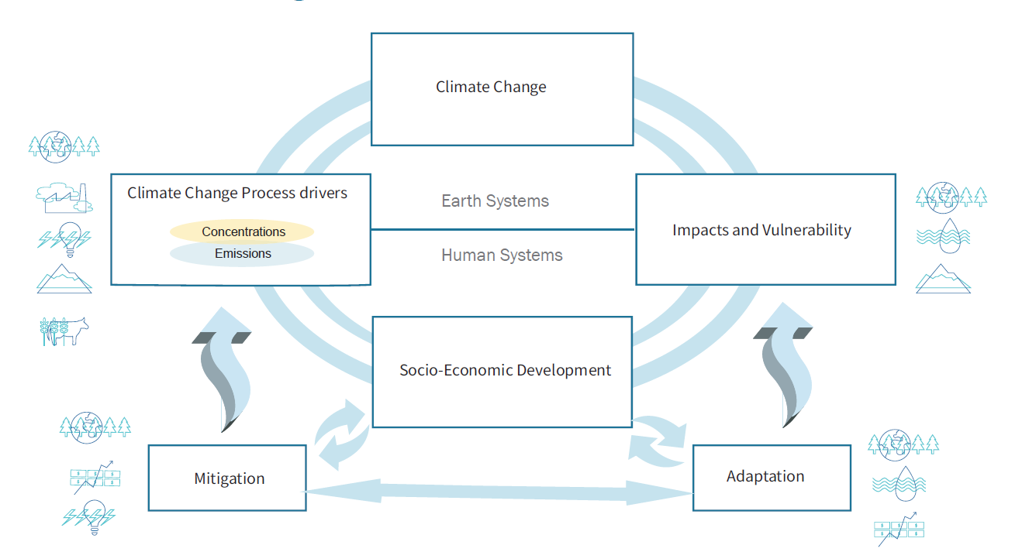
The SEEA provides important information for climate change mitigation and adaptation efforts

