Slide 1
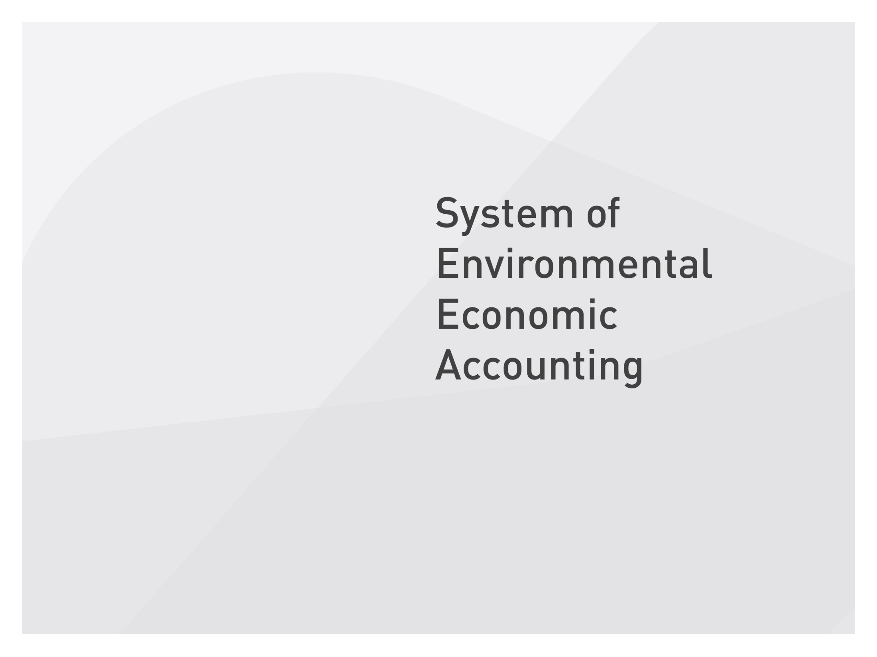




Slide 2
SEEA-Energy
An quick introduction
Sokol Vako
United Nations Statistics Division

Slide 3
What is SEEA-Energy
SEEA Energy is a ”subsystem” to SEEA Central Framework, which in details decribes how information for energy flows and stocks and changes of energy resources should be organised
Agreed concepts, definitions, classifications, tables, and accounts related to energy supply and use and stocks of energy resources

Slide 4


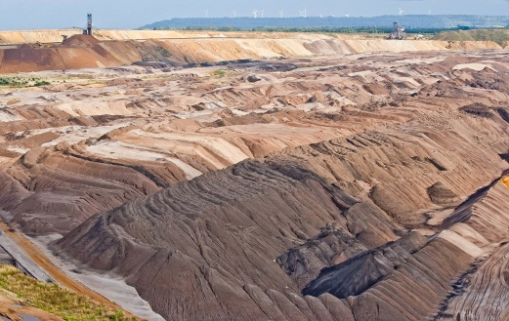
SEEA Energy includes three main types of information on energy
The supply and use of energy (flows)
The stocks of energy and the changes in them
Other economic aspects related to energy
Notes:
The supply and use of energy (flows)
Extraction and capture of energy from the environment
Production, transactions and foreign trade of energy
Losses of energy during production
The stocks of energy and the changes in them
Availability of energy resources and energy products at the beginning of a time period
Disappearance and entering into the stocks of enrgy during the time period
Availability of energy resources and energy products at the end of the time period
Monetary valuation of the depletion of energy resources
Other economic aspects related to energy
Expenditure on environmental protection, clean-up and energy resource management
The use of energy taxes and subsidies
Other economic instruments like tradeble carbon emission permits

Slide 5
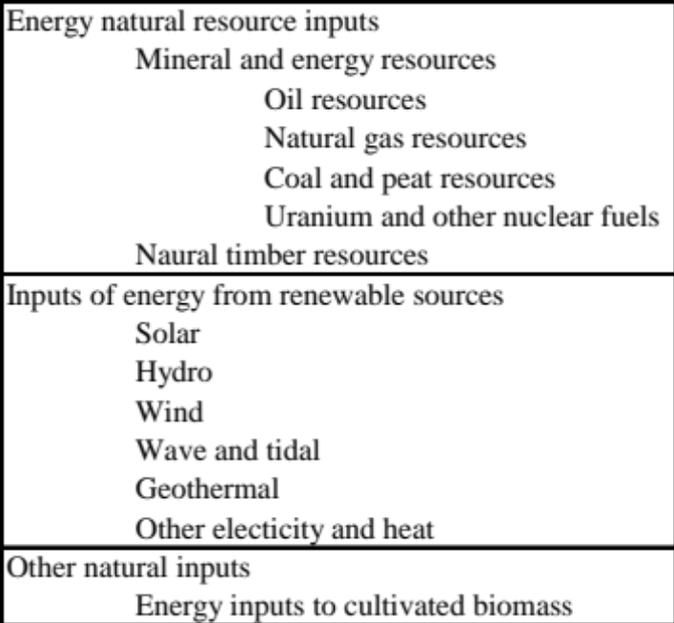
Energy as natural inputs
Natural inputs: This is energy resources i.e. energy as we find it in the environment, and which we may extract or capture
Notes:
”Conventional” solid and liquid natural resources (for extraction)
Circular” renewable forms of energy (for capture)
Energy embedded in cultivated biomass (for harvest)

Slide 6
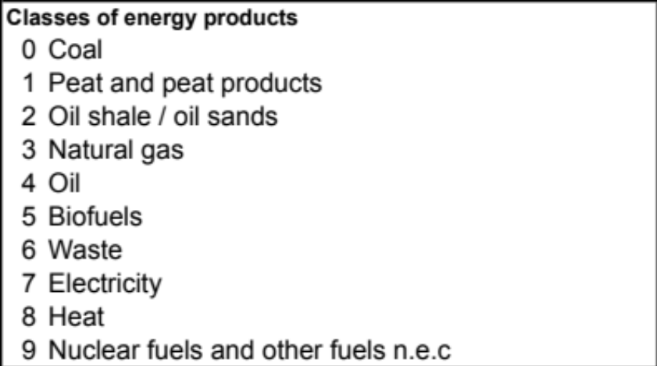
Energy as products
Energy products: This is energy in the form in which it is bought and sold or stored in inventories owned by companies. Products are always produced or generated by an economic unit belonging to the national or rest of the world economy.
Notes:
Energy products includes electricity, heat, coal, petrol, fuel wood, etc. Some energy products, e.g. oil, may be used for non-energy purposes, for instance to produce plastic.
In the national accounts energy as products is often classified according to the Central Product Classification, CPC, or some national version of it.
For the energy accounts, however, it is recommended to use the Standard International Energy Product Classification (SIEC).
Observe that there is no one-to-one relationship between CPC and SIEC.
It is often useful to distinguish between so-called primary and secondary energy productsbe cause it helps to identify how much energy that really enters and are used by the economy.
Primary energy: Primary energy products are products that are directly related to the removal or capture of energy from the environment. Crude oil, coal and natural gas are considered primary form of energy. Also biofuels, heat and energy produced by capturing energy from renewable sources from the environment are considered primary energy products.
Secondary energy products are the result of a conversion of energy products in the national economy. All petroleum products that are outputs of a refinery process in the national economy are secondary products.

Slide 7
Energy as residuals
Energy losses are grouped into 4 groups:
losses during extraction, e.g. when natural gas evaporates during extraction
losses during distribution, e.g. when an oil tanker spills oil
losses during storage, e.g. when petrol leaks from a tank
losses during transformation, e.g. heat losses when coal is used for production of electricity
Notes:
Observe, that air emissions, ashes and desulpurising products are also residuals linked to energy production and use, but these are not included in the energy accounts when energy is measured and recorded by calorific values and a common unit like Joules.

Slide 8
Main types of SEEA-Energy accounts and tables
Supply and use tables for recording of flows of energy
  in the form of natural inputs, products and residuals
  related to production, consumption and accumulation
  between the national economy, the environment and the rest of the world
Asset accounts for recording of the stocks of energy and changes in the stocks
  the closing stock is equal to the opening stock plus changes in the period
  only asset accounts for mineral and energy resources (and timber resources)
Notes:
With the help of the supply and use tables the energy can be
followed
- from the initial extraction or capture from the environment or when
it crosses the border from the rest of the world
through the economy as it is converted by industries, transacted or used
by industres,households or the rest of the world
- untill it finally flows back to the environment as losses of energy
All flows are identified by its origin (where does it come from)
and its destination (whre does it go) and its magnitude (number of Joules or
dollars,etc.) per time unit
Observe that the rows for energy from natural inputs and energy residuals are only relevant
for the physical accounts, since there are no market values attached to these flows.
The supply and use tables are linked by the basic law that supply is equal to the use
It also applies to all units for which total inputs must equall total outputs
So far the methodology for the recording of stocks of renewable energy resources (i.e. wind energy) is not developed enough to be included in SEEA Energy. But observe that the physical flows of renewable energy is recorded in the supply and use tables.
Supply use tabes and asset accounts for energy are the main
accounting types in SEEA-Energy.
However, SEEA-Energy does also include describe other accounts which are useful for analysis of the role of energy in the economy.
Examples of such accounts are accounts that highlight
Energy-related subsidies and taxes;
Transactions related to tradable permits to emit carbon;
Expenditures to decommission nuclear power plants.

Slide 9
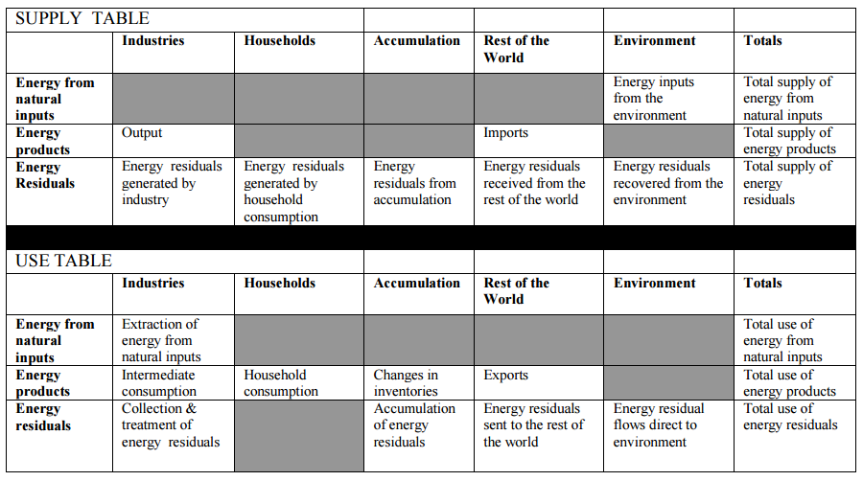
Supply and use
Notes:
The supply and use of energy (flows)
Extraction and capture of energy from the environment
Production, transactions and foreign trade of energy
Losses of energy during production
The stocks of energy and the changes in them
Availability of energy resources and energy products at the beginning of a time period
Disappearance and entering into the stocks of enrgy during the time period
Availability of energy resources and energy products at the end of the time period
Monetary valuation of the depletion of energy resources
Other economic aspects related to energy
Expenditure on environmental protection, clean-up and energy resource management
The use of energy taxes and subsidies
Other economic instruments like tradeable carbon emission permits

Slide 10
Energy statistics and balances
Basic energy statistics should feed into the balances and accounts
Basic energy statistics and energy balances provides the starting point in the compilation of physical flow energy accounts
Some differences between accounts and balances
  Differences in terminology and concepts
  Conceptual differences territory principle / residence principle
  Treatment of transport
Notes:
Some of the flows described in the basic energy statistics and the energy balances can be shown directly in the energy accounts
Energy use by residents abroad needs to be added to the imports in the supply table and added to the use of energy in the relevant industry in the use table
Energy use by non-residents on the territory needs to be registered as an exports in the use table
The primary production of energy in the top block of the energy balance needs to be broken down by ISIC industries in the energy accounts supply table
The use of energy in the sectors in the middle and lower blocks of the energy balance also needs to be broken down by ISIC industries in the energy accounts use table
The latter also goes for the use of energy accounted for in the transport sector part of the energy balances lower block. Whereas in the energy balance, the transport is grouped into a single sector, in the energy accounts, the use of energy for transport purposes is broken down by the ISIC industries and the households

Slide 11
Applications of energy accounts
Policy relevance
  Inform decisions on supply and use of energy
  Richer understanding of the role of energy in the economy
    Decoupling indicators
  Modeling and scenario analysis
2030 Sustainable Development Agenda
  Goal 7 on Energy

Slide 12
Some further details on asset accounts

Slide 13
Details on asset accounts
Deposits of oil resources, natural gas, coal and peat resources, thorium and uranium
Known deposits categorized into 3 categories based on UNFC 2009 criteria
  Class A: Commercially recoverable resources
  Class B: Potentially commercially recoverable resources
  Class C: Non-commercial and other known deposits

Slide 14
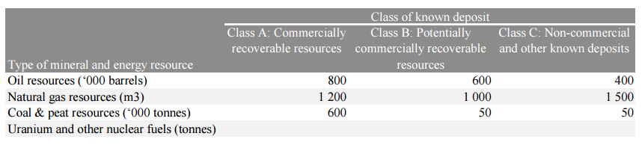
Details on stocks of resources

Slide 15
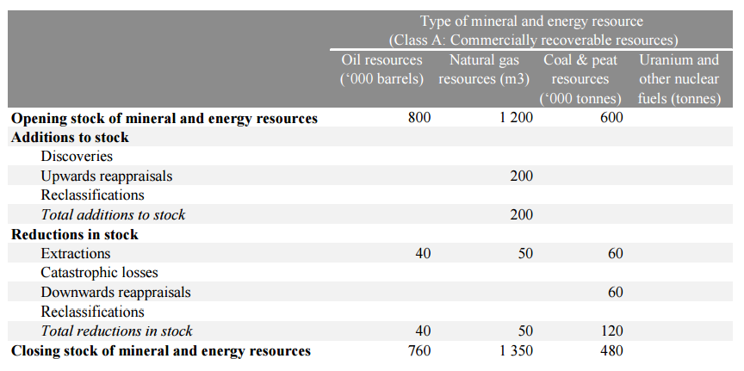
Details on physical asset accounts

Slide 16
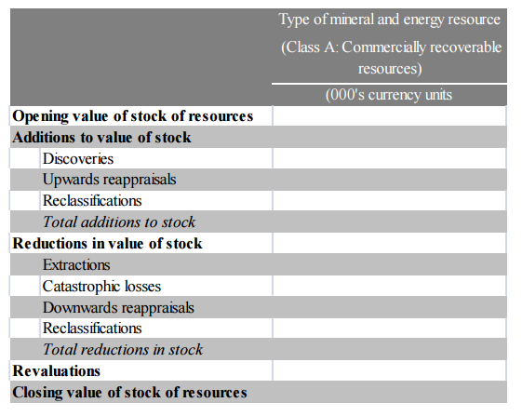
Details on monetary asset accounts

