Slide 1
“The interlinkages and integrated nature of the Sustainable Development Goals are of crucial importance in ensuring that the purpose of the new Agenda is realized.”
Source: Preamble of Agenda 2030

Slide 2


SEEA and the SDGs

Slide 3
What is the SEEA?
“The System of Environmental-Economic Accounting (SEEA) is a framework that integrates economic and environmental data to provide a more comprehensive and multipurpose view of the interrelationships between the economy and the environment and the stocks and changes in stocks of environmental assets, as they bring benefits to humanity.
It contains the internationally agreed standard concepts, definitions, classifications, accounting rules and tables for producing internationally comparable statistics and accounts.
The SEEA framework follows a similar accounting structure as the System of National Accounts (SNA). The framework uses concepts, definitions and classifications consistent with the SNA in order to facilitate the integration of environmental and economic statistics.
The SEEA is a multi-purpose system that generates a wide range of statistics, accounts and indicators with many different potential analytical applications. It is a flexible system that can be adapted to countries' priorities and policy needs while at the same time providing a common framework, concepts, terms and definitions.”
Source: https://seea.un.org/

Slide 4
SEEA – The common conceptual approach
How do we juxtapose environmental and economic information?
How do we disaggregate and compare across sectors?
How do we define efficiency?
How do we define productivity?
When is something considered waste?
How do we define reuse and recycling?
How do we measure and classify expenditure, taxes and subsidies?
What is a resource?
→ The answers to these and many more questions should be consistent across indicators
Aligning indicators to the SEEA and SNA helps build this consistency!

Slide 5
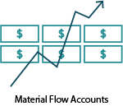


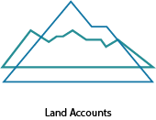

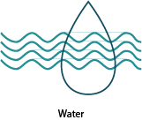



What does SEEA cover?

Slide 6











Which goals are covered by SEEA?

Slide 7
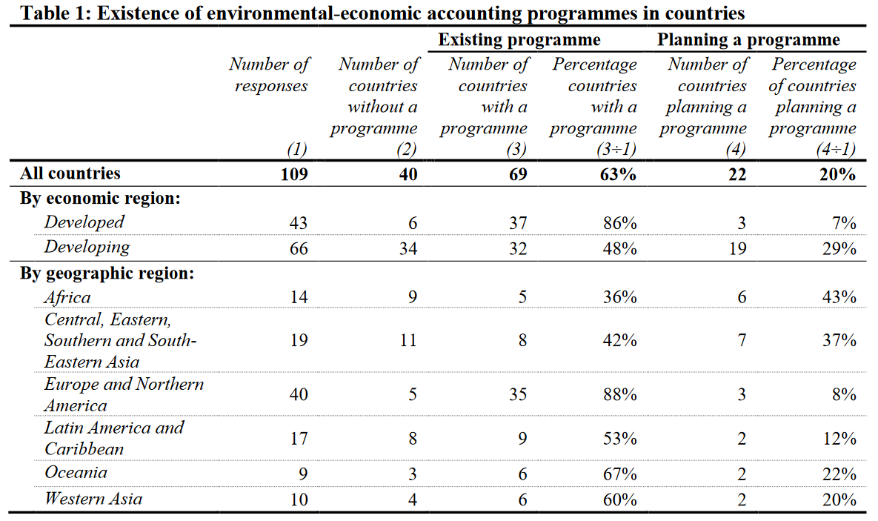
Who is covered by SEEA?
Source: UNCEEA “Global Assessment of Environmental-Economic Accounting and Supporting Statistics 2017

Slide 8
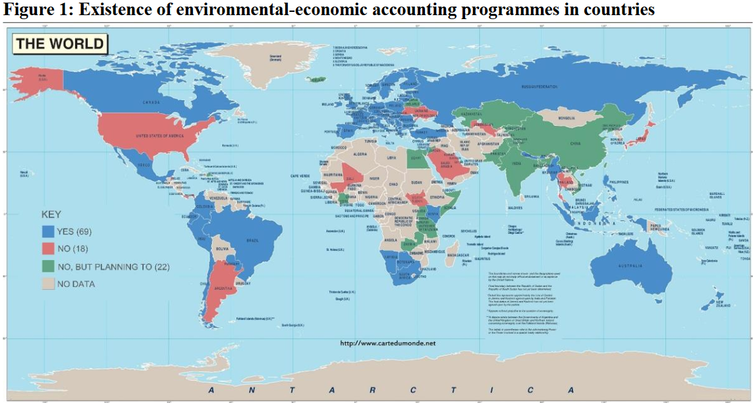
Who is covered by SEEA?
Source: UNCEEA “Global Assessment of Environmental-Economic Accounting and Supporting Statistics 2017

Slide 9
SEEA – The common conceptual approach
How do we juxtapose environmental and economic information?
How do we disaggregate and compare across sectors?
How do we define efficiency?
How do we define productivity?
When is something considered waste?
How do we define reuse and recycling?
How do we measure and classify expenditure, taxes and subsidies?
What is a resource?
→ The answers to these and many more questions should be consistent across indicators
Aligning indicators to the SEEA and SNA helps build this consistency!

Slide 10
UN Committee of Experts on Environmental-Economic Accounting (UNCEEA)
Established by the UN Statistical Commission at its 36th session in March 2005
Intergovernmental body (Countries, International Organizations) to provide overall vision, coordination, prioritization and direction in the field of environmental economic accounting and supporting statistics.
Objectives:
  Mainstream environmental-economic accounts and supporting statistics
  Develop the SEEA methodology and elevate experimental components of to an international statistical standard
  Advance the implementation of SEEA in countries

Slide 11
Global SEEA Databases
UNCEEA tasked by UN Statistical Commission to explore global databases using county data, which will facilitate use of SEEA for SDGs
Priority databases:
  energy
  air emissions
  material flow
  land
  water
SEEA Data Structure Definitions (DSDs) have been developed, tested and are now being finalized.

Slide 12
Aligning relevant SDG indicators with the SEEA
Progress made in aligning relevant SDG indicators with the SEEA through collaboration with custodian agencies
  Example: Goal 6: Ensure availability and sustainable management of water and sanitation for all
  Alignment of multiple indicators with the SEEA, including 6.4.1 (water-use efficiency) and 6.3.1 (proportion of wastewater safely treated)
  Country testing of indicators 6.3.2 (water quality) and 6.6.1 (water-related ecosystems) as part of the work programme of the UNCEEA
However, the SEEA can inform many more indicators that are not currently aligned
  Example: Goal 7, Ensure access to affordable, reliable, sustainable and modern energy for all
  Difference of territory vs residence principle for SDG 7 indicators
  Use of residence principle and SEEA facilitates analysis by economic sector, promotes consistent measurement over time
  Information derived from the SEEA can complement indicators 7.2.1, 7.3.1, 7.a.1 and 7.b.1

Slide 13
Conclusion
SEEA itself does not contain predefined indicator sets for SDG reporting
SEEA provides the statistical and accounting framework to measure many facets of the environment and economy in a coherent and integrated way
SEEA is the conceptual basis for building up the required integrated indicator framework to report on interlinked and integrated SDGs.
Global SEEA Database source for deriving global indicators
Closer collaboration between IAEG SDG and UN CEEA required

Slide 14

Thanks for your attention!
Sven C. Kaumanns
Head of Section
Environmental Economic Accounts and Sustainability
Federal Statistical Office of Germany

