Slide 1



Climate Change Statistics and SEEA Ecosystem Accounting
Implementation guidance
4–7 August 2026 · Chiba, Japan
Condensed guidance — two separate implementation tracks
Organized by UNSD and the UN Statistical Institute for Asia and the Pacific (SIAP)
Notes:
Talk points:
- Welcome participants and frame this session as a practical introduction to implementing climate-change statistics guidance.
- The attached source is the United Nations' 2024 Global Set implementation guide for national statistical systems.
- Its purpose is to improve monitoring of climate change, impacts and response actions through stronger official statistics.
- A central theme is closer cooperation among national statistical offices, UNFCCC focal points and other data producers.
- We will follow the implementation path from institutions and planning to production, dissemination and evaluation.
- The deck also distinguishes this climate-statistics track from the separate, complementary SEEA implementation track.

Slide 2
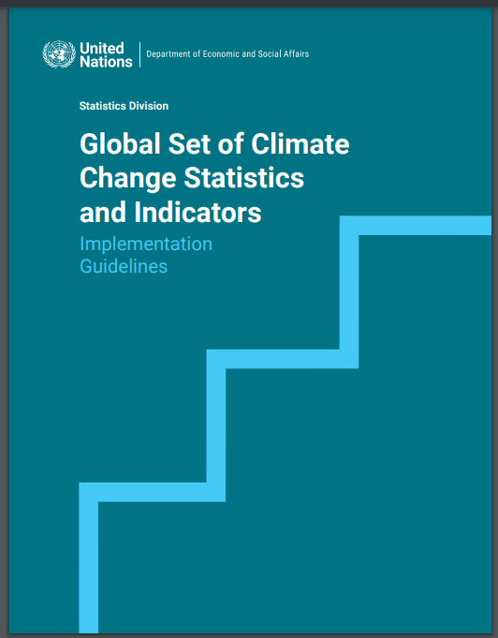
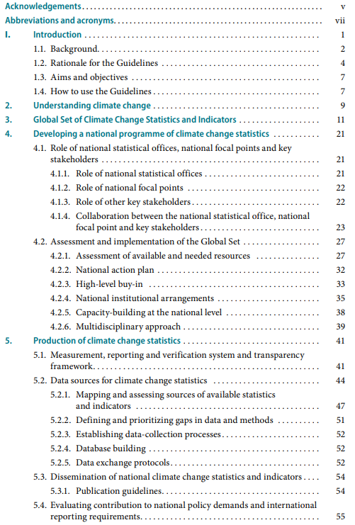
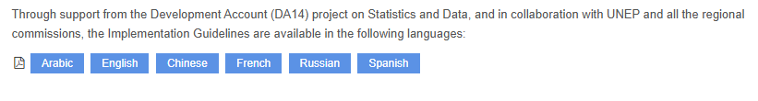
https://unstats.un.org/unsd/envstats/climate%20change/implementation_guidelines.cshtml
Notes:
Talk points:
- This is the full United Nations implementation guide and the online location for the supporting material.
- The guide begins with its rationale, the climate-change context and an introduction to the Global Set.
- Chapter 4 explains how to establish a national programme, including roles, assessment, planning and institutional arrangements.
- Chapter 5 moves into production: reporting frameworks, data sources, databases, exchange protocols and dissemination.
- The annexes provide an illustrative national action-plan structure and the detailed Global Set of indicators and statistics.
- Use the guide as a stepwise reference, adapting the sequence to national priorities, resources and legal mandates.

Slide 3
Aims and objectives
The Guidelines aim to help countries improve the monitoring of climate change, its impacts and response actions by better informing the UNFCCC-NFPs about the benefits of official statistics and by guiding the NSOs to increase their engagement in the area of climate change. The overall objectives of the Guidelines are to:
help countries to set up the national consultation processes which can embrace this multidisciplinary statistical work in a way complementary to the ongoing and future reporting to UNFCCC;
deepen countries’ self-assessment activities using the Global Set; and
provide the basis for countries to initiate the development of a national programme for sustained production of climate change statistics within the national statistical system (NSS).
Notes:
Talk points:
- The first aim is better national monitoring of climate change, its impacts and the actions taken in response.
- The Guidelines help UNFCCC national focal points recognize how official statistics can strengthen climate reporting.
- They also guide national statistical offices to take a more active role in this multidisciplinary field.
- One objective is to establish a national consultation process that complements current and future UNFCCC reporting.
- A second objective is deeper self-assessment using the Global Set to understand national relevance and readiness.
- The longer-term objective is sustained production of climate-change statistics within the national statistical system.

Slide 4
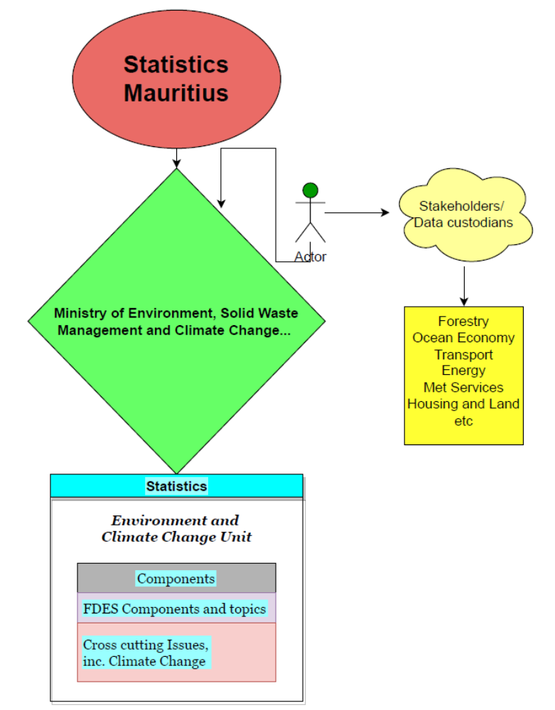
4. Developing a national programme of climate change statistics
4.1 Role of NSOs, NFPs and key stakeholders
4.1.1 Role of NSOs
4.1.2 Role of National Focal Points and climate policy authorities
4.1.3 Role of other key stakeholders
4.1.4 Collaboration between NSO, NFP and key stakeholders
4.1.5 National examples
Institutional dimensions
Notes:
Talk points:
- A national programme brings social, economic and environmental statistics together under a climate-change lens.
- The national statistical office leads on official-statistics standards, quality, validation, coordination and dissemination.
- The UNFCCC focal point connects the statistical programme with climate policy and international reporting obligations.
- Ministries, agencies, researchers, civil society and the private sector contribute sector knowledge and source data.
- The Guidelines note that collaboration between statistical offices and focal points still needs strengthening in many countries.
- Effective collaboration produces a more operational measurement, reporting and verification and transparency system.

Slide 5
4.2.2 National action plan
Steps | Activities | Year 1 |  |  |  | Year 2 |  |  |  | Year 3
 |  | Q1 | Q2 | Q3 | Q4 | Q1 | Q2 | Q3 | Q4 | Q1 | Q2 | Q3 | Q4
1 | Establish/strengthen relationship between NSO and UNFCCC-NFP
2 | Engage stakeholders and complete the self-assessment using the CISAT
3 | Establish a committee, inter-institutional working group or task force or expand an existing one
4 | Define an institution with a legal mandate
5 | Establish collaboration/communication channels between stakeholders and make institutional arrangements
 | Designate national thematic experts
 | Develop ToRs/MoUs
6 | Engage high-level support for TWG - data collection/formation of unit / mobilizing resources
 | Conduct institutional review and skills capacity assessment
 | Develop project proposals/applications
7 | Strengthen human resources
 | Provide training and capacity building
 | Designate desk officers/core team
 | Hire staff/consultants
8 | Improve technical resources
 | Improve IT infrastructure (software and hardware)
9 | Develop a national programme/national action plan on climate statistics
 | Develop national set of climate indicators (consistent/complementary with NDCs/NAPs/NCs) and metadata
 | Map the data sources and assess data quality
 | Define gaps and prioritize work on methods and data collection
 | Develop data collection methods (such as climate change surveys)
 | Integrate the programme/plan into NSDS and national climate policies
10 | Undertake data collection/database building
 | Establish data exchange protocols
 | Compile statistics/indicators
 | Prepare analysis of key findings and draft a report
 | Organize a validation workshop/TWG and stakeholders
11 | Prepare contributions to national policies and the reports for UNFCCC
12 | Disseminate statistics and indicators
13 | Conduct user surveys
14 | Evaluate and define priorities for future improvements
Self-assessment for building a National action plan on climate change statistics
The self-assessment will produce the needed understanding of what are the available resources (human and technical), available data, data gaps and what is (still) needed to support national climate policies and activities. Prioritisation of the needed data-related activities should be done taking into account the suitability of data collection methods including costs and reliability
Notes:
Talk points:
- The self-assessment should be a multi-stakeholder exercise, normally led by the national statistical office with the UNFCCC focal point.
- It inventories institutional arrangements, human and technical capacity, available data, methods, quality and remaining gaps.
- This creates a shared view of the country's maturity and the effort required to support climate-policy objectives.
- Priorities should reflect national relevance as well as the cost, reliability and suitability of possible data sources.
- The resulting action plan should assign a legal mandate, establish coordination, support regular production and address training needs.
- Countries can reorder the illustrative steps and build a timetable that fits their own statistical system and circumstances.

Slide 6
4.2.3 High-level buy-in – mobilize resources
It is recommended that the NSO and the focal points to the UNFCCC and other focal points obtain high-level support from their heads of ministries and agencies. Stakeholders will be more amenable to participating; provide more support for budgeting for meetings, staffing, etc. This would contribute to ensure the continuity of resources for the activity.
The agencies/funds which may offer direct financial assistance to countries are:
Green Climate Fund (GCF) was established at COP16, under the UNFCCC, to support developing countries with projects, programmes, policies and other activities related to climate mitigation and climate adaptation.
Global Environment Facility (GEF)
GIZ or Deutsche Gesellschaft für Internationale Zusammenarbe, is a German development agency that provides services in the fields of environmental protection, resource conservation, and climate change mitigation, among others.
Mobilize resources
Notes:
Talk points:
- High-level endorsement from ministry and agency leadership makes stakeholders more willing and able to participate.
- It also strengthens the case for budgets covering staff, meetings, technical systems and continuing programme needs.
- After the self-assessment, countries should mobilize existing and new human and technical resources around the highest priorities.
- Limited resources for regular coordination are identified in the Guidelines as a common barrier to inter-institutional work.
- Funding proposals should therefore be tied directly to the assessed gaps, planned outputs and national climate strategy.
- The funds and agencies shown are examples; the guide also lists other national, multilateral and capacity-building sources.

Slide 7
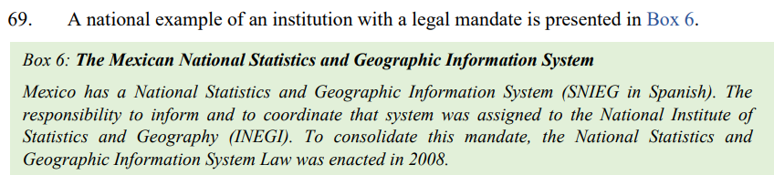
Institution with a legal mandate for the production of statistics on climate change
A national (or focal) institution with legal mandate will perform the following functions:
Set up a department/service or division in charge of climate change statistics;
Develop a legal framework of collaboration with other institutions (Ministry of the Environment, meteorological institute, research institutes, etc.) with a view to sharing statistics on climate change;
Submit training needs, a work plan and budget proposal to the government;
Establish/strengthen a climate change and/or environment statistics committee;
Notes:
Talk points:
- A clear legal mandate gives the programme authority, credibility and continuity beyond short-term projects.
- The designated institution should apply professional and ethical standards to collection, processing, storage and publication.
- It can create a dedicated climate-statistics unit or place the function within an existing environment-statistics structure.
- Formal agreements with ministries, meteorological services and research bodies should define data sharing and responsibilities.
- The institution should submit a realistic workplan, training requirements and budget for government or partner support.
- It should also establish or strengthen a committee to coordinate the national set of climate statistics and indicators.

Slide 8
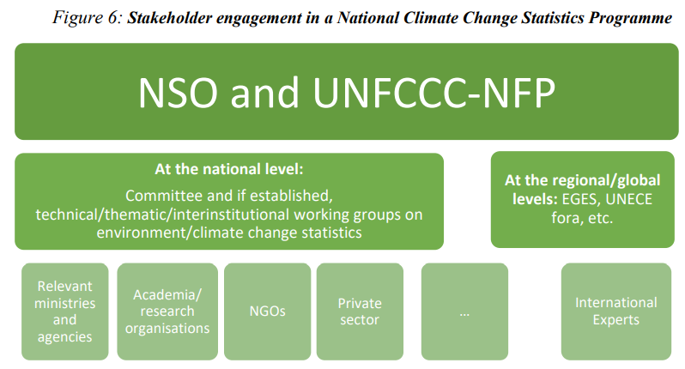
The committee may perform the following functions:
Develop a roadmap for the implementation of the Global Set and agree on the expected results of the work.
Organize the validation of the data, statistics, indicators and reports produced by the technical/thematical/interinstitutional working groups (if established) before submission to a higher-level body for approval/information as appropriate
Develop a communication strategy and agree on the dissemination of the national set of climate change statistics and indicators.
Integrate the national programme/plan of climate change statistics into the NSDS and national climate policies
Notes:
Talk points:
- The committee converts the legal mandate into an operational, shared programme across participating institutions.
- Its roadmap should define expected results, a timetable and the specific role and contribution of each stakeholder.
- Technical or thematic working groups may prepare data and indicators, while the committee organizes their validation.
- Validation should occur before products move to a higher-level body for approval or formal information.
- The committee should also agree on a communication strategy and the dissemination of the national set.
- Embedding the programme in the national statistical strategy and climate policies helps sustain ownership and resources.

Slide 9
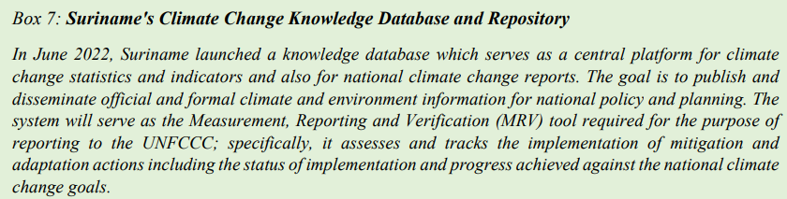
5.2 Data sources for climate change statistics
Define the sources of data on climate change
Map sources of available indicators/statistics and assess them in terms of quality and utility
Define and prioritize gaps in data and methods
Establish data collection processes
Build database of CC stats and indicators
Establish Data Exchange Protocols
Production of statistics
Types of data sources:
Census
Survey
Administrative records
Remote sensing and GIS
Monitoring systems
Scientific research
Notes:
Talk points:
- Begin by identifying the full national data ecosystem, including censuses, surveys, administrative records, remote sensing, monitoring and research.
- Inventories, modelling and other non-traditional sources can supplement these core sources where relevant.
- Use the Global Set metadata and CISAT to map each indicator's relevance, availability, method, quality and responsible provider.
- Prioritize gaps carefully: missing methods, missing data and missing resources require different responses.
- Collection processes should move from an action plan and sound methodology through stakeholder authentication and committee validation.
- A structured database and updated data-exchange protocols then support regular, secure and sustained production.

Slide 10
    5.3 Dissemination of national climate change statistics and indicators
Environment/climate change statistics compendium;
Statistical yearbook, including environment statistics or chapter/section within a yearbook;
Climate change statistics bulletin/report;
State of the environment report; and
Websites, databases and portals.
----
    Establish publication guidelines
Dissemination
Notes:
Talk points:
- Dissemination is where compiled statistics are released for use by policymakers, reporters and the public.
- Countries can use compendiums, yearbooks, dedicated bulletins, state-of-environment reports, websites, databases and portals.
- Using several formats helps serve different users while avoiding dependence on a single publication channel.
- Publication guidelines should cover metadata, transparency and consistent dissemination practices.
- A public release calendar and an appropriate publication frequency make the system more predictable and accessible.
- The goal is not simply to publish data, but to make reliable climate information easy to find, understand and reuse.

Slide 11
    5.4 Evaluating contribution to national policy demands and international reporting requirements
Contributions and benefits of applying the Global Set will be reflected in the NCs and BRs for Annex I Parties; and NCs and BURs for non-Annex I Parties but mostly in the new BTRs under the Paris Agreement to be submitted from 2024.
Assessment and implementation of the Global Set requires a multi-annual plan/programme and will assist in mobilising resources
Improved knowledge and understanding of climate science, the direct and indirect impacts of climate change (supported by qualitative and quantitative evidence where possible);
Changes in data and information;
Changes in data collection, management and storage of data;
Economic conditions and the availability and access to funding mechanisms;
Changes in financial, technical and human resources; and
Results from a monitoring and evaluation (M&E) framework.
Evaluation
Notes:
Talk points:
- Implementation should be judged by how well the statistics answer national policy needs and international reporting requirements.
- The guide links benefits to national communications, biennial reports and especially biennial transparency reports under the Paris Agreement.
- User surveys can test trust, usefulness, completeness and emerging demand for new data or indicators.
- Focused discussions can also reveal whether datasets remain aligned with changing policies, strategies and reporting needs.
- Because implementation is multi-annual, evaluation should be built into the long-term plans of all participating institutions.
- The programme should adapt as climate science, data systems, methods, funding, capacity and monitoring results change.

Slide 12
Separate guidance, complementary implementation logic
A. Global Set of Climate Change Statistics and Indicators Implementation Guidelines
Climate-change statistics guide: implement the Global Set and build a national programme for regular climate-change statistics and indicators.
Focus: institutions, nationally relevant indicators, stepwise data collection, publications and dissemination.
B. Towards the Institutionalization of the SEEA: Implementation Guide
SEEA implementation guide: implement SEEA Central Framework and SEEA Ecosystem Accounting at country level.
Focus: strategic planning, mechanisms, compiling accounts, dissemination and institutionalizing regular production.
How they connect
Both require governance, data exchange, capacity building and policy use—but they produce different outputs: climate statistics/indicators versus SEEA environmental-economic and ecosystem accounts.
Sources: Global Set of Climate Change Statistics and Indicators Implementation Guidelines; Towards the Institutionalization of the SEEA: Implementation Guide. Links: Climate-change guide | SEEA guide
Notes:
Talk points:
- The attached Guidelines directly support Track A: regular production of national climate-change statistics and indicators.
- That track follows a practical sequence of governance, self-assessment, prioritization, production, dissemination and evaluation.
- The Guidelines also recognize environmental accounts and SEEA resources as useful inputs to climate-statistics work.
- Track B, however, is a separate implementation guide focused on institutionalizing environmental-economic and ecosystem accounts.
- Both tracks depend on mandates, coordination, data exchange, capacity development and sustained policy use.
- Keep the outputs distinct: one produces climate statistics and indicators, while the other produces integrated SEEA accounts.

Slide 13

Thank you for your attention!
For more information please contact the Environment Statistics Section
at the United Nations Statistics Division:
E-mail: envstats@un.org
Website: https://unstats.un.org/unsd/envstats/
Notes:
Talk points:
- The key message is that implementation is an institutional process, not a one-time data-compilation exercise.
- Start with national consultation and a realistic self-assessment using the Global Set and its metadata.
- Secure a clear mandate, high-level sponsorship, stakeholder roles and the resources needed for continuity.
- Build repeatable processes for data collection, quality assurance, databases, exchange and dissemination.
- Evaluate whether the resulting statistics are meeting policy needs and international reporting requirements.
- Thank the audience and direct follow-up questions to the Environment Statistics Section and the resources shown here.

